Slide 1
WP6: Outreach
Jo Foden (Cefas)
David Mills, Simon Keeble, Aldo Drago, Nicki Villiers, Mark Hartman, Joaquín Tintoré

Slide 2
WP6 tasks
6.1 End-user products and services
(Community Hub, Datatool, public display)
6.2 Jerico OceanBoard
(prof & public and educational glider tool)
6.3 Summer schools
(Malta 2013 & The Netherlands 2014)

Slide 3
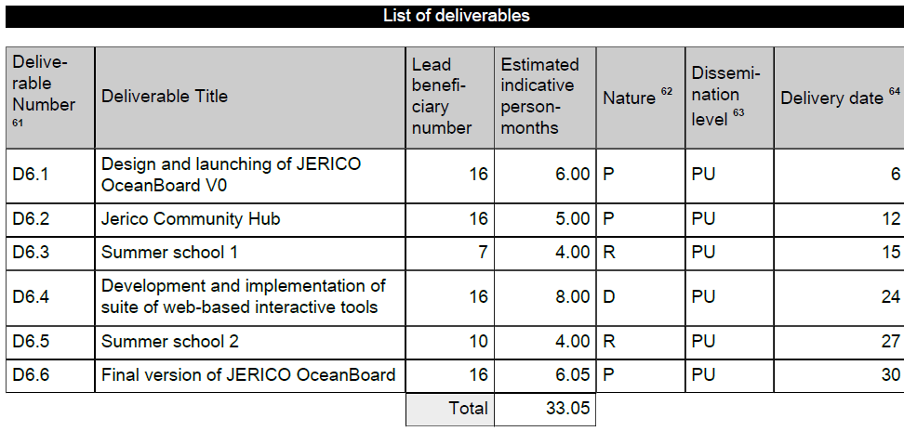
WP6 tasks
27
39
Notes:
Deliverables 1, 2, 3, 4 & 6 in green have been delivered (on time)
Deliverable 5 in blue is taking place in June

Slide 4
Task 6.1 end-user products & services
Sub-task 6.1.1 Build Community Hub
D6.2: ‘Prototype’ M12 completed
Sub-task 6.1.2 Development of Jerico Datatool
D6.4: ‘Demonstrator’ M24 completed
Sub-task 6.1.3 Jerico public display monitor
Notes:
Three sub-tasks within Task 6.1.

Slide 5
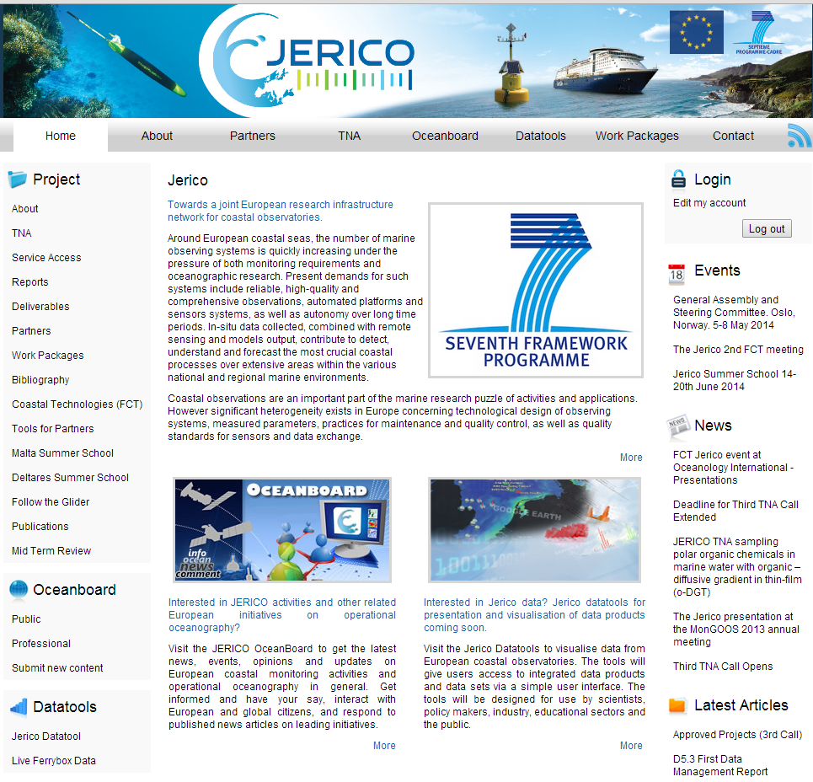
Task 6.1 end-user products & services: Jerico Community hub
Sub-task 6.1.1 Build community hub
Notes:
Sub-task 6.1.1 completed and Deliverable 6.2 was submitted on time.

Slide 6
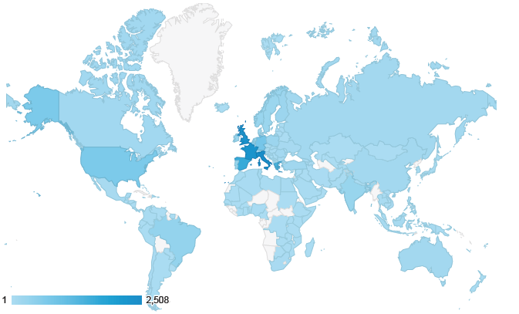
Task 6.1 end-user products & services: Jerico community hub
Sub-task 6.1.2 Development of Jerico Datatool
Launched in January 2012 it has had 19,000 visits from 157 countries
Notes:
Sub-task 6.1.2 completed and Deliverable 6.4 was submitted on time.
The Jerico Datatool is now available on the website and data are being fed in directly from MyOcean
This is an overview of locations of users, 1st Jan 2012 to 1st May 2014.
Italy, UK, France, Spain, Greece, Malta have registered the most sessions.

Slide 7
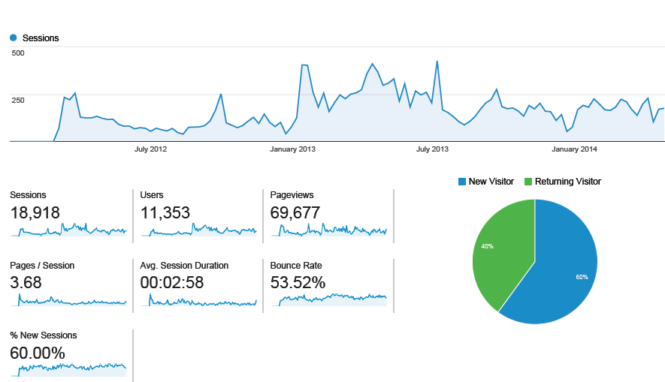
Task 6.1 end-user products & services: Jerico Community hub
Notes:
Audience overview 1st Jan 2012 to 1st May 2014.
Main graph shows number of session over time.
Nearly 19,000 sessions by 11,000 users.

Slide 8
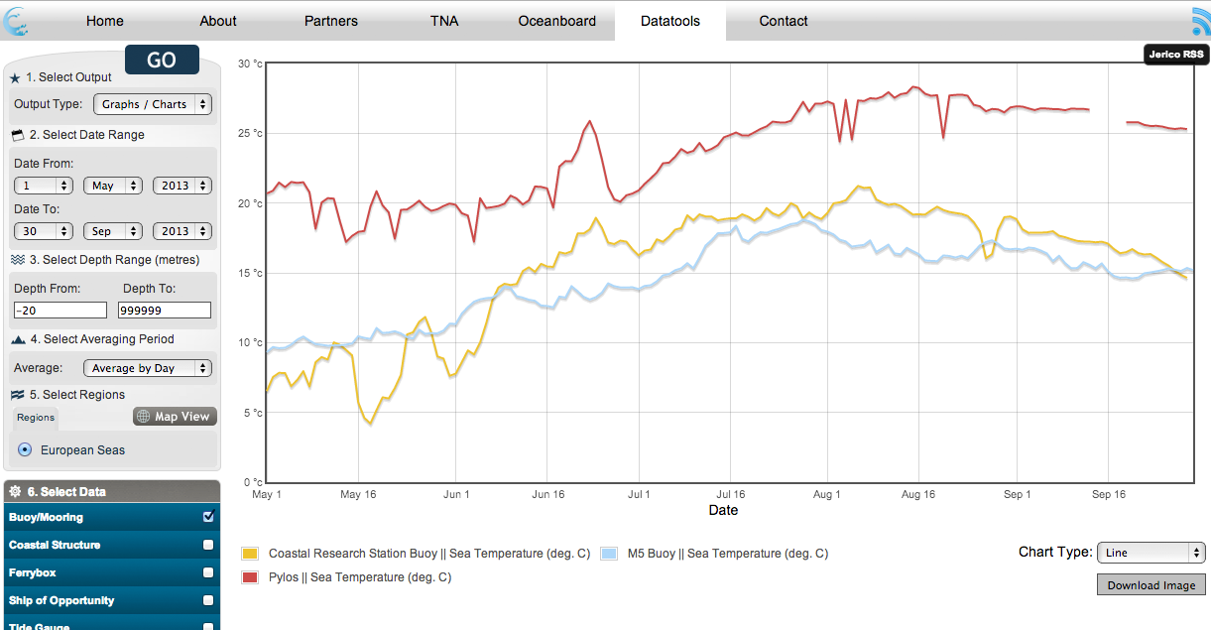
Task 6.1 end-user products & services: Jerico Datatool
Notes:
Temperature records from three buoys; Coastal research station buoy, M3 and Pylos
May to September 2013
Average daily temperature

Slide 9
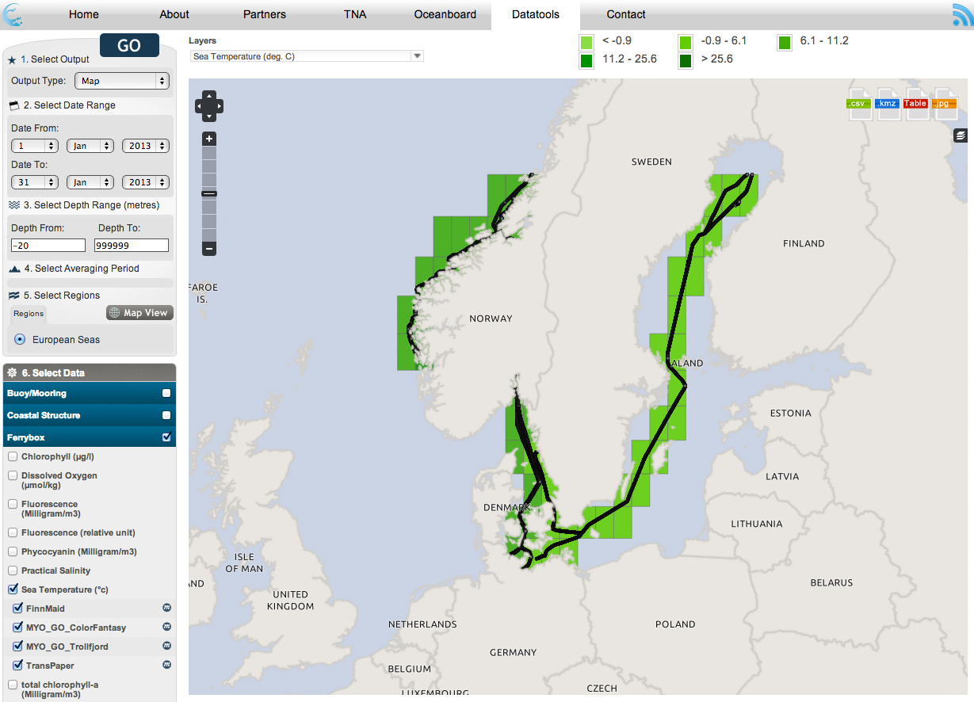
Task 6.1 end-user products & services: Jerico Datatool
Notes:
Sea temperature from FerryBoxes and satellite data (MyOcean)
Month of January 2013

Slide 10
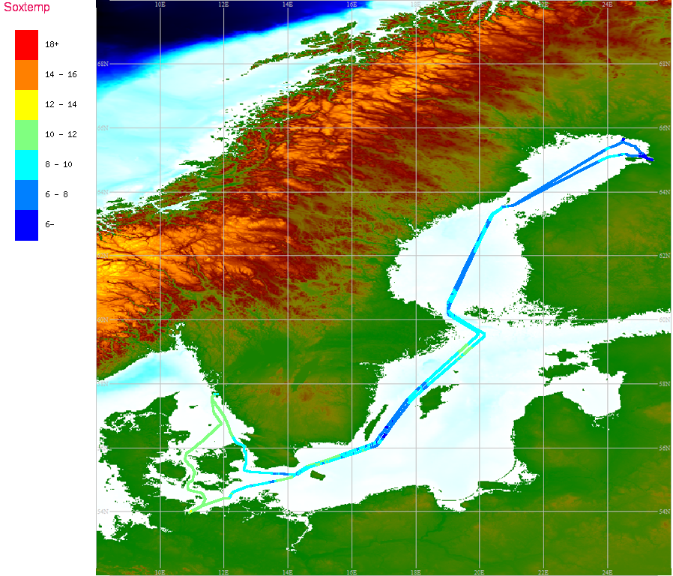
Task 6.1 end-user products & services: Jerico user display (JUD)
Sub-task 6.1.3 Jerico user display
Notes:
Sub-task 6.1.3 complete.
Development of the Jerico User Display was led by Mark Hartman at NOC.

Slide 11
Task 6.1 end-user products & services: Jerico user display (JUD)
State of play
No new developments for 12 months
Testing by SMHI & HCMR – some improvements incorporated into the software
DropBox for sharing:
Email Mark Hartman to join: mch@noc.ac.uk
Beta test version of software – PHP using MySQL as database.
Future ideas and testing could posted.
Notes:
Problem: the Pride of Bilbao ferry was discontinued at the start of the Jerico project, making it impossible for Mark to test ideas and prototypes.
Bent at HCMI carried out beta-testing of the Jerico User Display.
Mark will make the beta-test version of the JUD software available on DropBox. Please send email to Mark.
Ideas for future:
It would be good to see the software used with interaction between several partners each with some knowledge of how to modify the software to suit its own ends. This would give a common tool and methods for new users to visualise their data,
Possible improvement by incorporating a table of current data values together with the current configuration,
How to implement some degree of data quality control prior to the images being display to screen,
How to make the system more robust to data or system anomalies,
How to produce images that can be transmitted over a coaxial cable,

Slide 12
Task 6.2 Oceanboard
Sub-task 6.2.1 Jerico PROF
Sub-task 6.2.2 Jerico PUB
D6.1: Launch OceanBoard, completed M6
D6.6: Final version OceanBoard, completed M30
Sub-task 6.2.2 Educational tool on gliders
Notes:
The OceanBoard was launched and Deliverable 6.1 was completed
The OceanBoard was finalised in M30 (Oct 2013) and Deliverable 6.6 was submitted on time.

Slide 13
Task 6.2 Oceanboard

Slide 14
Task 6.2 Oceanboard

Slide 18
Oceanboard@jerico-fp7.eu

Slide 19
Oceanboard@jerico-fp7.eu
Notes:
Final version of the OceanBoard was delivered on time M30 (Oct 2013)

Slide 20
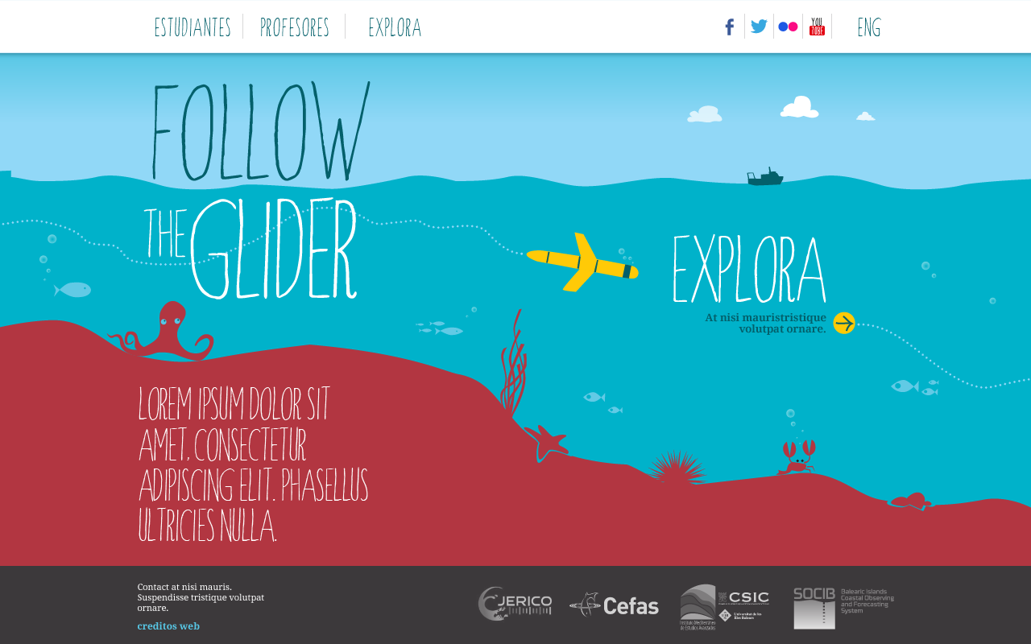
Task 6.2 Oceanboard
Sub-task 6.2.2 Educational tool
Notes:
Glider Educational Tool: Home page with an adapted design for kids and students

Slide 21
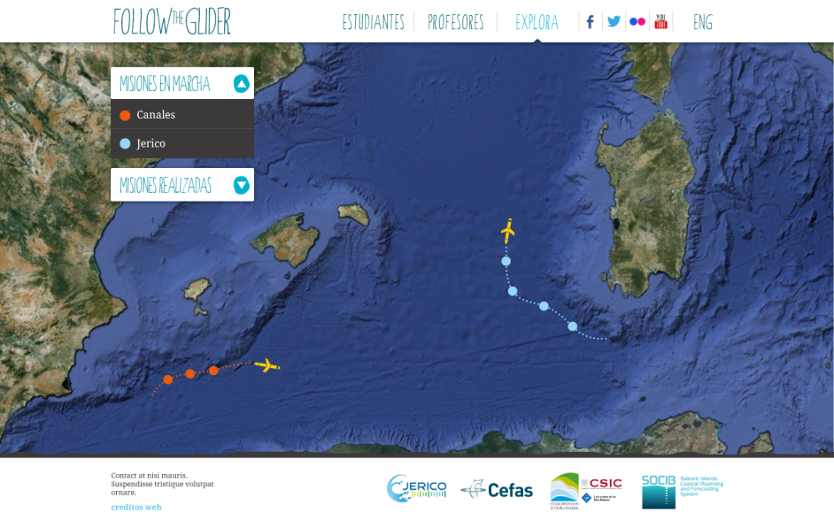
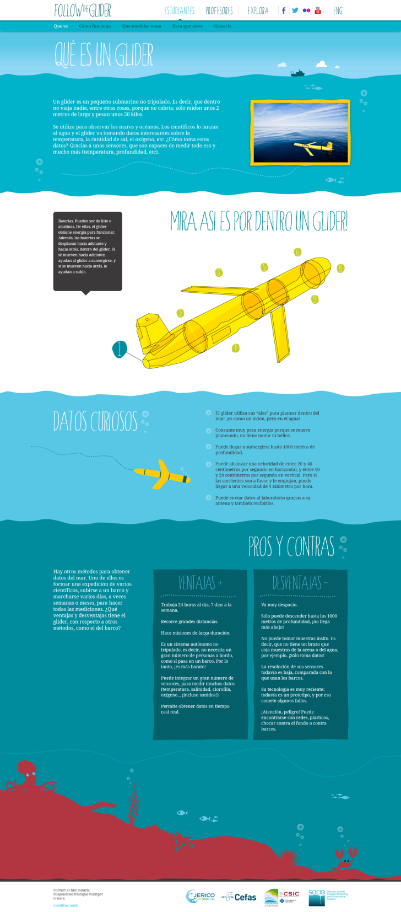
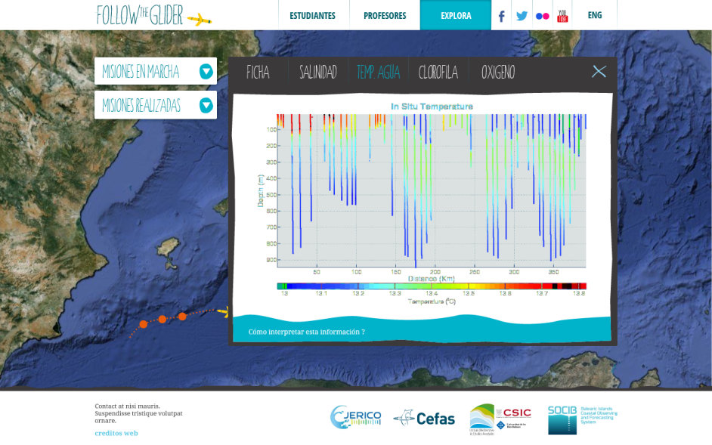

Slide 22
Task 6.3 summer schools
Sub-task 6.3.1 Jerico summer school 1; Malta
D6.3 Summer school 1 completed M27
Milestone 20: First summer school report completed M28
Sub-task 6.3.2 Jerico summer school 2; Deltares, The Netherlands
D6.5 Summer school 2 M39 (July 2014)
Milestone 21: Second summer school report M40 (Aug 2014)
Notes:
First summer school and associated Milestone report was delivered on time.

Slide 23
Task 6.3 summer schools: Malta
1st Summer school 8th–13th July, University of Malta
Operational Oceanography in the 21st Century – The Coastal Seas
84 applicants,
28 countries: Europe, Middle East, South America, Asia,
35 participants selected.

Slide 24
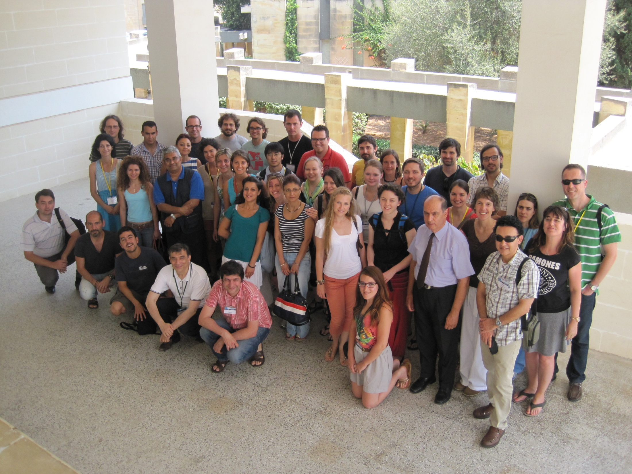
Task 6.3 summer schools: Malta

Slide 25
Task 6.3 summer schools: Malta
Malta summer school programme
Overview on operational oceanography
Coastal observatories; COSYNA, sensors & platforms, FerryBox, ROVs
MyOcean
Numerical modelling techniques
Data Management; data exchange, QC, data format, climatologies, SeaDataNet
Visualisation and analysis of time series data
Applications; satellite data, oil spill models, Jerico Datatool
Excursion to HF radar

Slide 26
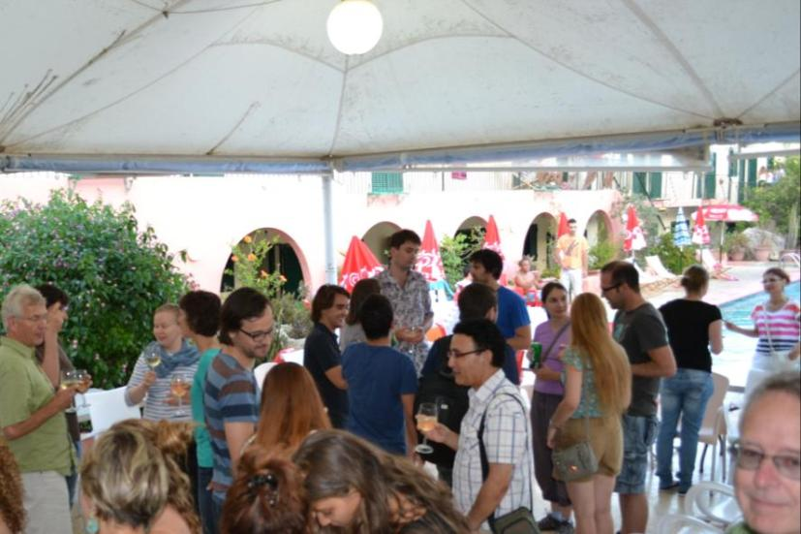
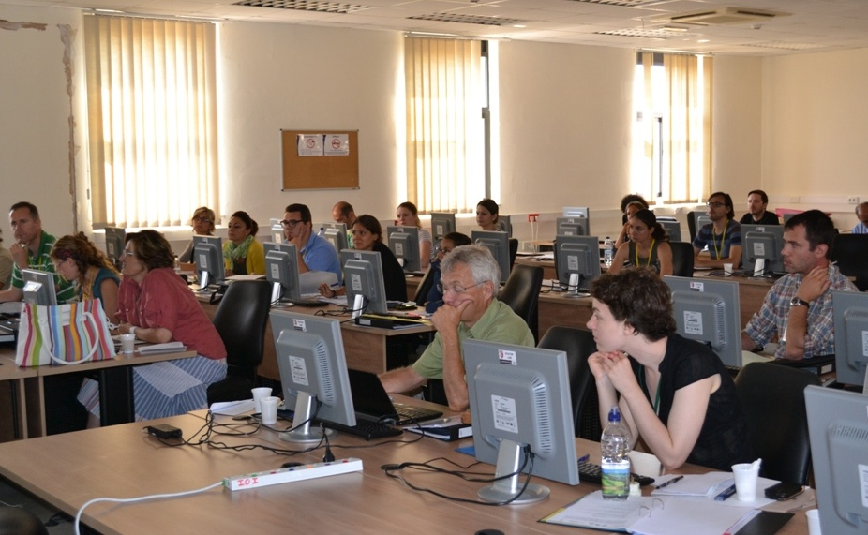
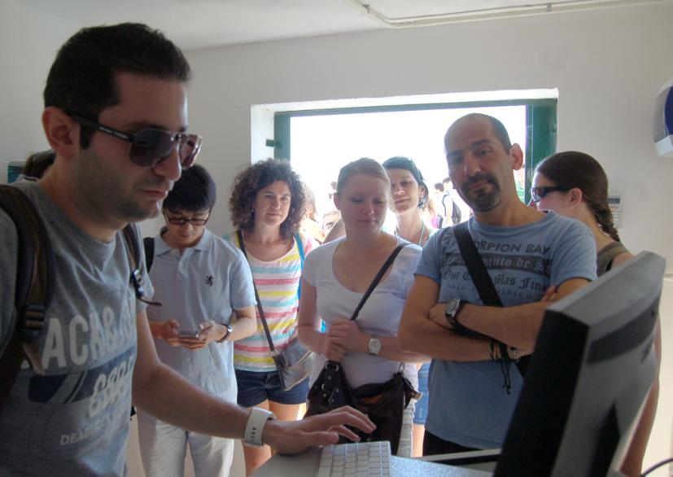
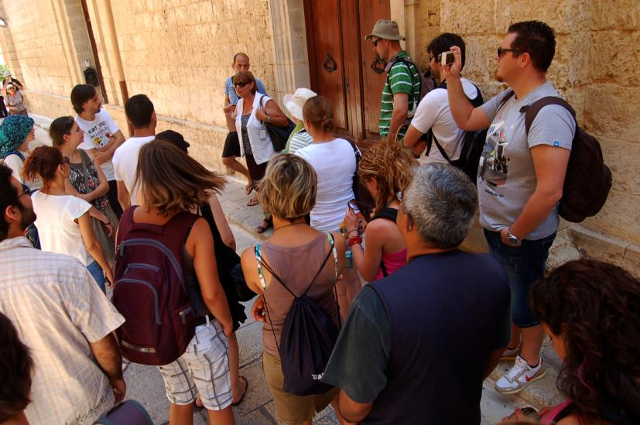
Task 6.3 summer schools: Malta
Notes:
Excellent facilities at the venue with computer laboratory and a fantastic job done by Aldo’s team, especially Adam Gauci with computer and software support.
Social programme with ice-breaker, dinner and excursion to Mdina. Fieldtrip to see the HF radar station with a talk by Adam Gauci

Slide 27
Task 6.3 summer schools: Malta
Malta summer school evaluation by participants

Slide 28
Task 6.3 summer schools: Malta
Malta summer school report on the Jerico community hub

Slide 30
Task 6.3 summer schools: Deltares
From Data to Decisions
Marine monitoring > data > information > knowledge Monitoring & policy use (data acquisition) Version control (data management) EU portal landscape (data dissemination) From points to maps (data analysis) Model coupling (data assimilation) 4th paradigm, Big data (data interpretation)

Slide 31
Task 6.3 summer schools: Deltares
Deltares summer school programme
Saturday Arrival, icebreaker and dinner
1 evening visit to Sand Engine coastal observatory
Sunday Data & information for monitoring [Cefas et al., FixO3]
MSFD, EMECO, monitoring strategy and networks
Monday Data interpolation
DIVA/DINEOF [University de Liege, Prof. J-M Beckers]
Tuesday Data dissemination
[EMODnet/SDN/MyOcean/EuroGOOS, EurOBIS]
Co-organized with Delft Software Days (extra audience)
Wednesday Data management and curation
DOI, DataCite, Versioning [3TU datacenter, OpenEarth]
Thursday Data assimilation
[OpenDA]
Friday Data processing (departure at lunch)
Web Processing Service [EMECO et al., OpenEarth]

Slide 32
Task 6.3 summer schools: Deltares
Applications for summer school
Advertised at MODEG meeting , mail-list & 5 LinkedIn groups (ICES, EMODnet, Delft3D, OpenEarth, NCK Netherlands Centre for Coastal Research)
Applicants’ regional spread:
Poland (5), Netherlands (1), Chile(1), Italy (1), Argentina (1), Russia (1, Caspian Sea), Spain (1)
Applicants’ current occupation; 7 MSc level &4 PhD
PhD student / research assistant (8), Research fellow (1), Post-doc (1), DM Specialist (1)
Gender: F (6), M (5)
Still accepting late applications

Slide 33
WP6 tasks
6.1 End-user products and services
(Community Hub, Datatool, public display)
6.2 Jerico OceanBoard
(prof & public and educational glider tool)
6.3 Summer schools
(Malta 2013 & The Netherlands 2014)

