Slide 1
2nd General Assembly – NIVA HQ
WP5: DATA MANAGEMENT AND DISTRIBUTION
Review and Status
Rajesh Nair¹, Loic Petit De La Villeon², Gilbert Maudire², Caterina Fanara (cfanara@ogs.trieste.it)¹, and Alessandro Crise¹
¹OGS (Istituto Nazionale di Oceanografia e di Geofisica Sperimentale), Italy
² IFREMER, France

Slide 2
WP5: the operating strategy
Create suitable partnerships with ongoing European data management initiatives to meet objectives → formalize links and actively engage with SeaDataNet-II (SDN-II) & MyOcean (MyO) to support JERICO data flow and dissemination.
Use what exists → SDN-II for Delayed-mode (DM) data & MyO for (near) Real-time (nRT) data.
Avoid duplication of efforts → cooperate with SDN-II & MyO in the development/improvement of data handling methodologies and data quality assurance procedures, prioritizing JERICO-specific monitoring parameters/technologies.

Slide 3
WP5: why this operating strategy?
Create suitable partnerships with ongoing European data management initiatives to meet objectives → supports the “open & free” data policy paradigm; will aid in ensuring compatibilty, interoperability, and the implementation of communal data handling practices.
Use what exists → Many JERICO partners are already contributing to (or are prepared to contribute to) SDN-II/MyO.
Avoid duplication of efforts → cooperating with SDN-II/MyO will allow JERICO to participate in establishing Europe’s database and management infrastructure for coastal marine data.

Slide 4
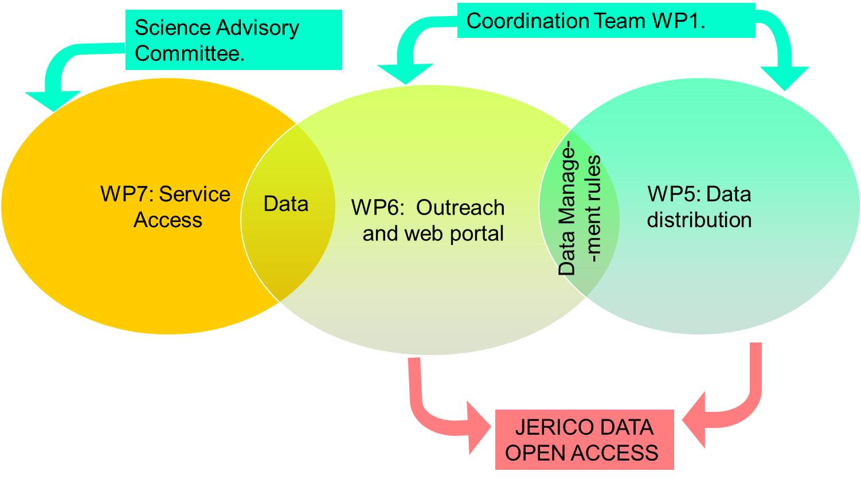
WP5: the operating structure
Oceanboard
JERICO has an «open access» data policy. The flow of data from JERICO partners to the community of users is driven by the synergic action of three WPs.
WP5 defines the rules for data management and distribution.
WP7 is collecting data from partners.
WP6 provides the platform for distribution of data and tools.

Slide 5
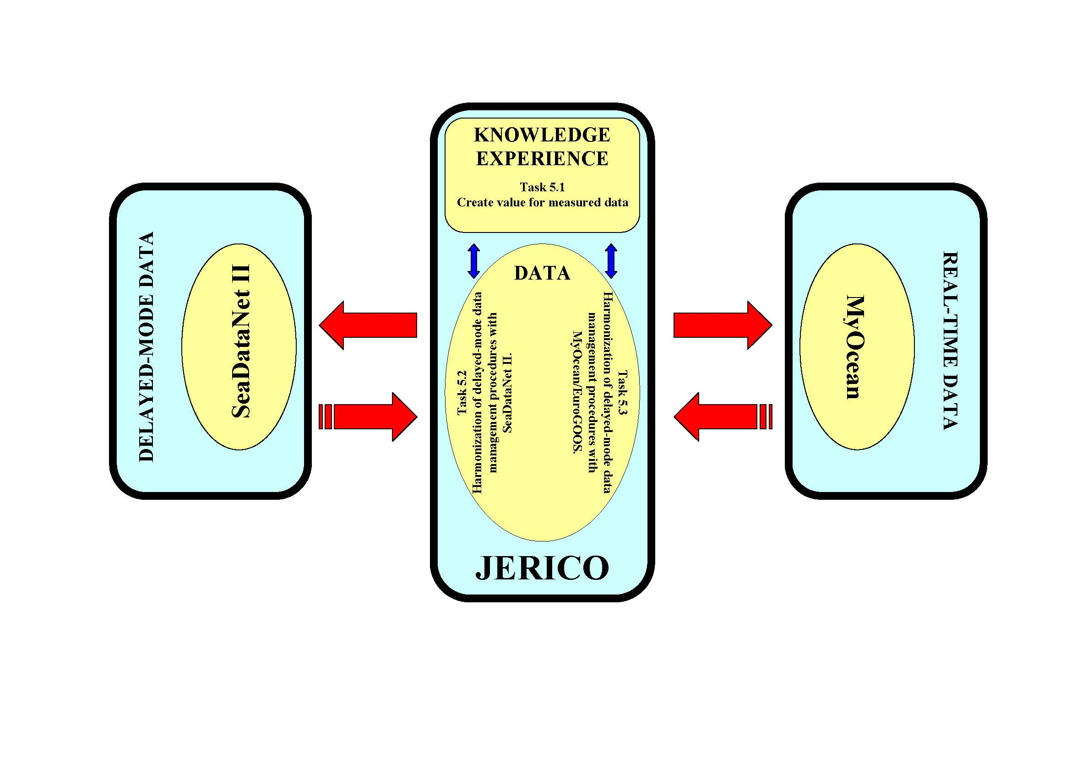
WP5: a functional description
EMODNETPP

Slide 6
WP5: overview of tasks
  5.1 Create value for measured data (Task Leader: OGS; other partner
  involved: HCMR)
  Activity description: development of common procedures for assigning
  uncertainties to measured parameters.
  5.2 Harmonization of delayed-mode data management procedures
  with SeaDataNet (Task Leader: IFREMER; other partners involved:
  HCMR, MUMM, OGS)
  Activity description: development of the JERICO data management
  framework for delayed-mode data.
  5.3 Harmonization of real-time data management procedures
  with MyOcean/EuroGOOS (Task leader: IFREMER; other partners
  involved: CNR, NIVA, IMR, HCMR, PUERTO, SMHI)
  Activity description: development of the JERICO data management
  framework for dealing with real-time data.

Slide 7
WP5: creating value for measured data
Guidelines for Uncertainty
Activity partners: OGS / HCMR
Rajesh Nair (rnair@ogs.trieste.it)
Nevio Medeot (nmedeot@ogs.trieste.it)
George Petihakis (gpetihakis@hcmr.gr)
Manolis Ntoumas (mntou@hcmr.gr)

Slide 8
WP5: creating value for measured data
Guidelines for Uncertainty
  The deliverable, D5.4, the document “Guidelines for Uncertainty” was prepared, and has been submitted to the Coordinator.
  D5.4:
    presents the essential principles and concepts central to the determination of measurement uncertainty;
    describes the different steps involved in an uncertainty calculation, and introduces reporting conventions;
    Provides guidance on the proper preparation of relevant documentation;
    outlines the importance of uncertainty determinations in the context of coastal marine observing activity.

Slide 9
WP5: creating value for measured data
D5.4: contents
1. DOCUMENT DESCRIPTION
2. EXECUTIVE SUMMARY
3. INTRODUCTION
4. MAIN REPORT
4.1. Some useful elementary concepts
4.2. Measurement and uncertainty
4.2.1 What is (and is not) a measurement?
4.2.2 What is measurement uncertainty?
4.2.3 Error, accuracy and precision versus uncertainty
4.2.4 Sources of uncertainty
4.3. Determining uncertainty
4.3.1 Defining the measurand
4.3.2 Designating the sources of uncertainty
4.3.3 Quantifying the uncertainty components
4.3.4 Calculating the combined uncertainty
4.3.5 Expanded uncertainty
4.4. Reporting uncertainty
4.4.1 The combined standard uncertainty (uc)
4.4.2 The expanded uncertainty (U)
4.4.3 The uncertainty budget
4.4.4 Good Practice recommendations for preparing documentation
4.5 Uncertainty evaluation in the context of coastal marine observatories
5. CONCLUSION
6. BIBLIOGRAPHY

Slide 10
WP5: harmonization
Towards real-time integration of the
heterogeneous, distributed JERICO sensor network
into mainstream European information infrastructures
Activity partners: IFREMER / MARUM
Loïc Petit De la Villeon (Loic.Petit.De.La.Villeon@ifremer.fr)
Thomas Loubrieu (tloubrie@ifremer.fr)
Andree Behnken (abehnken@marum.de)

Slide 11
WP5: harmonization
OGC/SWE for JERICO: SensorML templates
Sensor Web Enablement is a suite of OGC standards enabling real time integration of heterogeneous sensors into the information infrastructure.
These standards cover: platform/sensor and process descriptions (sensorML, TML), the observation data flow from sensors (O&M) and the management of sensor requests, planning and alerts (SOS, SPS, SAS, WNS).
SensorML is the XML format dedicated to sensor system descriptions: it describes hierarchically sensor and observation networks. As such, it can be used to implement valuable platform catalogues.
Synergies with earlier studies in ESONET and OceanSites, and current work within SeaDataNet and ODIP, have been considered.

Slide 12
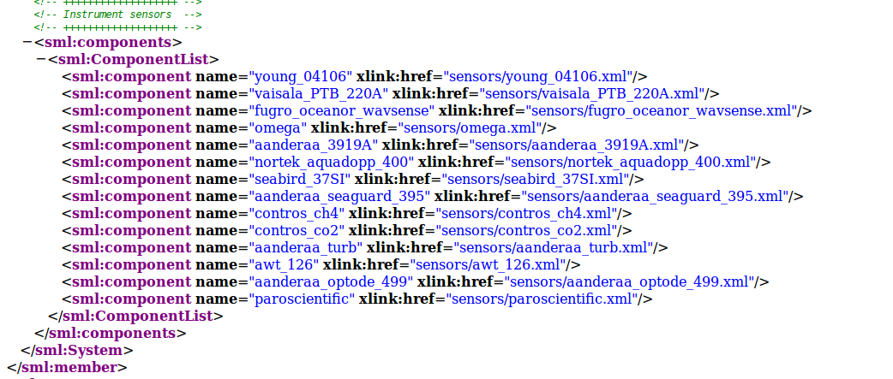
WP5: harmonization
A sensorML description of HCMR’s Poseidon - Pylos Platform
  Mooring with 14 sensors (atmospheric, sea-surface and water-column)

Slide 13
WP5: harmonization
Results
(available on an alfresco collaborative basis)
  Demonstration description in XML.
  Report on description from MARUM.
  IFREMER feedback.
Perspectives
  MARUM is considering feedback (to be sent).
  Implementation of requirements in SeaDataNet SensorML editor (12/2014).

Slide 14
WP5: harmonization
Delayed Mode data management
Activity partners: IFREMER / MARIS
Loïc Petit De la Villeon (Loic.Petit.De.La.Villeon@ifremer.fr)
Dick Schaap (dick@maris.nl)

Slide 15
WP5: harmonization
Results
(available as deliverable D5.1)
  End of last year: release of the second version of the
  “Delayed Mode Data Management Handbook”;
  Includes latest developments of SeaDataNet together with Eurofleets and ODIP (EU - USA - Australia);
  IFREMER feedback transmitted.
Perspectives
  Implementation when data will be available in Delayed Mode (at the end of the JERICO project).

Slide 16

WP5: link to WP7 (Service & Data Access)
Platforms and status of data flow
(as at the end of 2013)

Slide 17
WP5: deliverables
  Rendered deliverables
  D5.1: “DM data management handbook, V1”
  D5.2: “RT data management handbook, V1”
  D5.3: “First data management report”
  D5.4: “Guidelines for uncertainty”

Slide 18
WP5: deliverables
  Progressing deliverables
  D5.5: “Report on uncertainty for selected key parameters: temperature, salinity and chlorophyll-a”
  D5.6: “DM data management handbook, V2”
  D5.7: “Second data management report”
  D5.8: “RT data management handbook, V2”

Slide 19
2nd General Assembly – NIVA HQ
Thank You

Slide 20
DATA: some food for thought

Slide 21
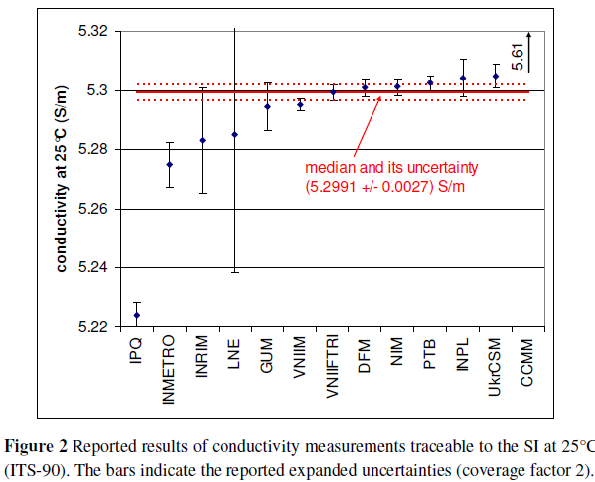
DATA: some food for thought

Slide 22
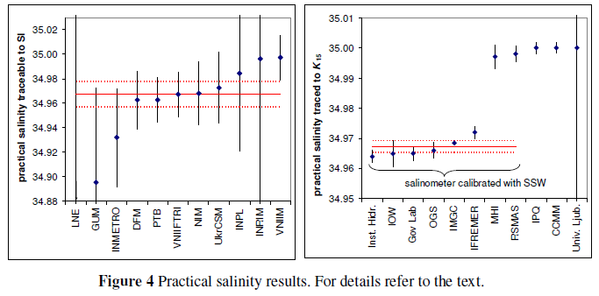
DATA: some food for thought

