Slide 1
STATUS of WP 3
Wilhelm Petersen, Helmholtz-Zentrum Geesthacht
Email: wilhelm.petersen@hzg.de

Slide 2
WP3: Harmonizing technological aspects
General Objectives:
To provide a common base for the operational use of FerryBoxes, gliders, fixed platforms along European coasts
To review the current status of existing systems in operational use in European seas
To define the best technical practices for compatible, robust and cost-effective systems
To define procedures for harmonizing and merging quality assessed FerryBox and Fixed Platform data at regional (ROOS) level
To define procedures and technological solutions for integration and testing of new sensors on these systems

Slide 3
WP3: Contributions of partners
partners in total: 17
budget: ~550 T€
total personal month: 105

Slide 4
Task leaders:
Task 3.1 FerryBox: Syke (Seppo)
Task 3.2 Glider: CSIC (Joaquin)
Task 3.3. Fixed Platform: CEFAS (Rodney)
´Task 3.x.3 test & application
of new sensors: HZG (Willi)

Slide 5
WP 3.1 FerryBoxes Tasks:
3.1.1: Review current status of existing FB systems (flow-through systems, sensors, quality control, data handling)
3.1.2: Best practice of FB systems (flow-through system, sensors, operation procedures, antifouling, control mechanisms, data handling)
3.1.3: Harmonization and merging quality assessed data from FB systems in ROOS regions
3.1.4: Test and integration of new sensors and best practices (tightly linked to WP10).

Slide 6
WP 3:
Status Task 3.1 FerryBox (FB) (responsible Seppo Kaitala):
Task 3.1 FerryBox:
1st JERICO FerryBox workshop (30-31 August 2011 at HZG)
Report of 1st JERICO FerryBox workshop (distributed Nov. 2011)
Best practice of FB systems (T 3.1.2) (together with WP 4):
first discussion in 1st workshop,
continued in joint WS (WP3 & 4) about Best Practice in Oct 2012 in
Crete) -> forming of a working group, led by Kai Sorensen (NIVA)
2nd FerryBox workshop in April 2013 in Helsinki
→ side meeting in Oslo May 2014
D 3.1. Report on current status of FerryBox (updated February 2014)

Slide 7
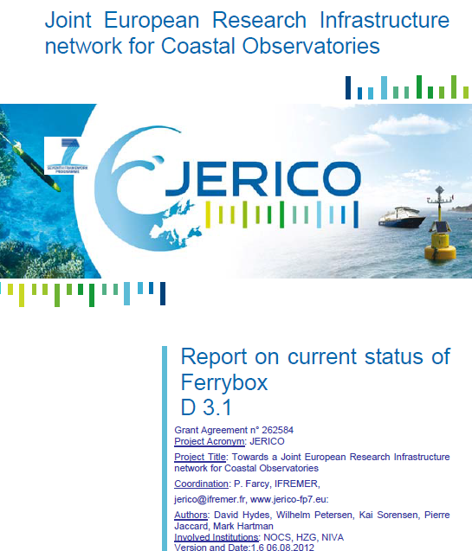
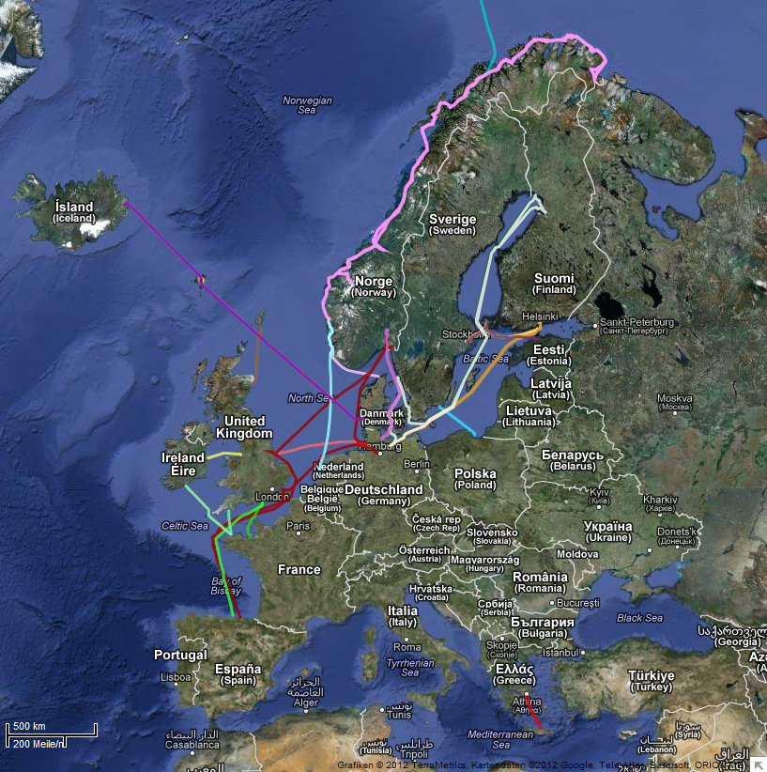
WP3: Harmonizing technological aspects
Task 3.1. Ferryboxes
www.ferrybox.org
7
W. Petersen, BSH Treffen Aug. 2012

Slide 8
D 3.1 Report on current status of FerryBoxes
Content:
1. | DOCUMENT DESCRIPTION | 3
2. | EXECUTIVE SUMMARY | 4
3. | INTRODUCTION | 5
4. | MAIN REPORT | 9
4.1. | Current Status of Ferrybox Operations (In European Waters) | 9
4.2. | Advice on the planning and installation of a new FerryBox system | 15
4.3. | Overview of potential advances resulting from the work of the JERICO project | 25
4.3.1. | Data transfer | 26
4.3.2. | Quality control | 29
 | ANNEXES AND REFERENCES | 34
 | References | 34
 | Annexe - Weblinks | 35

Slide 9
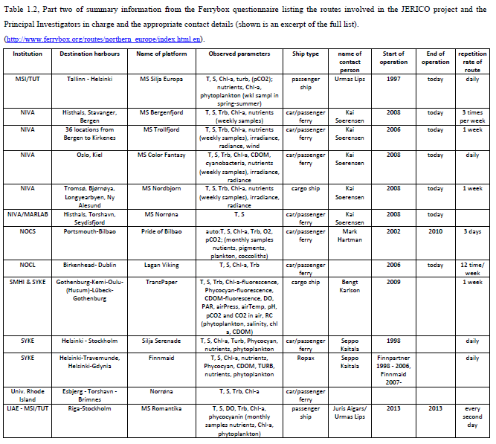
D3. 1 Current status Ferryboxes

Slide 10
WP 3.2 GliDer Tasks : taskleader Joaquin (CSIC)
Tasks:
3.2.1: Review current status of glider operation in Europe
3.2.2: Define the best technical practices for operation a fleet of glider
Activities:
  Workshop Gliders May 2012 joint meeting with GROOM* and EGO** (done)
  JERICO Glider Questionnaire (done)
  Questionnaire analysis (done)
  Report on current status of glider observatories within Europe
  Deliverable 3.2 (done)
* GROOM: Gliders for Research, Ocean Observation and Management, Start Oct. 2011, Duration 36 months
** EGO: Everyone’s Glider Observatories

Slide 11
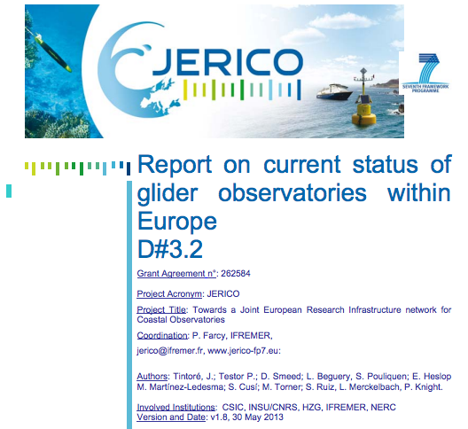
Task accomplished

Slide 12
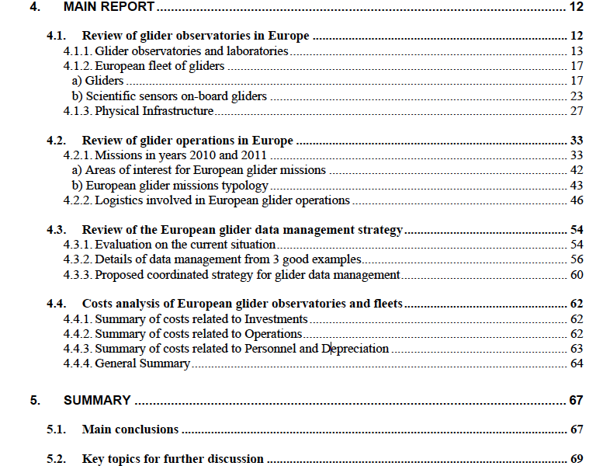
OUTLINE
Deliverable 3.2: Current Status of Glider Observatories

Slide 13
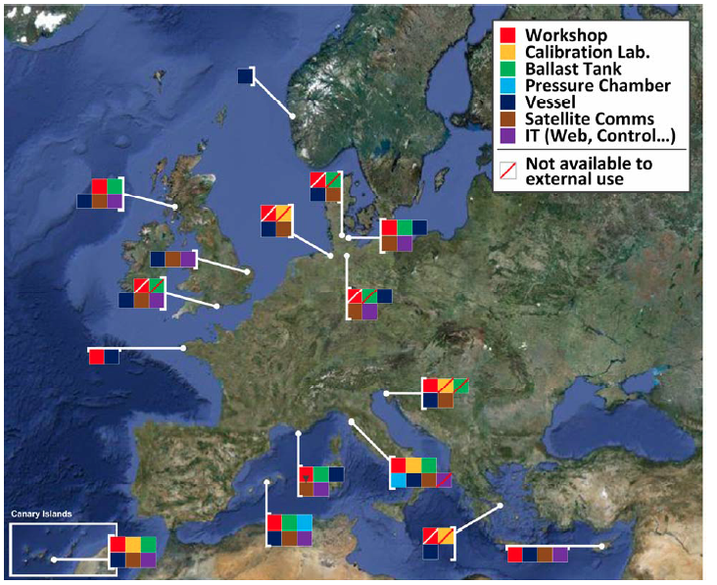
Deliverable 3.2: Current Status of Glider Observatories
Distribution of European Glider Infrastructures

Slide 14
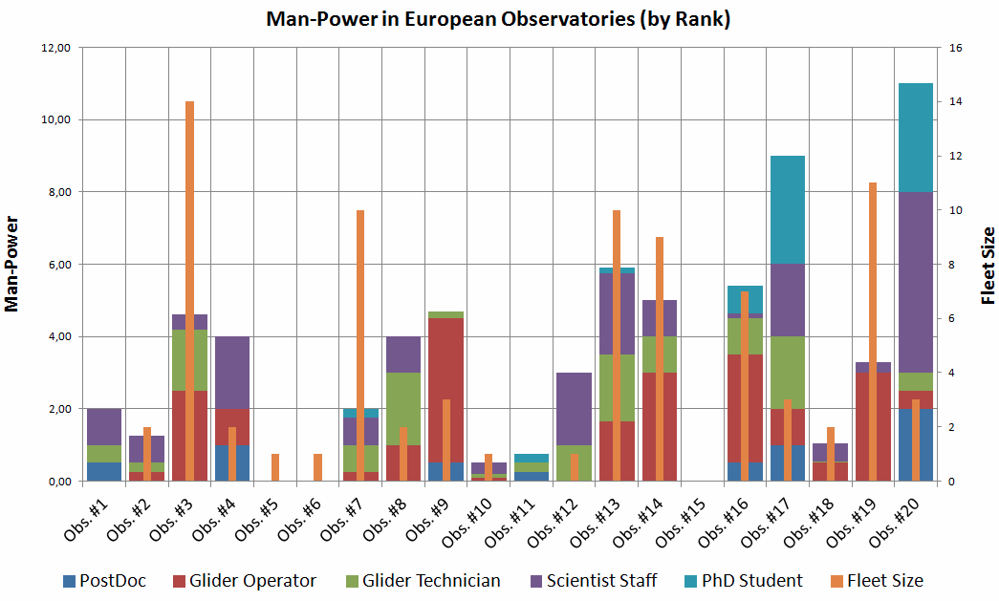
Deliverable 3.2: Current Status of Glider Observatories
Man-Power available to each European observatory compared
to its individual fleet size

Slide 15
WP 3.3 Fixed Platform (FP) Tasks:
Taskleader Rodney Forster
3.3.1: Review of the current status of all existing fixed observing sites
→ Deliverable 3.3. (done Aug 2013)
3.3.2: Workshop to identify elements of fixed platform technology which clearly represent best practice (WS in Rome April 2012 and Crete 2012)
3.3.3: Harmonization and merging quality assessed data from fixed platform systems in ROOSes
3.3.4: Comparison of new sensors and assessment of their applicability for fixed stations <-> WP 10
→ D 3.4

Slide 16
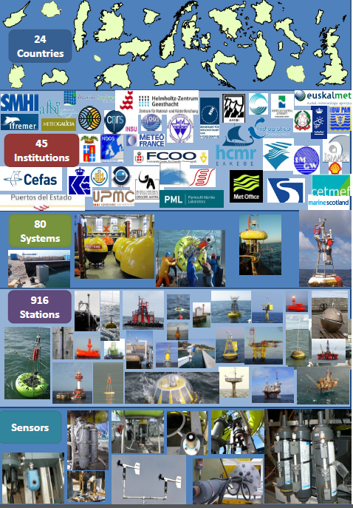
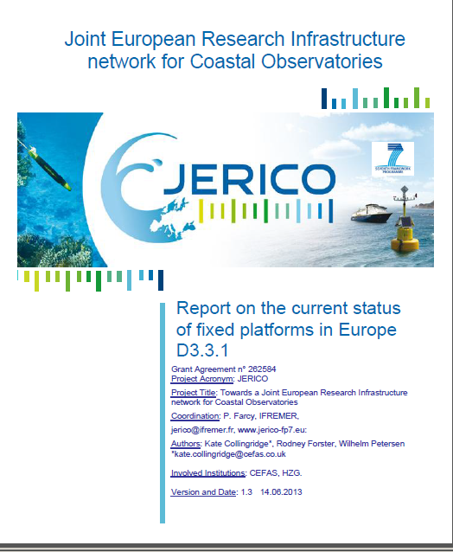

Slide 17
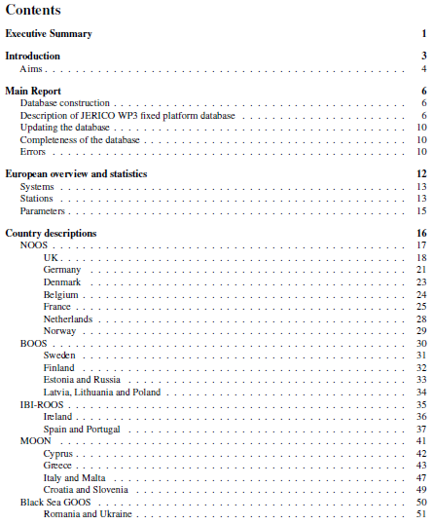
Deliverable D 3.3.: Current Status of Fixed Stations in Europe

Slide 18
Deliverable 3.3.
Current Status of Fixed Stations in Europe
all data are included in a database which will be updated regularly (CEFAS)
Over 900 different fixed platform measuring sites mapped by region (NOOS, BOOS, IBI-ROOS and MOON)
463 sea level measuring stations, 446 sea temperature stations and 237 wave measuring stations were recorded in this survey
very wide variety of instruments and platform types are in use at these sites.
observing systems are predominantly located in the shallow coastal zone where the seabed is less than 50 m deep.
80 identifiable marine observing systems (with on average 11 nodes or measuring stations)
33 of the 80 systems belong to organizations who are partners in the JERICO project (= 39%)

Slide 19
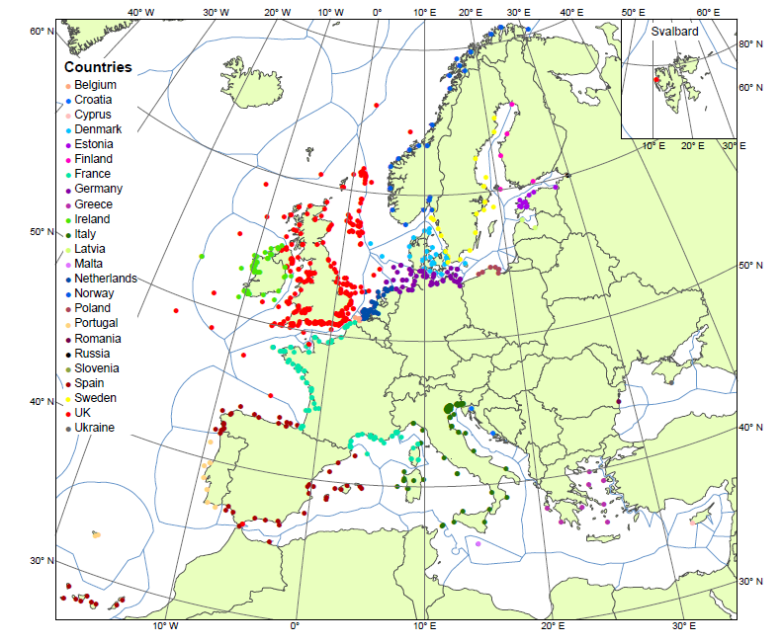
Deliverable D 3.3.: Current Status of Fixed Stations in Europe

Slide 20
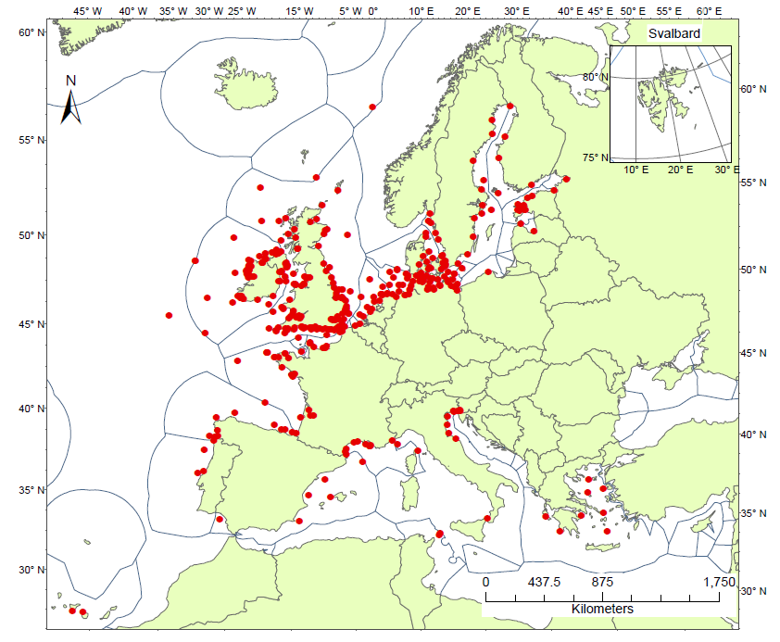
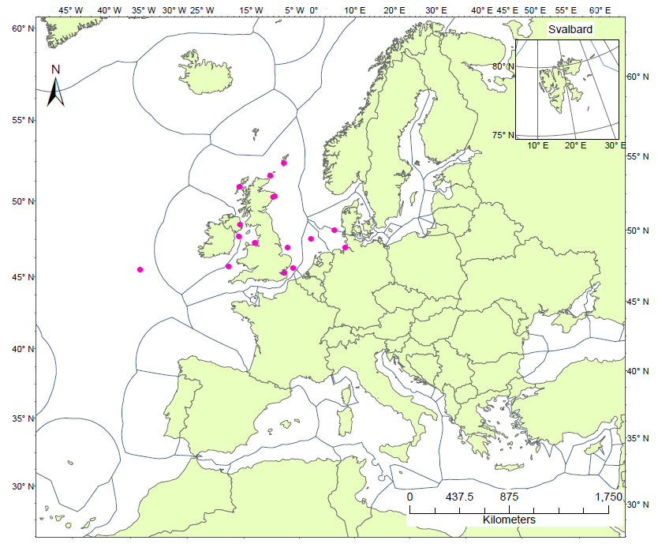
Deliverable D 3.3.: Current Status of Fixed Stations in Europe
Jerico Fixed Platforms
Sea temperature
Jerico Fixed Platforms
Nutrient

Slide 21
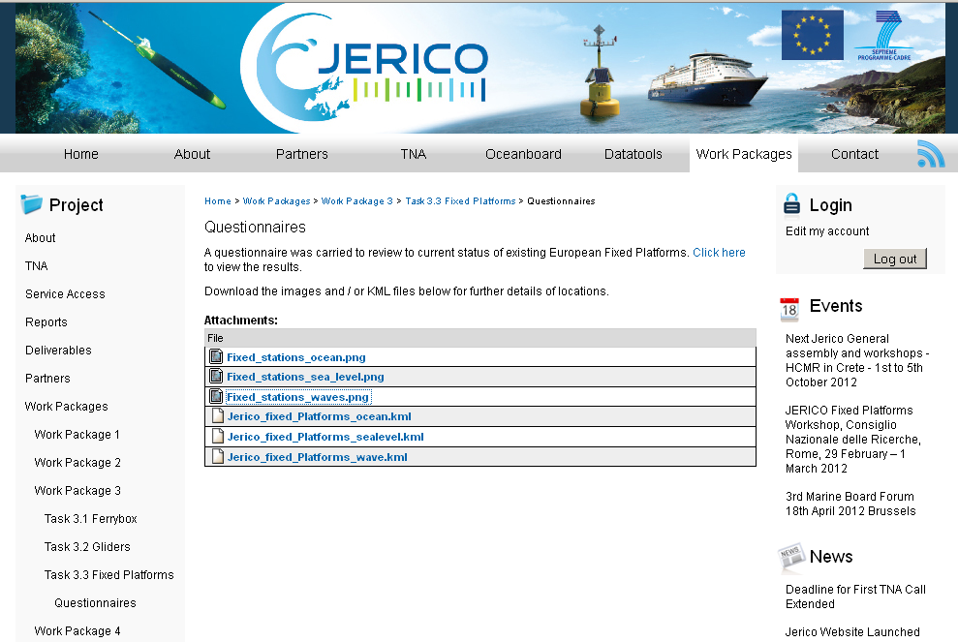

Slide 22
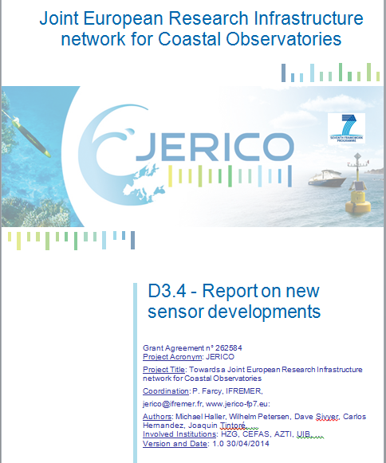
D 3.4. Report on new sensor developments

Slide 23
Conclusion WP3
Tasks completed:
  Most tasks in schedule or already completed
Remaining tasks:
  Best practise for all three kinds of platforms together with WP 4 (→ D 4.4)
    FB and GL to a large extend already .available
    FP: very heterogeneous structures, some efforts necessary in task 3.3 (CEFAS), working group, lead: Carlos
  3.1.3: Harmonization and merging quality assessed data from FB systems in ROOS regions (already common practice, data delivered to MyOcean)
  3.3.3: Harmonization and merging quality assessed data from fixed platform systems in ROOS regions (NOOS, BOOS, MOON, IBI-ROOS): “This activity is cross-cutting through WP3 and will harmonize the outputs of fixed platforms with other systems such as FerryBox/ships of opportunity”. Test sites: North Sea (Cefas, HZG, Ifremer) and Adriatic (CNR).
  3.1.4 und 3.3.4: Test and integration of new sensors and best practices (tightly linked to WP10). → D 3.4.

Slide 24
Conclusion WP3 (cont)
Deliverables:
completed:
  D 3.1 (FerryBox)
  D 3.2 (Glider)
  D 3.3 (Fixed Platforms)
  remaining:
  D 3.4 (Report on new sensor developments and their suitability for different platforms ) postponed to end of May/June 2014
  D 3.5: Conclusion report task 3.1 [month 42 = Oct 2014!!]
  “Report summing up the main conclusions from the 2nd workshop on the best practice, common procedures and agreed standards of FB systems”

Slide 25
Announcements:
Side meetings:
Best practice:
FerryBox: today , lunch break?
Fixed Platforms: ???
Gliders: not necessary
Next FerryBox workshop (FerryBox Community):
Tallin 8.-9. September 2014 (www.ferrybox.org)

Slide 26
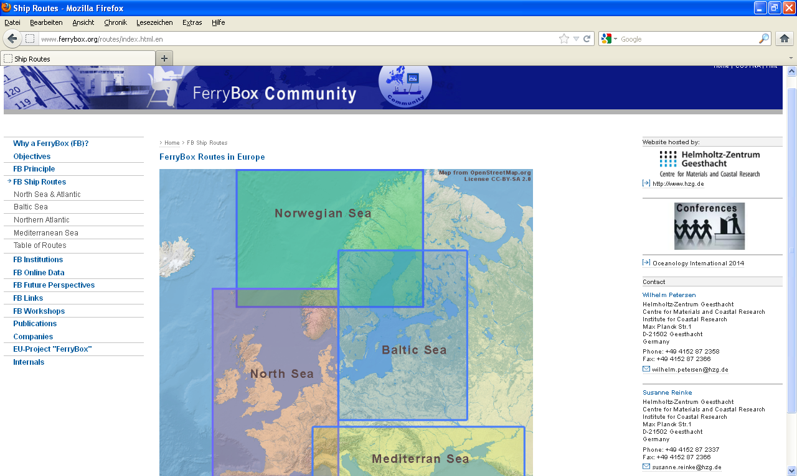
www.ferrybox.org
26
W. Petersen, BSH Treffen Aug. 2012

Slide 27
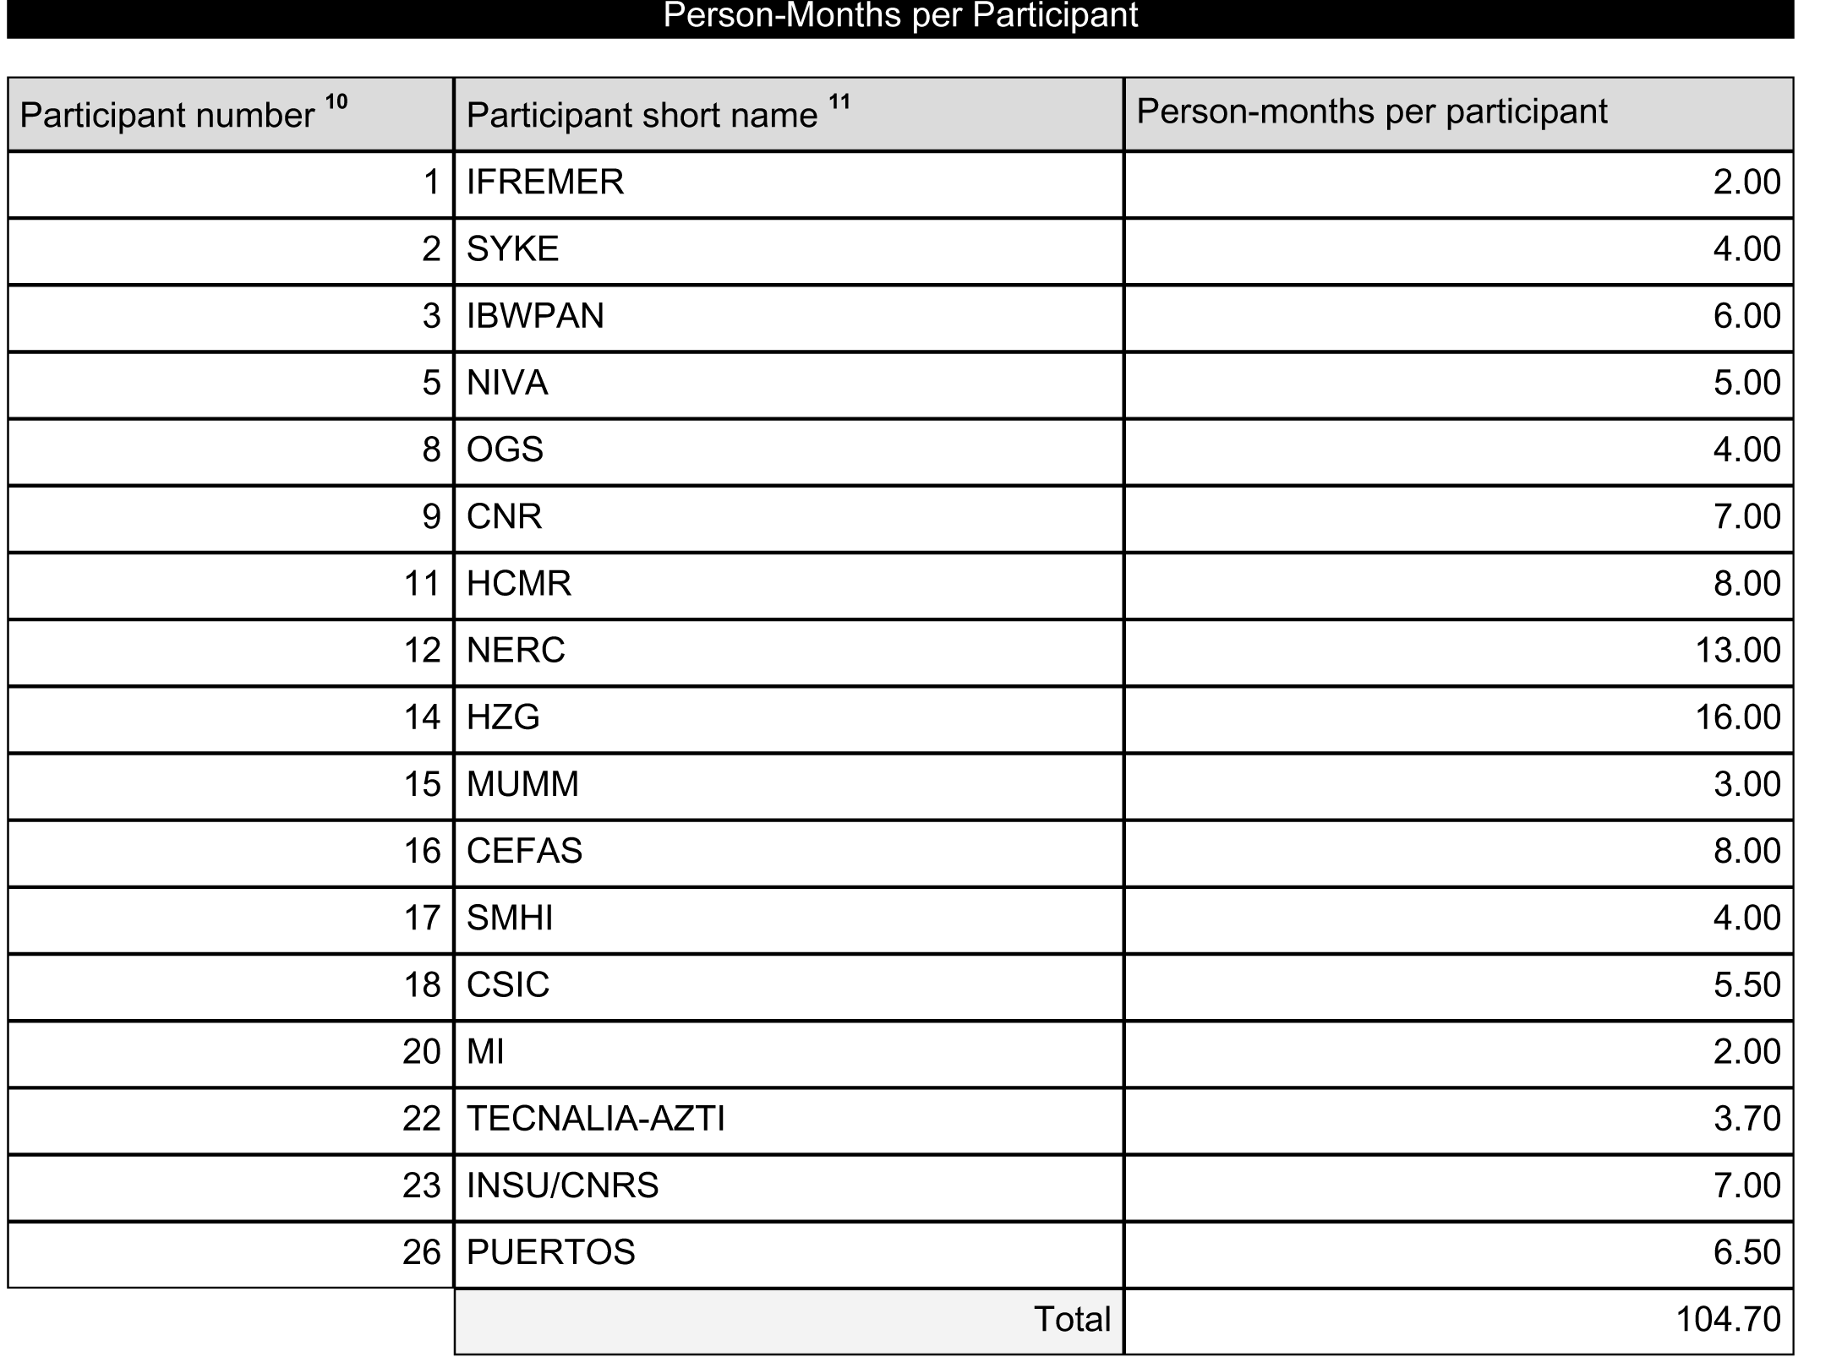
WP3: Personal month per partner

