Slide 1
JERICO WP10: JRA Emerging technologies (Improve system components)
Glenn Nolan

Slide 2
JERICO WP SCHEME
WP0
Management
Steering Committee
Science Advisor Committee (SAC)
WP1
Common Strategy
Forum for Coastal technology (FCT)
WP2
Regional Activities
WP6
Public Outreach & Education
WP3
Technological Aspects
WP4
Harmonizing Operation
WP5
Data Distribution
WP9 – JRA/ Observing System Design
WP7 – SA/ Targeted Operational Phase
WP8 – TNA/ Access to The Infrastructure
WP10 – JRA/ Improve System Components
- Management
- NA
- TNA
- JRA

Slide 3
WP10 Overview 2013
10.1
10.2
10.3
10.4
10.5
10.6
Biological compartments
Contaminants
Profiling technology
VOS
Ferrybox QA
In situ video
PAH
Adriatic
SPM inter
comparison
SOOP
Workshop
Sediment profile imagery
Algal pigments
Ligurian
Algorithim development
FV
Recopesca
In situ fixed camera
CO2
Atlantic
RS, Buoy, Lander concurrent measurements
FlowCam
Zooscan
Notes:
1. Project Management: This WP concerns the overall management of the project and the organisation, administration and progressing of all tasks associated with the running of the project.
2. Reanalysis and Training: Initial assignment of key areas and species for study, collate marine core service data and satellite data , develop model to run hindcast simulation, validate and fine tune model runs.
3. Nowcast / Forecast: Design of Regional VØ Model System running for specific species and location, Develop transport pathways and acquire remote and in-situ measured data which will all feed into HAB-DDSS
4. Alert System: Design and develop HAB-DDSS system, User acceptance testing, design of web portal to HAB-DDSS, Expert interpretation of the regional information assembled within HAB-DDSS
5. User Acceptance and Sustained Production: User requirement workshop, economic assessment to assess improved ability to mitigate risk and increase productivity, develop business model for project sustainability. Successful integration of system into current user practices and their working environment
6. Dissemination and Exploitation: Develop project Website and bulletin board, assign publicity of project and present at workshops and conferences, develop warning system and circulate industry guidelines

Slide 4
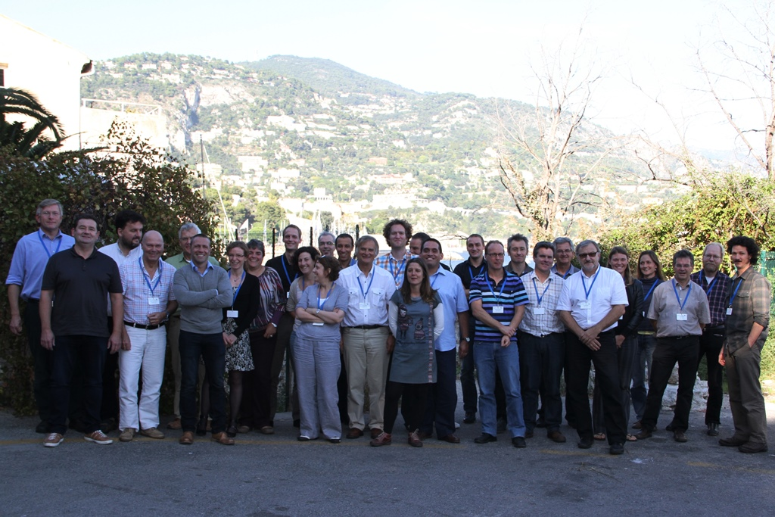
Workshop partcipants

Slide 5
Villefranche workshop
A workshop was held on October 16th to 18th 2013 at the Villefranche observatory to outline progress on emerging technologies within the JERICO FP7 project (Work-package 10). A particular focus of the workshop was to invite researchers outside the project consortium to:
Learn of technology developments within JERICO and
Present results of their own experiments and technology development
The workshop was a mixture of invited talks and practical demonstrations of some of the technologies involved. There were a total of 24 invited talks and 2 additional practical demonstrations.
The talks focused on 5 key tasks within the emerging technologies area:
10.1 Biological compartments
10.2 Contaminants
10.3 Profiling technologies
10.4 Ships/vessels of opportunity
10.5 Ferrybox Quality Control algorithm development

Slide 6
WORKSHOP: General remarks and conclusions
A comprehensive array of new research was presented during this workshop. The research presented comes from within the JERICO consortium and from many contributors outside the JERICO project who were interested in disseminating their work to the wider community. The JERICO consortium will need to make some recommendations on terms of the state of the art of key future technologies, many focused on biological compartments. To that end, JERICO needs to compile a list of the technologies presented at the workshop and to consider the following key aspects:
Suitability of the technology to particular applications
The most appropriate platform to deploy the technology from
Operational readiness of the technology
Research and development opportunities (highlighting current gaps)
The workshop also broadened the connections of the JERICO community to a variety of other researchers

Slide 7
TASK 10.1: BIOLOGICAL COMPARTMENTS
Four principal techniques are developed in this task:
1st development is on in situ video images of the sediment interface acquired using ROV or other mobile systems
2nd development is on in situ sediment profiler camera
3rd development: video sequences, obtained with fixed platform
4th development: dealing with pelagic ecosystems analysis of images obtained with Flowcam, Cytoflow and Zooscan systems.
In order to promote these techniques and to get user feedback,
a follow on demonstration survey should be organised.
The future of the software depends on the interaction between users and developers.
There is also a need to standardize data formats

Slide 8
TASK 10.3: PROFILING SYSTEMS
Solid progress is reported for the EOL buoy experiment in the Ligurian Sea.
The MAMBO/PAGODE inter-comparison in the Adriatic Sea is now underway with results expected in 2014. Early results suggest this is very challenging.
An open ocean profiler experiment is in the DoW but there don’t appear to be resources to conduct the experiment. (Atlantic/Celtic Seas).

Slide 9
Task 10.4: ships of opportunity
A workshop was held in the early part of the JERICO project on using ships of opportunity.
An overview of unmanned surface vehicles (USVs) was presented at this workshop to highlight some of the developments that have taken place in that regard. The reader is referred to the workshop presentations for more detailed information.
Considerable progress was reported for the Italian Fisheries Operational Oceanographic System (FOOS) where equipping fishing vessels with sensors (eg. temperature, salinity, catch weight and net drum rotations) is becoming a mature and well understood technology. The focus is shifting towards making useful products for fishermen from the data collected from sensors on board fishing vessels.

Slide 10
Deliverables: WP10
Deliverable Number | Deliverable title | Lead Beneficiary | Estimated indicative person months | Nature | Dissemination level | Delivery date
D10.1 | Report on trials and deployment | 20 | 20 | R | PU | 36
D10.2 | Set of software | 23 | 60 | R | PU | 42
D10.3 | Report on data analysis | 14 | 32.5 | R | PU | 42
D10.4 | Report on potential new sensors | 1 | 30 | D | PU | 42
Total |  |  | 142.5

Slide 11
PROGRESS TO DATE (MID TERM REVIEW)
WP 10 | year 1 |  |  |  | year 2 |  |  |  | year 3 |  |  |  | year 4
 | Q1 | Q2 | Q3 | Q4 | Q5 | Q6 | Q7 | Q8 | Q9 | Q10 | Q11 | Q12 | Q13 | Q14 | Q15 | Q16
T10.1 - Developments of new tools and strategies for the monitoring of key biological and processes
T10.2 - Developments of physico-chemical sensors and implementation on new platforms
T10.3 - Emerging technology - profiling technology, inter-comparison with mature technology, glider navigation and operation
T10.4 - Ships of opportunity, next generation fishing vessel probes
T10.5 - Ferrybox QA Algorithim
T10.6 - Sediment measurements in shallow coastal waters
Deliverables

Slide 12
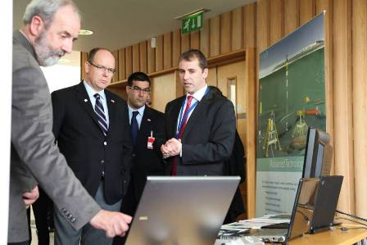
WP10: Next steps
Major focus on deliverables over the next 6 months (May to October 2014)
Paul Gaughan (MI) to help in these tasks.
Adriatic profiler experiment (continues)
10.5 and 10.6:
Ongoing

Slide 13
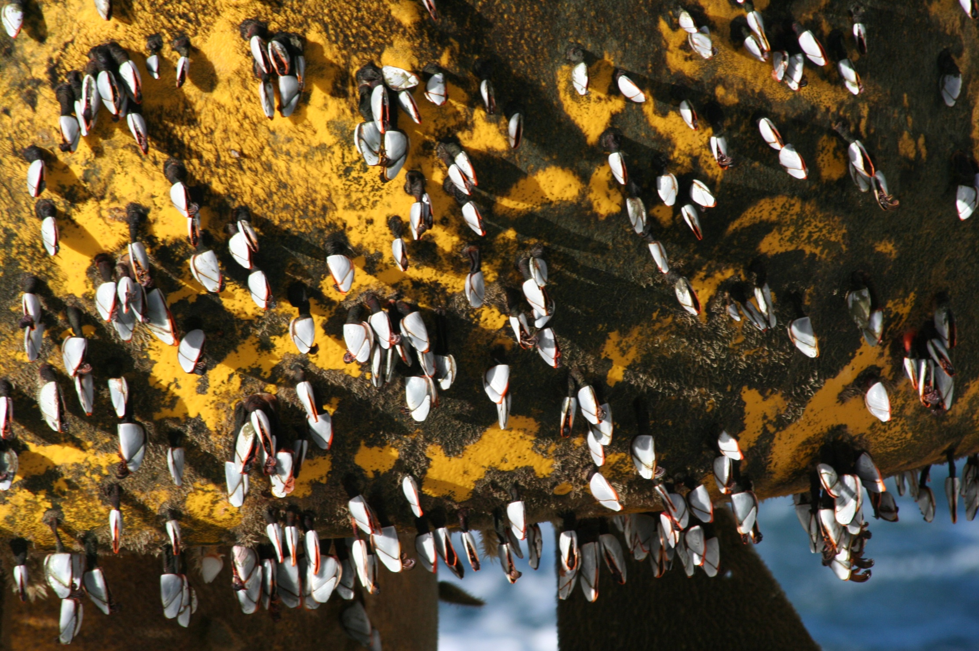
Thank you

Slide 14
WP10 Overview 2013
10.1
10.2
10.3
10.4
10.5
10.6
Biological compartments
Contaminants
Profiling technology
VOS
Ferrybox QA
In situ video
PAH
Adriatic
SPM inter
comparison
SOOP
Workshop
Sediment profile imagery
Algal pigments
Ligurian
Algorithim development
FV
Recopesca
In situ fixed camera
CO2
Atlantic
RS, Buoy, Lander concurrent measurements
FlowCam
Zooscan
Notes:
1. Project Management: This WP concerns the overall management of the project and the organisation, administration and progressing of all tasks associated with the running of the project.
2. Reanalysis and Training: Initial assignment of key areas and species for study, collate marine core service data and satellite data , develop model to run hindcast simulation, validate and fine tune model runs.
3. Nowcast / Forecast: Design of Regional VØ Model System running for specific species and location, Develop transport pathways and acquire remote and in-situ measured data which will all feed into HAB-DDSS
4. Alert System: Design and develop HAB-DDSS system, User acceptance testing, design of web portal to HAB-DDSS, Expert interpretation of the regional information assembled within HAB-DDSS
5. User Acceptance and Sustained Production: User requirement workshop, economic assessment to assess improved ability to mitigate risk and increase productivity, develop business model for project sustainability. Successful integration of system into current user practices and their working environment
6. Dissemination and Exploitation: Develop project Website and bulletin board, assign publicity of project and present at workshops and conferences, develop warning system and circulate industry guidelines

Slide 15
MONITORING OF KEY BIOLOGICAL COMPARTMENTS AND PROCESSES
J.C Duchene A. Gremare, A. Romero-Ramirez

Slide 16
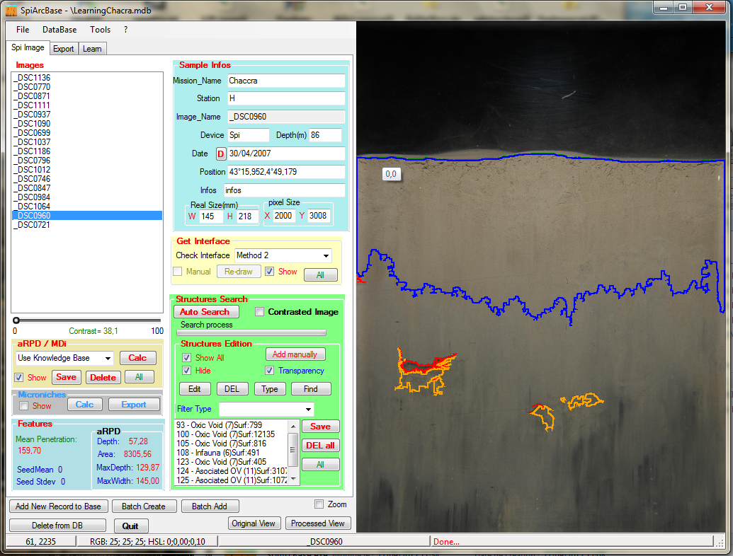
In situ sediment profile images to infer the ecological quality status of benthic habitats using either existing or newly developed indices
SpiArcBase:
Enhance the interpretation of features observed on SPIs
Facilitate image management and structure visualization via a database
Available to download:
http://spiarcbase.epoc.u-bordeaux1.fr/

Slide 17
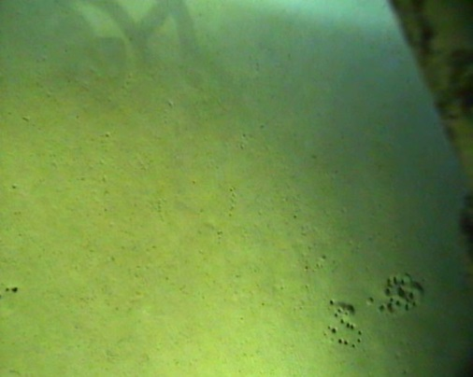
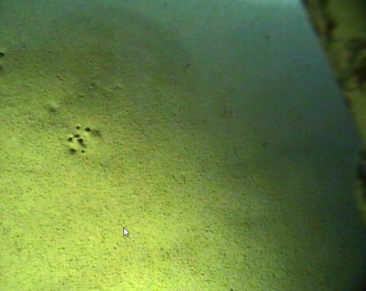
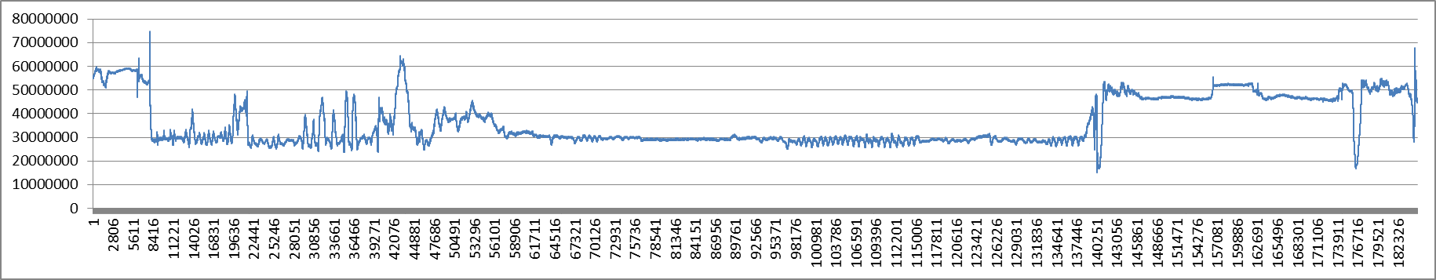
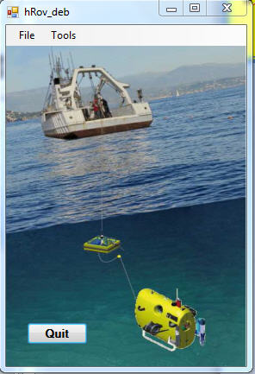
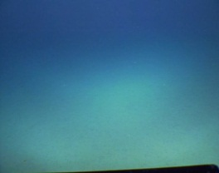
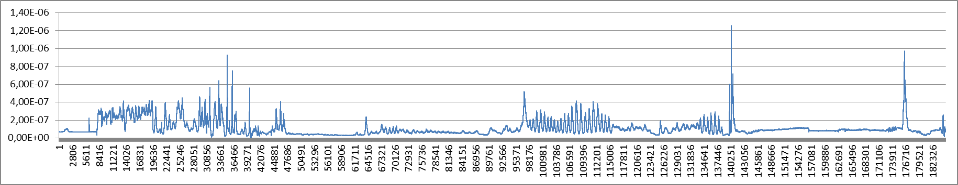
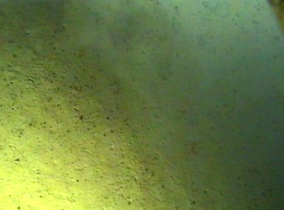
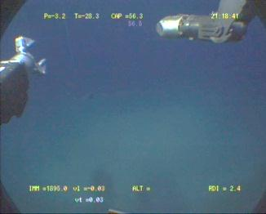
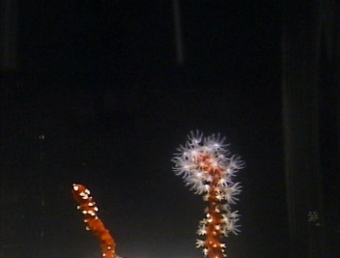
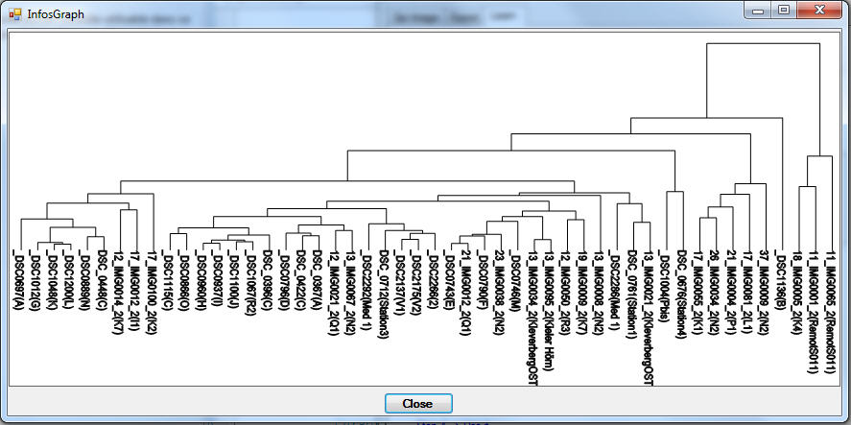
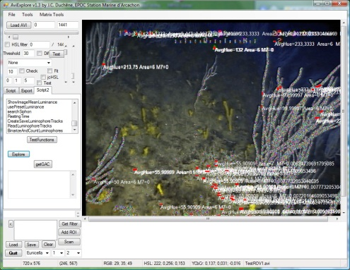
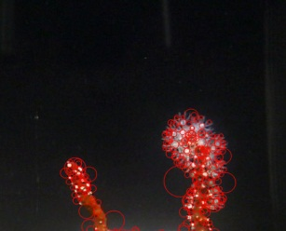
Video imaging of water sediment interface
Sequence detection
(depending on ROV speed)
Object counting
Extraction of ROV arms sequences
Polyp counting
Object classification

Slide 18
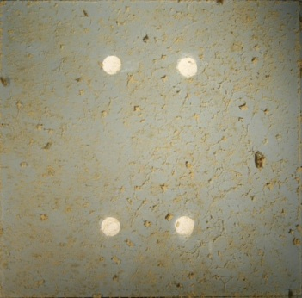
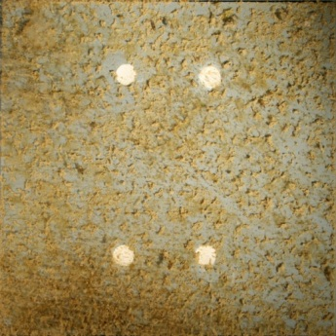
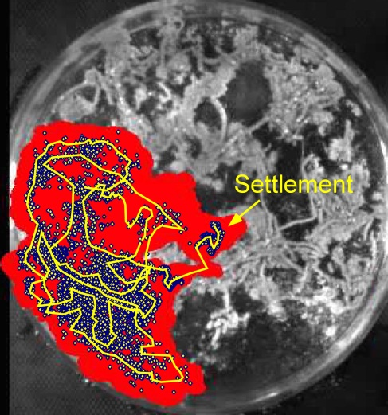
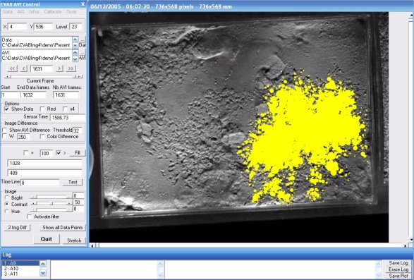
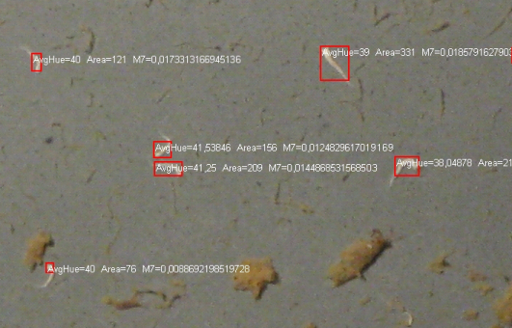
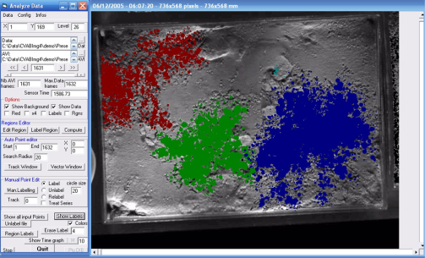
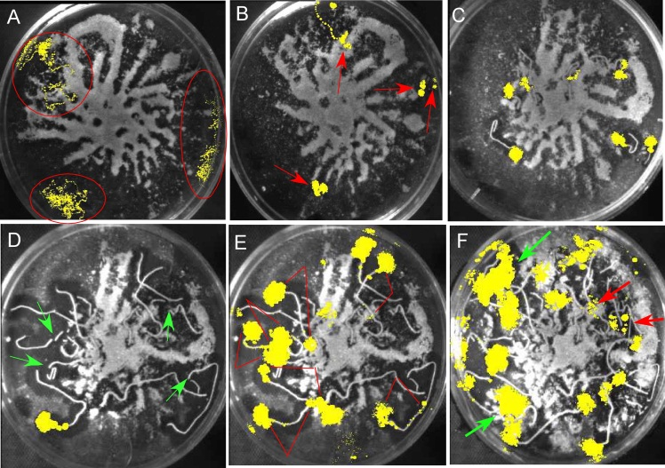
Video imaging by fixed cameras
Recruitment analysis: shape analysis on juveniles, early competition, substrate coverage
Adult interactions and competition
Early sediment occupation
35-day survey
Interspecific
Interactions and competition
Intraspecific competition in tubicolous polychaetes

Slide 19
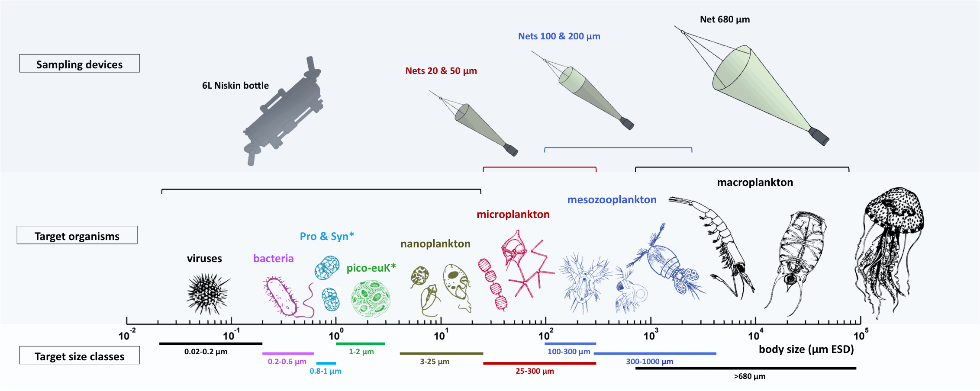
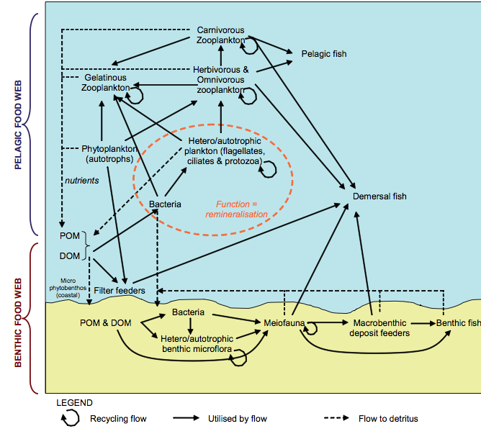
Environnement 3 D, très variable
MES, polluants chimiques et organiques
END-TO-END plankton community analysis of the plankton can be performed using imaging systems

Slide 20
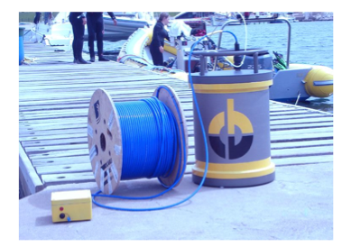
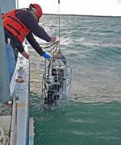
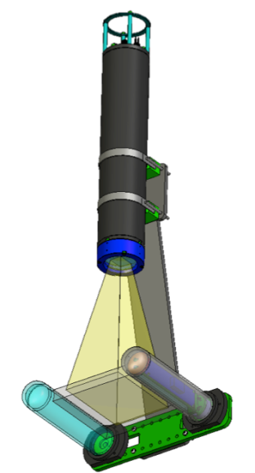
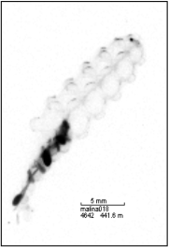
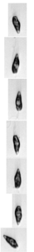
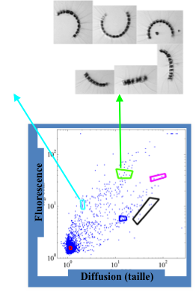
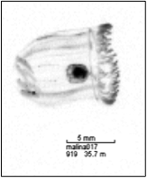
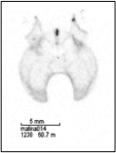
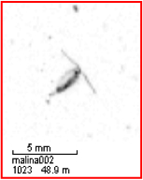

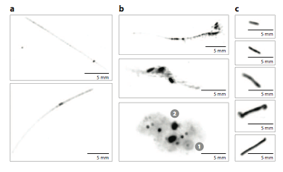
We try to take into account future development of
in situ systems (cytometer, flowcam and UVP)
>100 µm
1-10µm
10-100µm

Slide 21
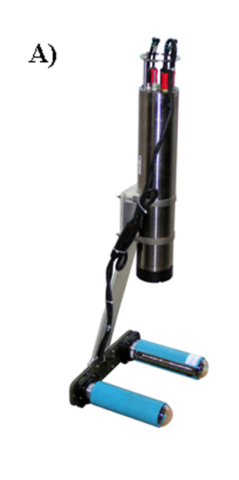
Pelagic ecosystem « end to end » monitoring using semi automated imaging systems
UVP, LISST
DELIVERABLE:
Common software for image analysis and data management for Flowcam, Zooscan.
We try to take into account other instruments (for other size ranges)
4
2: FlowCam
3: Zooscan
1: Flowcytometer
L. Stemmann, M. Picheral, Jean Baptiste Romagnan ,
F. Prejger, A. Elineau, G. Obolensky
OOV CNRS-UPMC (Janvier 2013)

Slide 22
Working progress 2011 - 2012:
Develop an integrated suite of software:
Released a first version of zooprocess 7.09 (in February 2012).
zooprocess 7.12 has been displayed on the zooscan web page (http://www.obs-vlfr.fr/LOV/ZooPart/ZooScan/).
2 Test different protocols for sampling:
Samples have been collected weekly with Niskin bottles and different nets (50, 100, 200 and 680 µm meh size) to collect protozoa and metazoa.
Samples have been analysed using the FlowCam and Zooscan.
The full analysis has been completed in summer 2012.
Testing different software settings for optimization of the
(semi-)automatic recognition of plankton groups. and additional collection at Point B. This work has just started.

Slide 23
Publications based on JERICO
Pieter Vandromme, Lars Stemmann, Carmen Garcia-Comas, Léo Berline, Xiaoxia Sun, Gaby Gorsky (2012) Assessing biases in computing size spectra of automatically classified zooplankton from imaging systems: A case study with the ZooScan integrated system. Methods in Oceanography, doi:10.1016/j.mio.2012.06.001
Lars Stemmann, Marc Picheral, Lionel Guidi, Fabien Lombard, Franck Prejger, Hervé Claustre, Gabriel Gorsky (2012) Assessing the spatial and temporal distributions of zooplankton and marine particles using the Underwater Vision Profiler. CNRS Edition, ed. Françoise Gaill, Yvan Lagadeuc et Jean-François Le Galliard
Lars Stemmann & Hervé Claustre & Fabrizio D’Ortenzio (2012) Integrated observation system for pelagic ecosystems and biogeochemical cycles in the oceans CNRS Edition, ed. Françoise Gaill, Yvan Lagadeuc et Jean-François Le Galliard
t

Slide 24
JERICO WP10: JRA Task 10.2. Algal pigments and Carbonate system
Wilhelm Petersson, Jukka Seppala, Kai Sorenson

Slide 25
WP10 Overview 2013
10.1
10.2
10.3
10.4
10.5
10.6
Biological compartments
Contaminants
Profiling technology
VOS
Ferrybox QA
In situ video
PAH
Adriatic
SPM inter
comparison
SOOP
Workshop
Sediment profile imagery
Algal pigments
Ligurian
Algorithim development
FV
Recopesca
In situ fixed camera
CO2
Atlantic
RS, Buoy, Lander concurrent measurements
FlowCam
Zooscan
Notes:
1. Project Management: This WP concerns the overall management of the project and the organisation, administration and progressing of all tasks associated with the running of the project.
2. Reanalysis and Training: Initial assignment of key areas and species for study, collate marine core service data and satellite data , develop model to run hindcast simulation, validate and fine tune model runs.
3. Nowcast / Forecast: Design of Regional VØ Model System running for specific species and location, Develop transport pathways and acquire remote and in-situ measured data which will all feed into HAB-DDSS
4. Alert System: Design and develop HAB-DDSS system, User acceptance testing, design of web portal to HAB-DDSS, Expert interpretation of the regional information assembled within HAB-DDSS
5. User Acceptance and Sustained Production: User requirement workshop, economic assessment to assess improved ability to mitigate risk and increase productivity, develop business model for project sustainability. Successful integration of system into current user practices and their working environment
6. Dissemination and Exploitation: Develop project Website and bulletin board, assign publicity of project and present at workshops and conferences, develop warning system and circulate industry guidelines

Slide 26
TASK 10.2:
DEVELOPMENTS OF PHYSICO-CHEMICAL SENSORS AND IMPLEMENTATION ON NEW PLATFORMS
Subtask 10.2.1. Contaminants
Subtask 10.2.2. Algal pigments
Subtask 10.2.3. Carbonate system

Slide 27
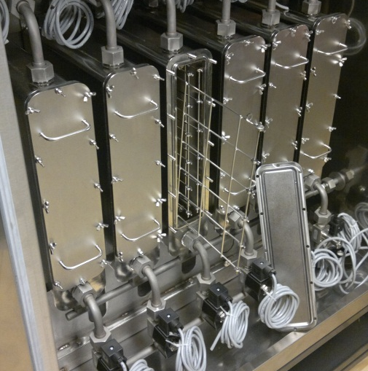
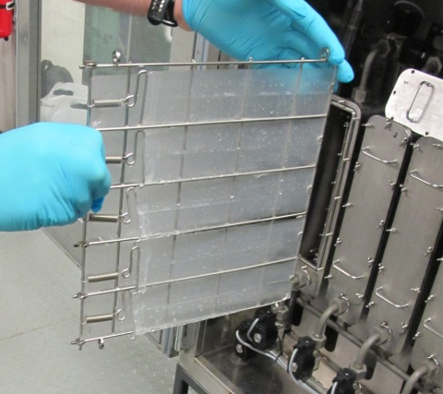
Protype testing - «Chemical extractor» Chem. Mariner project – Test Oslo-Kiel
Polyetylene membranes and triolin
Membranes brought to laboratory for analysing of PAH, PCB and some pesticider.

Slide 28
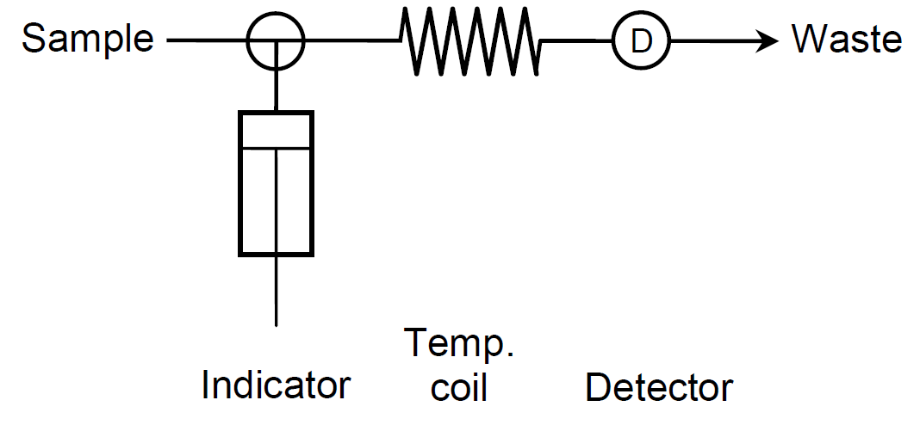
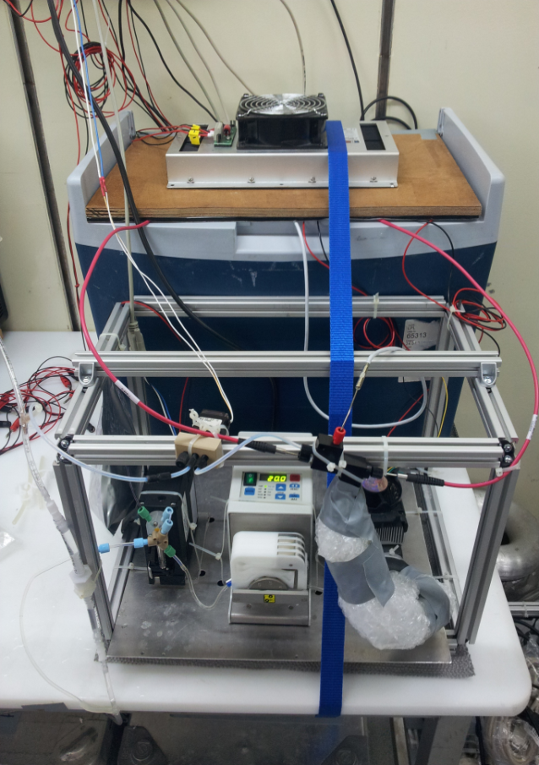
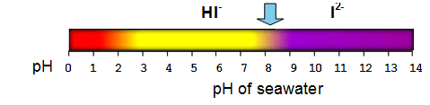
New Spectrophotometric pH – Sensor for Underway Systems
Principle
- Flow-Injection-System (FIA) system using an indicator dye m-Cresol purple
− Determination of the concentration of the indicator acid (HI⁻) / base (I²⁻) due to different absorption spectra (= absolute method)
− Calculation of the pH value using Henderson–Hasselbach equation
Results:
labour version ready
field test successful
prototypes have to be tested for longer unattended deployment
Precision ± 0.0007 Accuracy ± 0.003

Slide 29
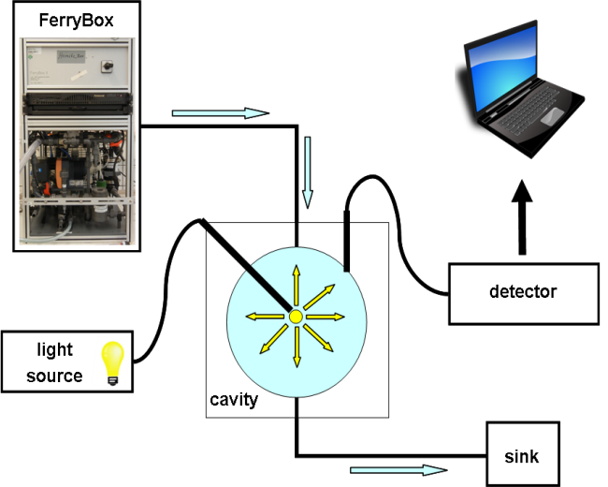
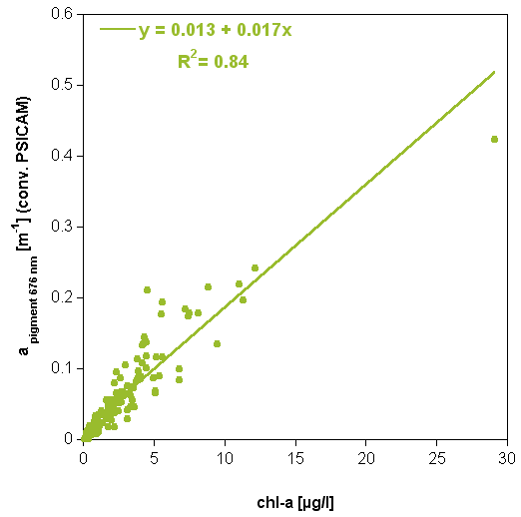
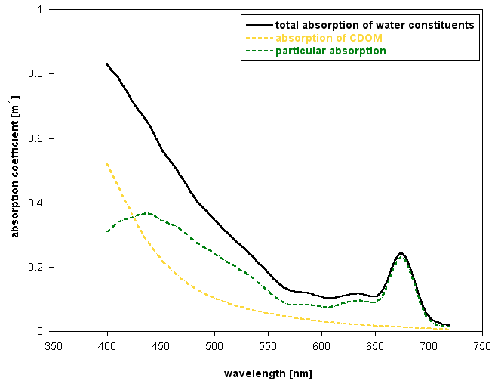
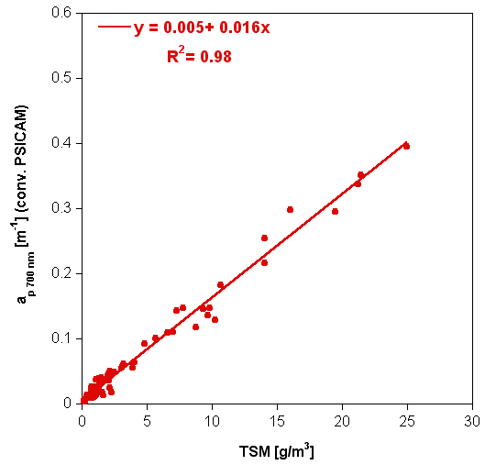
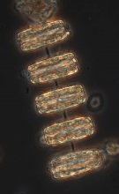
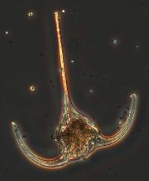
Flow-Through Point Source Integrating Cavity Absorption Meter (ft-PSICAM)
determination of chlorophyll-a and TSM
+ optional spectral analysis for algal group detection
chlorophyll-a
676 nm
700 nm
Results:
prototype successfully tested in the field
chlorophyll-a data more reliable compared to fluorescence data
automatically cleaning has to be optimized
algorithms for algae-group detection have to be developed
total suspended matter
(TSM)
Identification of algae groups from spectra
29

Slide 30
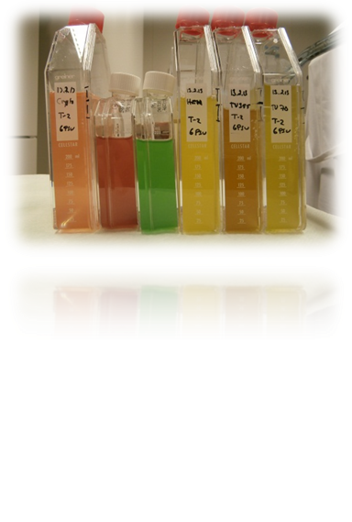
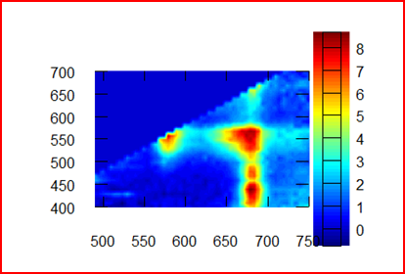
WP 10, Task 10.2.2 DEVELOPMENT AND IMPLEMENTATION OF SENSORS FOR THE ALGAL PIGMENTS ON SHIPS (SYKE, SMHI, NIVA)
(1) Spectral datasets (fluorescence / absorption / reflectance) will be analysed for the detection of phytoplankton pigments (algal groups)
Review existing instruments for spectral measurements
Multichannel fluorometers, absorption/attenuation meters, spectroradiometers (2013-14)
Multivariate analysis of spectral data sets to detect spectrally distinct phytoplankton groups.
Main techniques: Principal Component Analysis, Partial Least Squares (2013-14)
Using existing field data

Slide 31
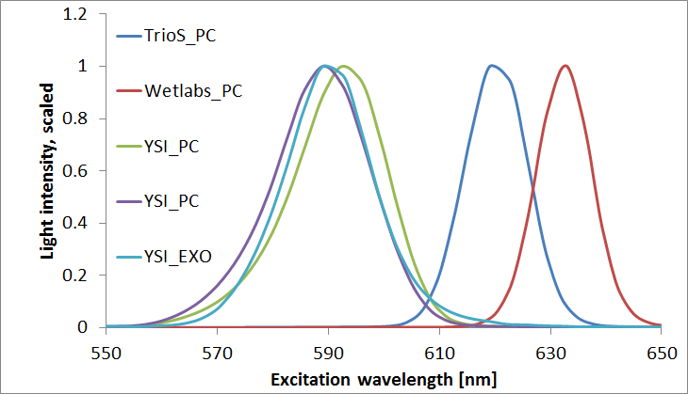

WP 10, Task 10.2.2 DEVELOPMENT AND IMPLEMENTATION OF SENSORS FOR THE ALGAL PIGMENTS ON SHIPS (SYKE, SMHI, NIVA)
(2) Commercially available single-wavelength fluorometers for accessory pigments (e.g. phycoeryhtrin) will be tested.
Review existing fluorometers
Lab tests with various instruments (2013)
Survey on phycobilin fluorometer specifications (2013)
Testing fluorometers for phycoerythrin detection.
Tests during research cruise (2012)
Ferrybox measurements (2013)
Lab measurements to support data (2013)

Slide 32


WP 10, Task 10.2.2 DEVELOPMENT AND IMPLEMENTATION OF SENSORS FOR THE ALGAL PIGMENTS ON SHIPS (SYKE, SMHI, NIVA)
(3) Instruments measuring phytoplankton variable fluorescence will be tested and measurement protocols will be optimized for transect studies.
Review existing instruments and measuring techniques suitable for FerryBox applications
Survey on instrument specifications, their suitability for flow-through measurements (2012-13)
Testing instruments including optimization of measuring protocols and technical installations.
Two instruments (Chelsea & PSI), will be tested and measurement protocols examined and optimized (2012-14)

Slide 33

Norwegian Ferrybox network
Core water sensors
Inlet temperature
Temperature
Salinity
Turbidity
Oxygen
Biogeochemical
Chl fluorescence
PC Fluorescence
CDOM Fluorescence
pH and pCO2
Water samples
Chl-a
TSM
Turbidity
CDOM
Nutrients
Algal pigment absorbtion
Algae taxonomy
Deck sensors
Uppwelling Radiance
Down welling radiance
Downwelling Irradiance
Wind

Slide 34


Franatech pCO2 systems for Ferrybox installations
Membrane based system
Solid state detector
Calibration on-board
Easy to maintain/replace
Flow through system
Uses external pump (Ferrybox)
Water leakage detector
Internal logging and on-line SW
Communication with Ferrybox

Slide 35

Field tests between GO_pCO2 and Franatech
+/- 2 % accuracy of the calibration gasses

Slide 36


Combined approach pH and pCO2 into the Ferrybox
Physically implemented into the pCO2 will be tested!
pH and carbonate
pCO2
Combined in a common labview
Software with data from the Ferrybox eg. SST, pressure

Slide 37




Cruise deployments
D366
June/July 2011
Extended Ellett Line
May/June 2013
System deployed on the three cruises and currently running simultaneously with the PCO2 sensor.

Slide 38



NOC SubCtech pCO₂ Installations
Endeavour during August 2013
Comparison with CEFAS system
Area: North Sea
Finnsea from 2014
Installation to complement existing Alg@line sensors
Area: Finland to Spain
Cefas Endeavour
2
Finnlines Finnsea
1

Slide 39

Characteristics of the current system
Automated shipboard system
Sample volume= 500 µL
Indicator volume= 12 µL
Frequency: 10 samples/hr
Thymol Blue Indicator
Surface seawater temperature
Accuracy ≤ 4 mpH (n=20)
Precision= 1 mpH (n=20)
pH system aboard RRS Discovery

Slide 40

Improved Robustness for JERICO
Removal of PC – integrated controller
Version 1: PIC microcontroller
RS232 interface for FB implemented
Version 2: Atmel SAM4L
Improved interfaces, system control
RS232 and USB interfaces
Development of conformal coasting for improved water resistance
Version 1: sensor system controller
Notes:
For ferry box applications, and particularly when running on vessels with low infrastructure we need to make the system more robust. One element of this is the electronics – a PC is not a good long term solution. Therefore we have designed and manufactured bespoke electronics that can run the systems directly. The electronics (V1) are working well and V2 are in development. We are still working on trying to integrate these with the ferry box version of the pH sensor, and to demo this.

Slide 41

Improved Robustness for JERICO
Adaptation of bespoke in-situ syringe pump
Version 1:
Glass barrels
Titanium V plungers and quad ring seals
Stepper motor screw drive
Version 2:
Titanium II barrels a plungers
Version 2 syringe pump (on nutrient “lab on a chip”)
Notes:
The Syringe pumps (Harvard, USA) that we have previously used use are not very reliable – most of the problems are in control, they are really designed to be operated manually in the lab. We have therefore investigated a number of alternative pumps including solenoid diaphragm pumps (lee co and biochem) and syringe pumps (lee co). We have also developed our own bespoke syringe pump. This is an adaptation of a submersible system (and is hence robust). However at time of writing we have a problem with wear in the seals which we are still working on. The maximum life we have achieved is 10000 measurements. Periodically we get worse life, and wear results in particles entering the system which degrades performance. Hence we are working to eliminate this wear problem through design.

Slide 42
Future work
Combine pH and pCO2 into one system
Deployment for long term tests on three ship routes (seasons, years)
Kattegat/Skagerrak (low saline water, high Chl-a)
Coastal areas (Fjords, Rivers mouth)
Barents Sea (cold waters/Arctic)
Long term technical experience
Long term calibrations experience (NOAA-gas)
Establish the overall precision and accuracy
Comparison and implementation in the monitoring program
Hopefully implementation into the monitoring programs?
Comparisons with other systems (Jerico-activity?)
GO-System, other membrane systems and other detectors

Slide 43
WP10 Overview 2013
10.1
10.2
10.3
10.4
10.5
10.6
Biological compartments
Contaminants
Profiling technology
VOS
Ferrybox QA
In situ video
PAH
Adriatic
SPM inter
comparison
SOOP
Workshop
Sediment profile imagery
Algal pigments
Ligurian
Algorithim development
FV
Recopesca
In situ fixed camera
CO2
Atlantic
RS, Buoy, Lander concurrent measurements
FlowCam
Zooscan
Notes:
1. Project Management: This WP concerns the overall management of the project and the organisation, administration and progressing of all tasks associated with the running of the project.
2. Reanalysis and Training: Initial assignment of key areas and species for study, collate marine core service data and satellite data , develop model to run hindcast simulation, validate and fine tune model runs.
3. Nowcast / Forecast: Design of Regional VØ Model System running for specific species and location, Develop transport pathways and acquire remote and in-situ measured data which will all feed into HAB-DDSS
4. Alert System: Design and develop HAB-DDSS system, User acceptance testing, design of web portal to HAB-DDSS, Expert interpretation of the regional information assembled within HAB-DDSS
5. User Acceptance and Sustained Production: User requirement workshop, economic assessment to assess improved ability to mitigate risk and increase productivity, develop business model for project sustainability. Successful integration of system into current user practices and their working environment
6. Dissemination and Exploitation: Develop project Website and bulletin board, assign publicity of project and present at workshops and conferences, develop warning system and circulate industry guidelines

Slide 44
JERICO WP10: JRA 10.2 Emerging technology - profiling technology, inter-comparison with mature technology
L.Coppola CNRS-INSU coppola@obs-vlfr.fr

Slide 45

EOL: profiler coastal buoy existing since 2004 in Villefranche/Mer
Two version: 2004-2008 and 2009-2011
Third version of the buoy still under construction
EOL version 3 progress:
Partnership signatures in July 28th between CNRS, University and Mobilis company
Top structure finished in June 2011
Float has to be bigger (14m3)
Installation planned in November 2012

Slide 46


Insert text
The new EOL buoy version 3 has been deployed in March 29th 2013 in the Villefranche bay.
The new version is larger and bigger than the previous one: 4 tons & 8m height & 3.6 diameter
The CTD profiler has been re-integrated in the buoy which provide one T&S profile every day (0-100m)
Additionally a cytometer has been also integrated for picoplankton & bacteria analysis

Slide 47
Deployment of the new EOL buoy version 3 in Villefranche
Weather station has been implemented on the top of the EOL3 buoy with real-time transmission of data weather
These data are accessible on the web site:
http://vtslite.siitech.com/vtslite/AView.aspx
EOL ID = 992271400
pCO2 CONTROS sensor should be installed in July 2013

Slide 48



The OGS profiling data buoy

Slide 49
OGS Update
OGS buoy has been refitted and is ready to go
Tests on float tethering system (late May)
PAGODE float to be shipped from IFREMER soon
Experiment in summer 2013

Slide 50





WP10 Demonstration survey the Kattegat-Skagerrak front
Aim – describe processes in 3-D
Three FerryBox routes in the area
Buoys, one Argo float
Monthly monitoring cruises
Short cruises with research vessel in August 2012, May 2013 and June 2013
Cooperation with WP3 and 4 and the University of Gothenburg

Slide 51
WP10 Overview 2013
10.1
10.2
10.3
10.4
10.5
10.6
Biological compartments
Contaminants
Profiling technology
VOS
Ferrybox QA
In situ video
PAH
Adriatic
SPM inter
comparison
SOOP
Workshop
Sediment profile imagery
Algal pigments
Ligurian
Algorithim development
FV
Recopesca
In situ fixed camera
CO2
Atlantic
RS, Buoy, Lander concurrent measurements
FlowCam
Zooscan
Notes:
1. Project Management: This WP concerns the overall management of the project and the organisation, administration and progressing of all tasks associated with the running of the project.
2. Reanalysis and Training: Initial assignment of key areas and species for study, collate marine core service data and satellite data , develop model to run hindcast simulation, validate and fine tune model runs.
3. Nowcast / Forecast: Design of Regional VØ Model System running for specific species and location, Develop transport pathways and acquire remote and in-situ measured data which will all feed into HAB-DDSS
4. Alert System: Design and develop HAB-DDSS system, User acceptance testing, design of web portal to HAB-DDSS, Expert interpretation of the regional information assembled within HAB-DDSS
5. User Acceptance and Sustained Production: User requirement workshop, economic assessment to assess improved ability to mitigate risk and increase productivity, develop business model for project sustainability. Successful integration of system into current user practices and their working environment
6. Dissemination and Exploitation: Develop project Website and bulletin board, assign publicity of project and present at workshops and conferences, develop warning system and circulate industry guidelines

Slide 52
JERICO WP10: JRA task 10.4 VESSELS OF OPPORTUNITY
Laurent Delaunay, IFREMER
Michela Martinelli CNR-ISMAR

Slide 53





New observing systems for ships of Opportunity
Ifremer – June 2012 – Workshop on Autonomous Surface vehicles

Slide 54



FOS - Fishery Observing System: 7 vessels monitoring the Adriatic Sea since 2003
n.1 Purse seine
Small pelagic species
n. 6 Midwater pair trawlers

Slide 55
















SSD-Pesca Project
Future Upgrade of the FOS to
FOOS: Fishery & Oceanography Observing System
The e-logbook allows the control center to download the collected data and send back other info to the fisherman daily via GPRS or satellite
Demersal resources
1 Bottom trawler already implemented More vessels by the end of 2013
Collected data: GPS, water temperature, salinity, pressure, meteorology, catch amount, species caught and target species size

Slide 56
New observing systems for ships of Opportunity
Considerable work to date by Laurent Delaunay
Prototype proposal also (MOBESENS kayak, VAIMOS sailing boat)
Working plan for Adriatic experiment
Working plan for Irish Seas experiment
On national RVs for remainder of 2013
Deploy on 10 FVs in TOP 2014.

Slide 57
WP10 Overview 2013
10.1
10.2
10.3
10.4
10.5
10.6
Biological compartments
Contaminants
Profiling technology
VOS
Ferrybox QA
In situ video
PAH
Adriatic
SPM inter
comparison
SOOP
Workshop
Sediment profile imagery
Algal pigments
Ligurian
Algorithim development
FV
Recopesca
In situ fixed camera
CO2
Atlantic
RS, Buoy, Lander concurrent measurements
FlowCam
Zooscan
Notes:
1. Project Management: This WP concerns the overall management of the project and the organisation, administration and progressing of all tasks associated with the running of the project.
2. Reanalysis and Training: Initial assignment of key areas and species for study, collate marine core service data and satellite data , develop model to run hindcast simulation, validate and fine tune model runs.
3. Nowcast / Forecast: Design of Regional VØ Model System running for specific species and location, Develop transport pathways and acquire remote and in-situ measured data which will all feed into HAB-DDSS
4. Alert System: Design and develop HAB-DDSS system, User acceptance testing, design of web portal to HAB-DDSS, Expert interpretation of the regional information assembled within HAB-DDSS
5. User Acceptance and Sustained Production: User requirement workshop, economic assessment to assess improved ability to mitigate risk and increase productivity, develop business model for project sustainability. Successful integration of system into current user practices and their working environment
6. Dissemination and Exploitation: Develop project Website and bulletin board, assign publicity of project and present at workshops and conferences, develop warning system and circulate industry guidelines

Slide 58
10.5 FERRYBOX QA ALGORITHIM
Wilhelm Petersson, Mark Hartman, Kai Sorenson

Slide 59

Task 10.5 FerryBox QA FerryBox near-real-time data quality control** at HZG
** Real time data quality control (RTQC) according to the recommondations of EuroGOOS DATA-MEQ working group (http://www.eurogoos.org/documents/eurogoos/downloads/eg10_19_rtqcprocedures.pdf)
MyOcean ftp site (NIVA)

Slide 60


Sensors

Slide 61
WP10 Overview 2013
10.1
10.2
10.3
10.4
10.5
10.6
Biological compartments
Contaminants
Profiling technology
VOS
Ferrybox QA
In situ video
PAH
Adriatic
SPM inter
comparison
SOOP
Workshop
Sediment profile imagery
Algal pigments
Ligurian
Algorithim development
FV
Recopesca
In situ fixed camera
CO2
Atlantic
RS, Buoy, Lander concurrent measurements
FlowCam
Zooscan
Notes:
1. Project Management: This WP concerns the overall management of the project and the organisation, administration and progressing of all tasks associated with the running of the project.
2. Reanalysis and Training: Initial assignment of key areas and species for study, collate marine core service data and satellite data , develop model to run hindcast simulation, validate and fine tune model runs.
3. Nowcast / Forecast: Design of Regional VØ Model System running for specific species and location, Develop transport pathways and acquire remote and in-situ measured data which will all feed into HAB-DDSS
4. Alert System: Design and develop HAB-DDSS system, User acceptance testing, design of web portal to HAB-DDSS, Expert interpretation of the regional information assembled within HAB-DDSS
5. User Acceptance and Sustained Production: User requirement workshop, economic assessment to assess improved ability to mitigate risk and increase productivity, develop business model for project sustainability. Successful integration of system into current user practices and their working environment
6. Dissemination and Exploitation: Develop project Website and bulletin board, assign publicity of project and present at workshops and conferences, develop warning system and circulate industry guidelines

Slide 62
JERICO WP10: JRA Task 10.6
Fritz Francken, Matthias Baeye & Michael Fettweis

Slide 63
Task 10.6: EMERGING TECHNOLOGY – REMOTE SENSING OF SUSPENDED PARTICULATE MATTER CONCENTRATION, INTER-COMPARISON WITH SMART BUOY AND BENTHIC LANDER (MUMM)
Rationale
Tripods have recorded extensive data sets of continuous time series of SPM near the bottom.
Large synoptic scenes of surface SPM concentrations may be retrieved from satellites
Surface is missing link
Smart buoy will allow to link both data and increase match-ups

Slide 64




Passive Measuring buoy: turbidity
Shallow water turbidity meter
OBS-5+ Campbell Scientific, autonomous
+ wiper in order to avoid bio-fouling
in cooperation with

Slide 65



Location
at a water depth of 1-2 m, near MOW1
at a distance of 6 km from Zeebrugge harbor
data will be logged internally over periods of several months (depending on sampling frequency)

Slide 66

Courtesy: eugene mc keown, biospherics LTD
OBSERVING THE COASTAL OCEAN

