Slide 1
Main achievements of WP10.1: Benthic modules
Objectives
Create three image analysis software and corresponding user guides for: SPI, mobile and fixed image acquisition carriers
Current status
SPI module: finished
Mobile module: almost finished
Fixed module: finished
Embedding in a single package: in process
Redaction of a user guide: in process

Slide 2
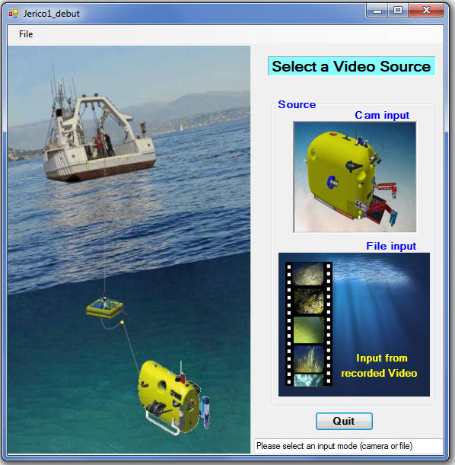
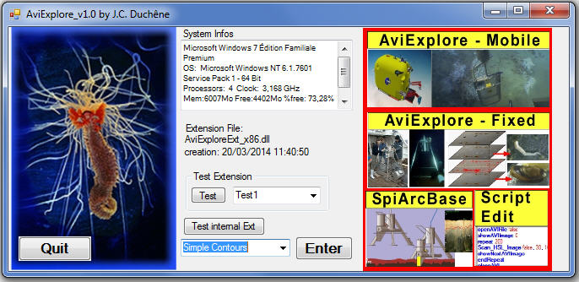
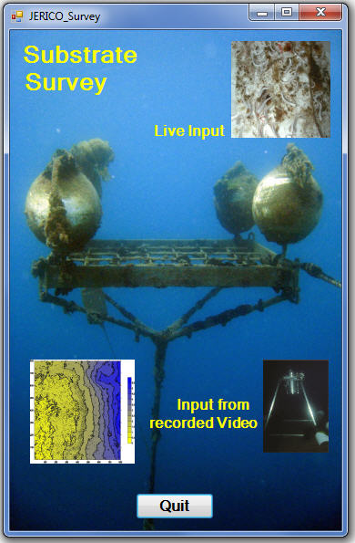
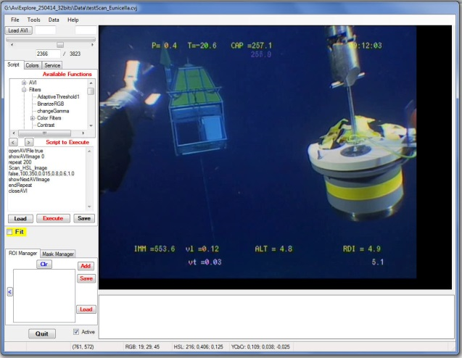
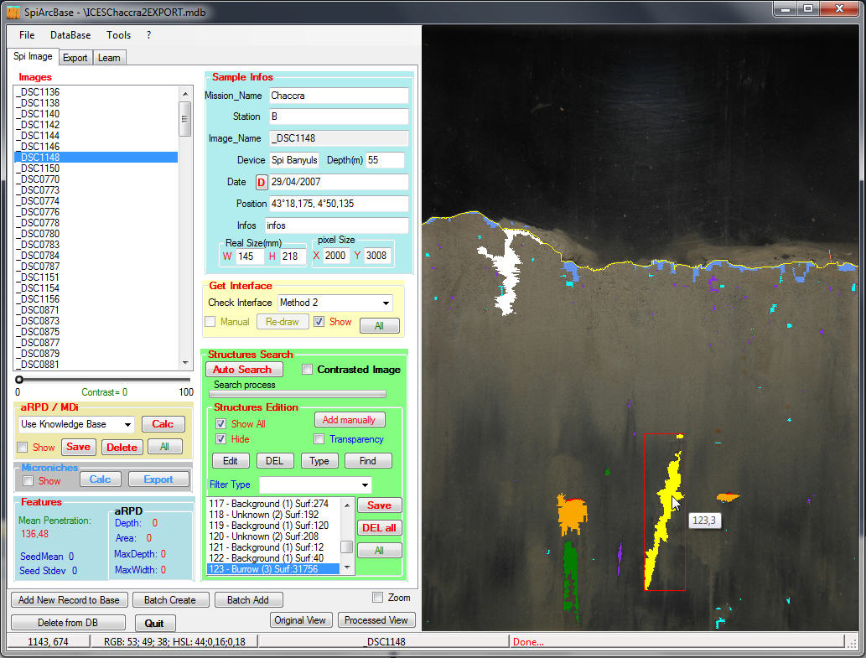
AviExplore program
1 - Mobile
2 - Fixed
3 - SpiArcBase
Script Editor
(common to the 3 modules)

Slide 3
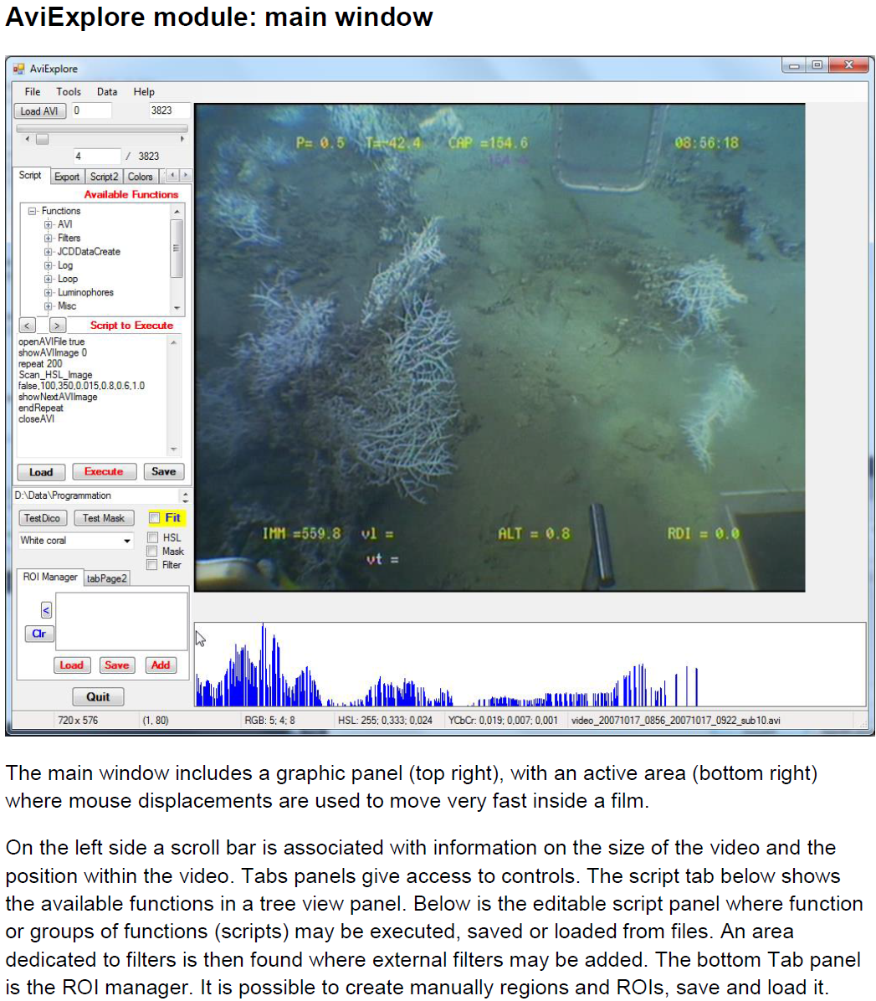
Example of a page of the
User guide

