Slide 1
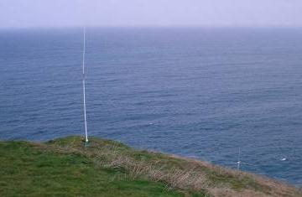
Future strategy IN COASTAL OBSERVATION INFRASTRUCTURE
HF Radar, Discussion on H2020 proposal
Julien MADER I AZTI-Tecnalia I jmader@azti.es
Patrick GORRINGE I EuroGOOS I patrick.gorringe@eurogoos.eu
Wed May 7th 2014, Oslo

Slide 2
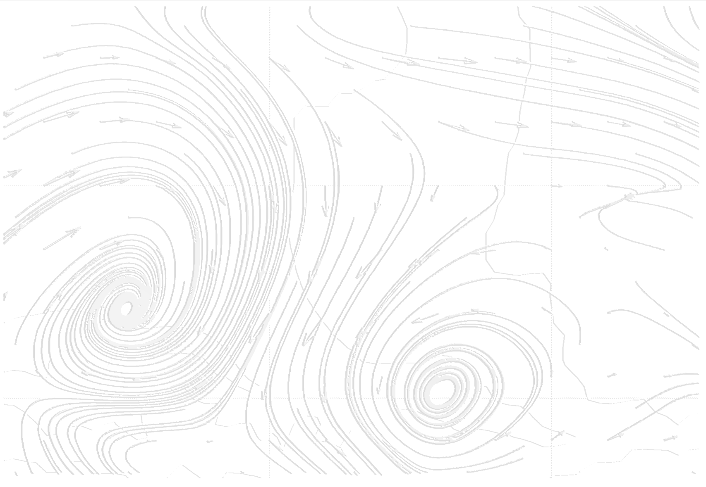
FIRST IDEAS TO ANSWER THE FOLLOWING QUESTIONS
What are the challenges in Europe about HF Radar technology?
How HFR can be integrated in the coastal observatory network?
What can be the possible tasks in networking activities (Best practices)?
Can we propose access to infrastructure (TNA) to do what or virtual access ?
Is there any technological developments we can integrate in the Joint Research Activities (JRA)?

Slide 3
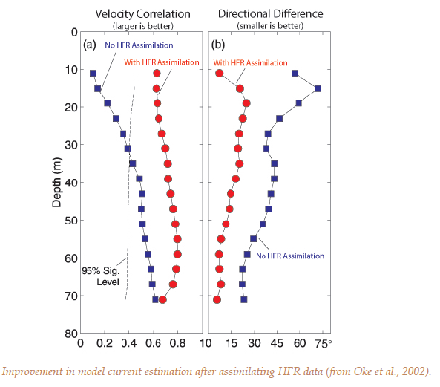
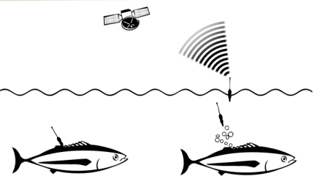
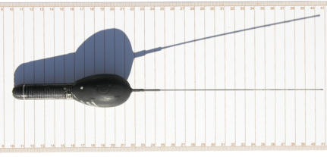
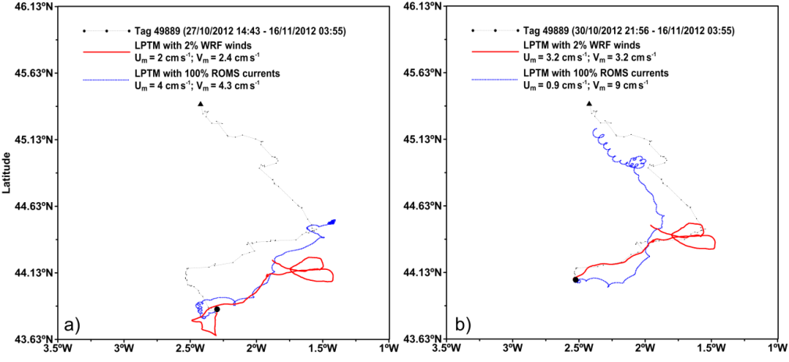
CONTEXT
HFR, key technology for ocean current monitoring (& APPLICATIONS)
Ocean currents determine the movement of surface waters, providing critical information to support pollutant tracking, search and rescue, harmful algal bloom monitoring, navigation route optimization, etc.
Need to improve accuracy of existing operational products on ocean currents
Example in US
Example in Bay of Biscay
Satellite pop-up tag for fish tracking

Slide 4
CONTEXT
HFR, key technology for ocean current monitoring (& APPLICATIONS)
Observing technologies like HF radar and underwater gliders are now currently added to the existing systems.
Benefits:
  In the OO framework:
    Real time high resolution and synoptic assessment of sea conditions
    Direct Real Time products and Short Term prediction products
    Validation / data assimilation for numerical models
  Scientific interest:
    Cover a wide range of spatial-temporal scales in a synoptic way to study ocean processes (HF, spatial structure)

Slide 5
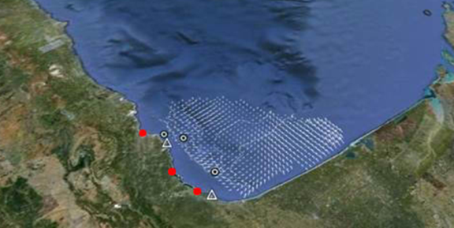


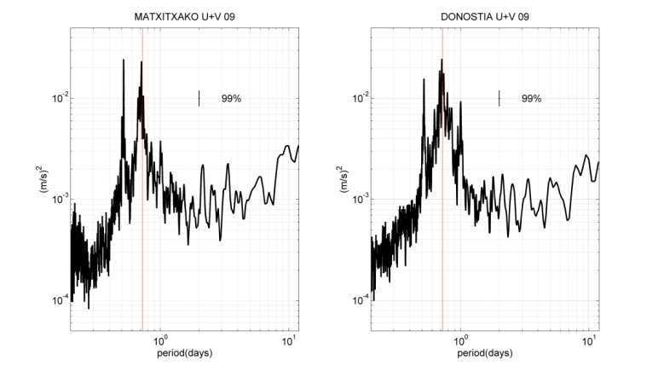
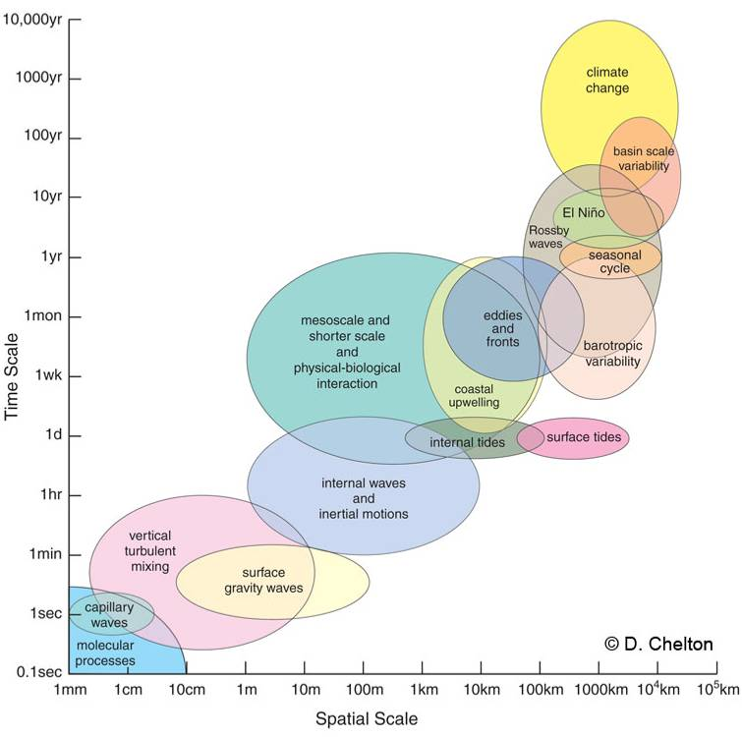
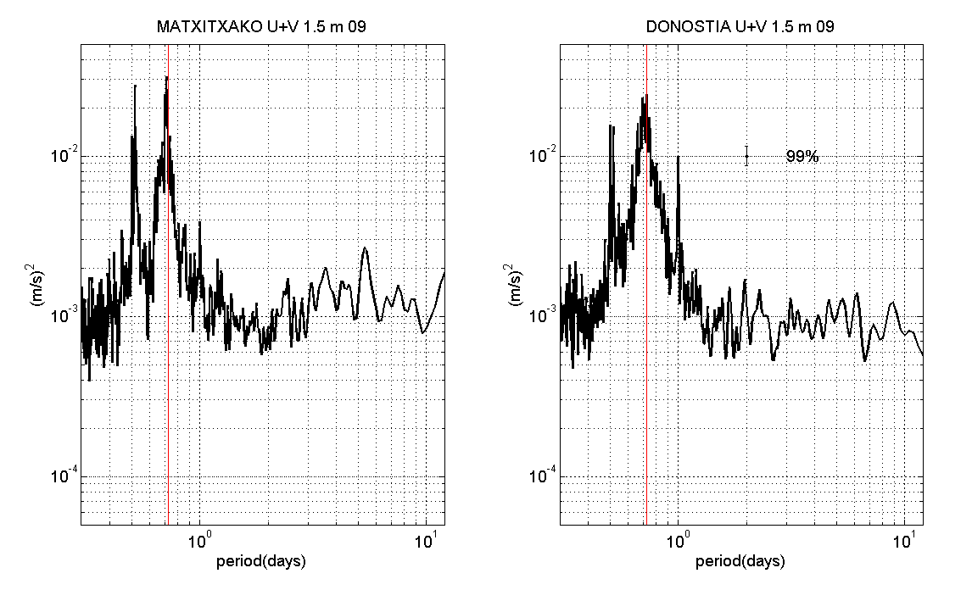
key technology to provide increased spatial and temporal resolution
MATXITAKO
DONOSTIA
Spatial and temporal scales of ocean processes(D. Chelton, 2001).
HF Radar
SD
f
f
SD
D
D
BUOY ADC 1,5 m
SD
f
f
SD
D
D
Mesoscale (50-500 km/ 10-100 days) is the dominant signal in the ocean (Le Traon and Morrow, 2001)
MAIN LOCAL PEAKS
D: diurnal
SD: semidiurnal
f: inertial

Slide 6
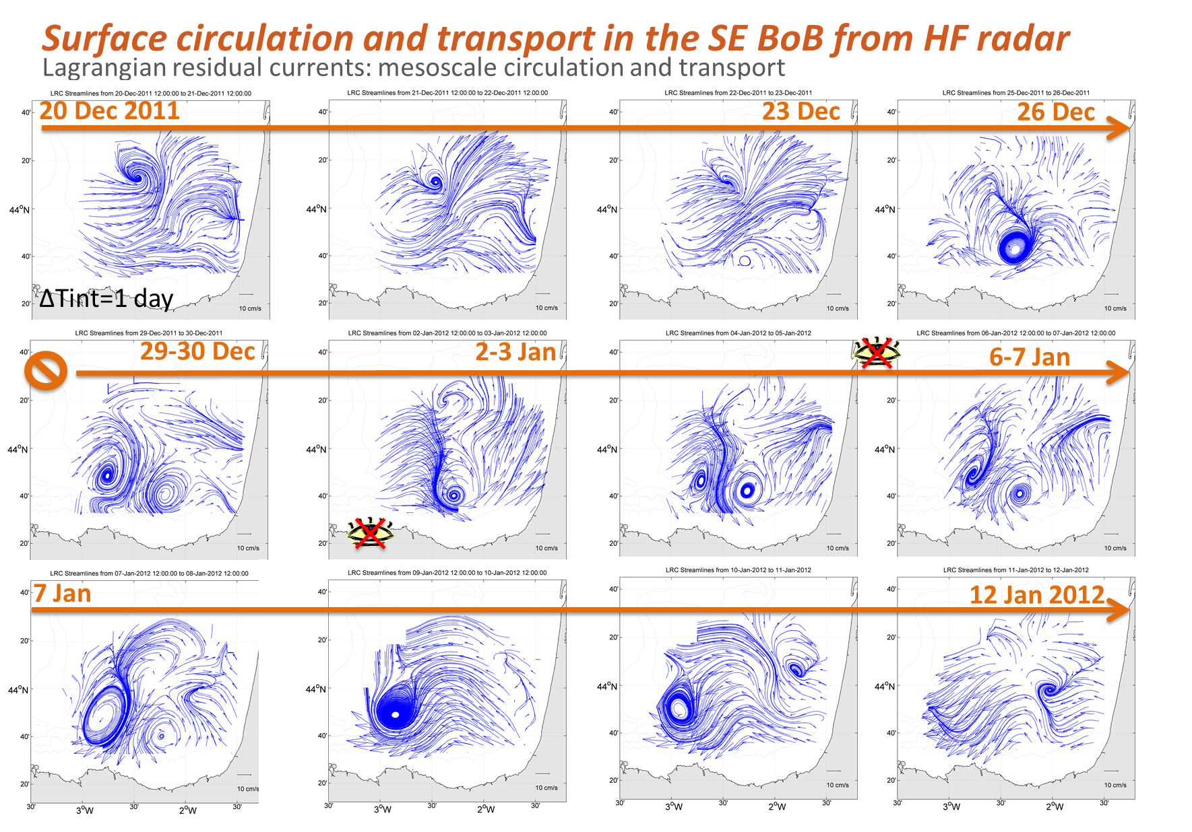
key technology to provide increased spatial and temporal resolution
NEW PERSPECTIVES ON COASTAL PROCESSES

Slide 7

Three Key Components for IOOS
HF Radar is recognized as a cost-effective solution IN IMPORTANT coastal observatories
Observing
  High-Frequency (HF) Radar (operational)
  Gliders (being developed)
  Animal Telemetry Network (ATN, planning)

Slide 8
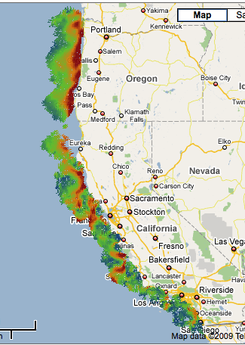
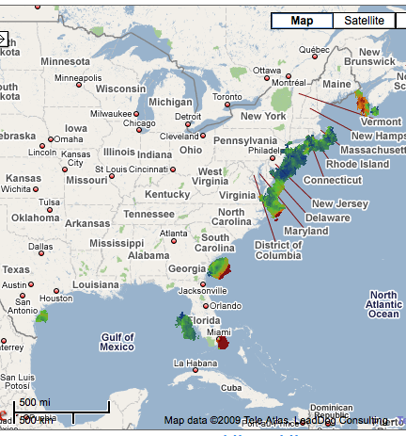
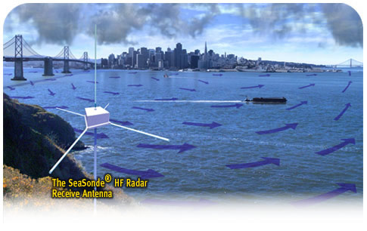
HF Radar as a leading Component
for Coastal Ocean Observing System
(hourly, 1-km)

Slide 9
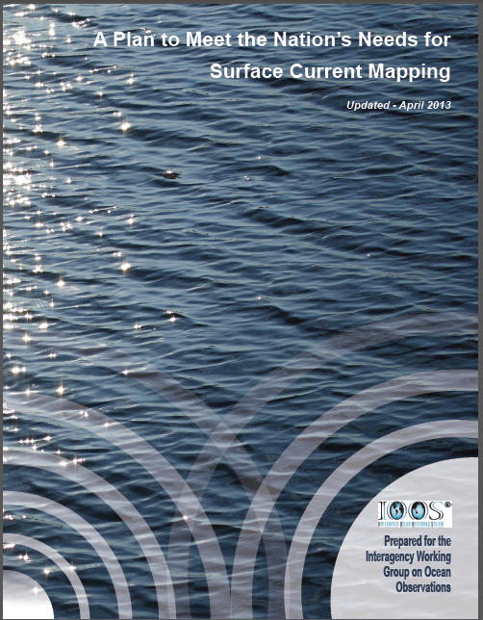
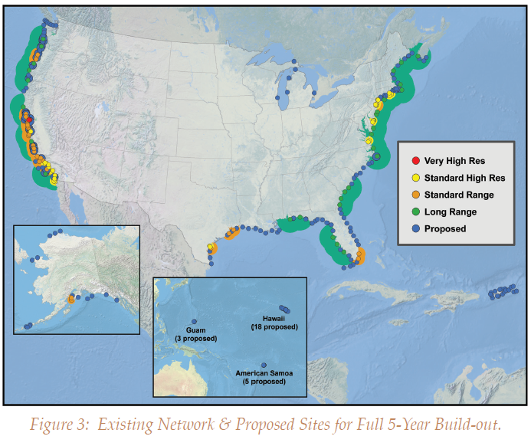
HF Radar as a leading Component
for Coastal Ocean Observing System

Slide 10
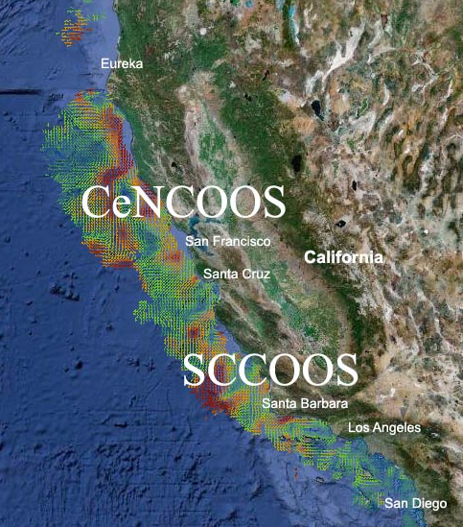
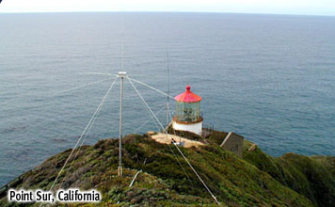
California High-Frequency (HF) Radar Network
In 2005, the California State invested $21 million to install 54 HF radar systems.
US IOOS is now providing $1.5M/year to operate the California HF radar network

Slide 11
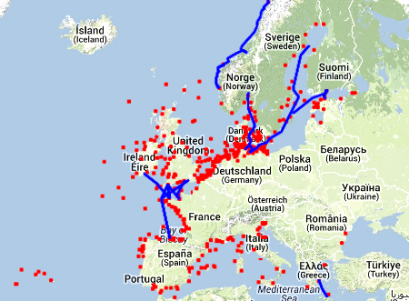


There are A SIGNIFICANT NUMBER OF HFR systems along European coast but until now not a global strategy neither view of the coverage (and gaps)
SOME OPERATIONAL HF RADAR SYSTEMS OVER EUROPE
(non-exhaustive)

Slide 12
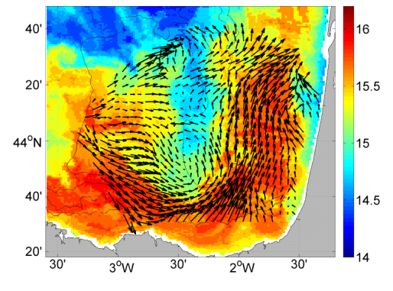
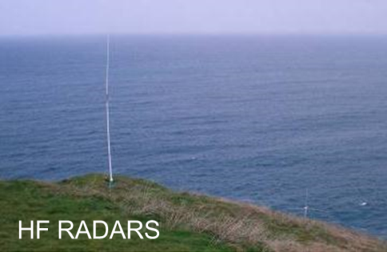
Towards an integrated European Ocean Observing System
One challenge: HFR network integration
Integration with other in situ coastal platforms (gliders, fixed, ferrybox,…)
Integration with in situ open ocean platforms
Integration with Ocean Surface Currents (OSC) satellite products; collaboration with GLOBCURRENT

Slide 13

EXAMPLE OF USEFULL METHODOLOGY FOR INTEGRATION
Surface circulation and transport in the SE Bay of BISCAY

Slide 14
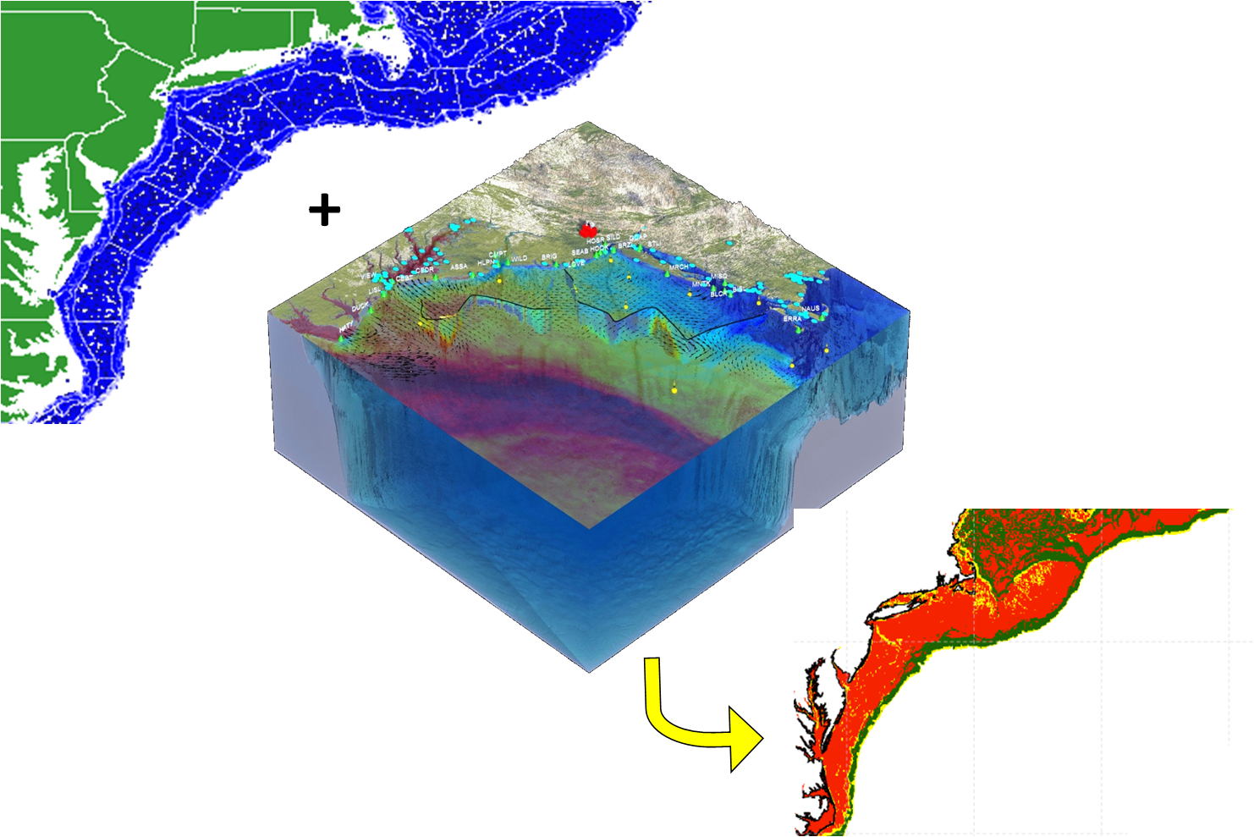

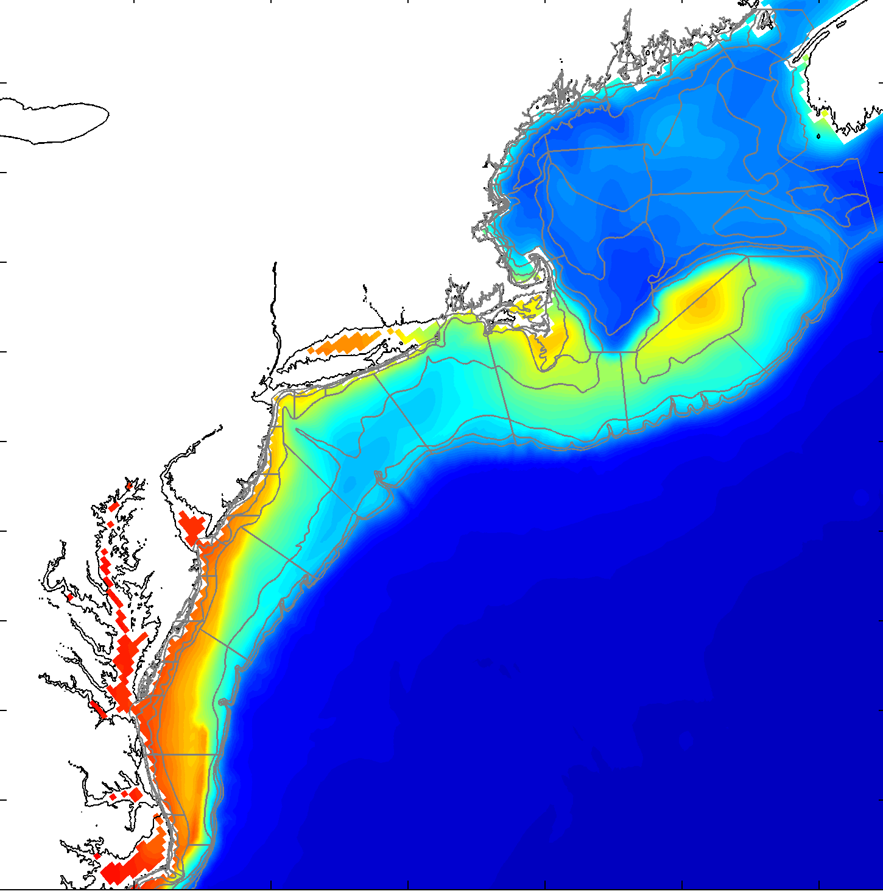
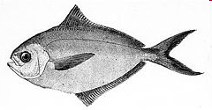
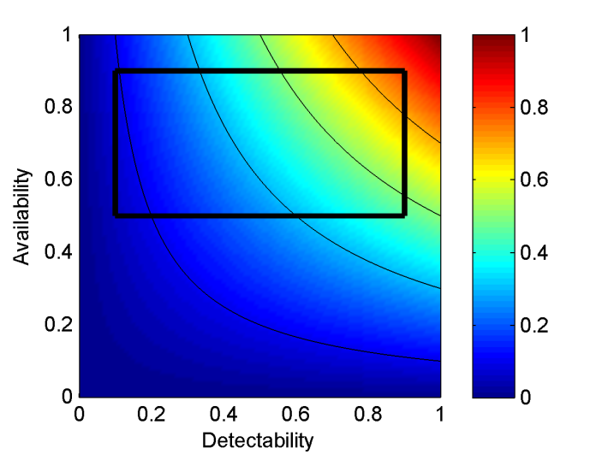


NOAA US
Fishery Data
EXAMPLE OF METHODOLOGY FOR INTEGRATION
BIOLOGICAL APPLICATIONS
Regional
Habitat
Projections
3D Ocean
Observations
+
Physical Models
Catchability = availability * detectability
To Inform Existing Single Species
Stock Assessment Models
(Catchability/Availability)

Slide 15
Towards an integrated European Ocean Observing System
Strategy for ocean current monitoring and progress in the design of an optimum observing system along the European coast
Taking into account the capacity of coastal ocean modelling for extrapolation, the use of HFR for process-oriented validation, data assimilation and diagnostic for high resolution open boundary conditions for coastal grids.

Slide 16
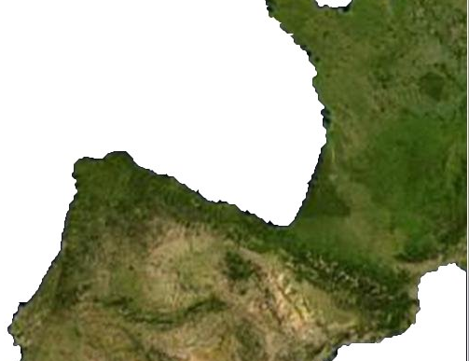
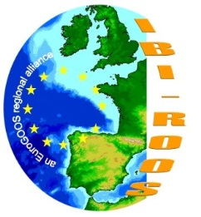
HF Radar, Key technology for process oriented validation

Slide 17
NEED TO PUSH THE INTEGRATION OF HFR platforms AT EUROPEAN LEVEL
A first initiative:
European HF Radar Networking for data sharing and delivery

Slide 18



HF Radar Group
EuroGOOS has been asked, within EMODnet Physics to:
”Initiate a coordinated approach to HF radar data in Europe”
User-driven European Network of HF radar experts

Slide 19

HF Radar Group
    1st informal meeting as a side event at the MyO Annual Meeting in Athens (27th March) to establish the group, discuss common issues, and presentations from group members ~ 18 attendees
    Splinter session on EMODnet Physics/HF Radars at EGU, 29th April, Vienna
    Next meeting as a side event to the EuroGOOS Conference in Lisbon
    http://eurogoos2014.hidrografico.pt
Interested to join?
Contact: patrick.gorringe@eurogoos.eu

Slide 20
HF Radar Group
Endorse a task to plan a European HF Radar Network for data sharing and delivery.
First step, make an inventory of existing networks in Europe.
Then discuss some of the challenges such as:
Data file formats
Data distribution and exchange
Data assimilation into operational models
Make use of the EuroGOOS ROOSs and available ROOS data portals for dissemination of data
Link to other similar ongoing initiatives on a regional and global scale……such as:

Slide 21
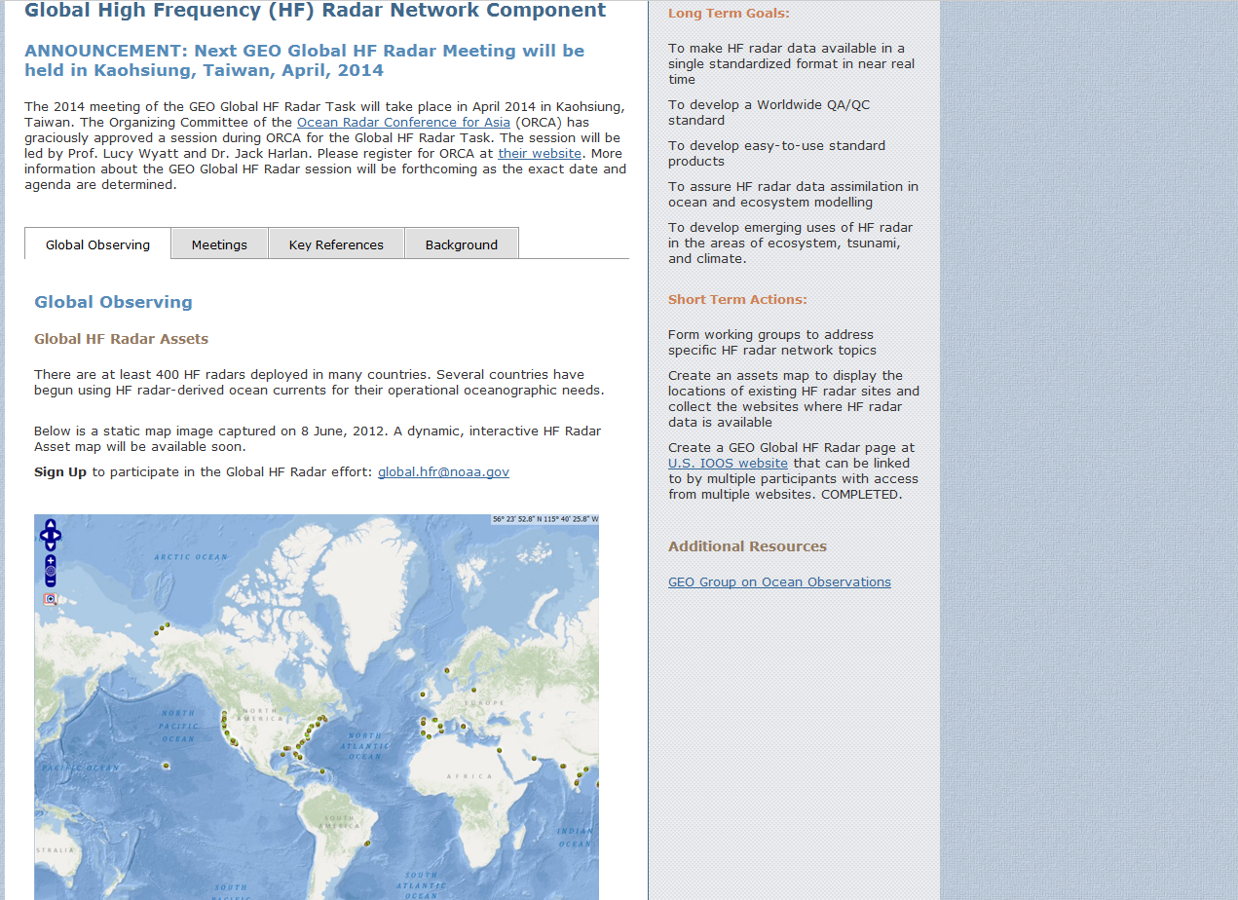
GEO HF Radar Global Task, www.ioos.noaa.gov/globalhfr/welcome.html

Slide 22
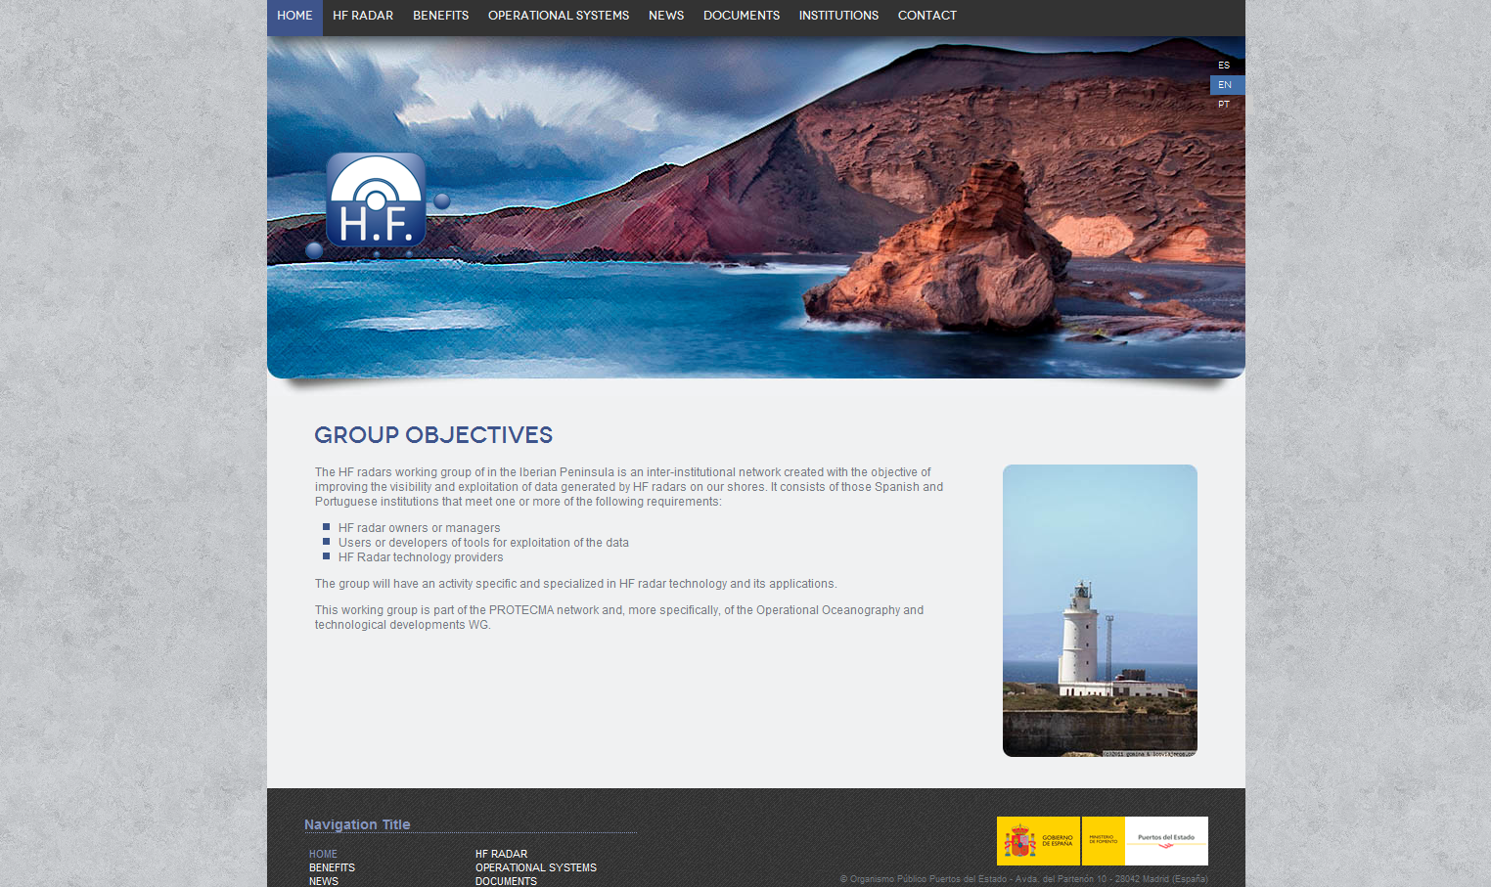
The Iberic Network of HF radars, www.iberoredhf.es

Slide 23
NEED TO PUSH THE INTEGRATION OF HFR platforms AT EUROPEAN LEVEL
HF Radar group driven by EuroGOOS - EMODnet Physics
→ European HF Radar Networking for data sharing and delivery
HF Radar component in an INFRAIA project would provide:
Technical input to this European network of users (Best practices, procedure harmonization, format standardization)
Integration of this key technology in the coastal observing network
Reinforcing the European role in the international community (led by US and AUS)
Integrating technological knowledge and developments (often academic) on HFR to make available actual operational solutions

Slide 24
POSSIBLE tasks in networking activities (Best practices)
Overview of regional components
Overview of technologies & harmonization
Operation and Maintenance Harmonization
1) Good practices for operating HFR radar; Frequency sharing & coordination with ITU
Inventory of technologies; best practices & identification of limitations and difficulties
Supplement the GEO task database with the up to date relevant information on each HFR in Europe
Scheme for the sharing of the frequencies bands with the neighbor countries to avoid interference
2) Data formats, processing, quality & management
Manual on HFR data format and processing on each step of the product levels
Manual on data validation and data quality
Agreement on a common format taking account of any existing international standards
List of protocols for the cross-validation and complementarities with in situ instruments and satellite observations
3) Applications & innovation
Inventory of end-user applications (lagrangian products, drift short term forecasting)
Review of scientific applications (descriptive physical oceanography and applications);
Assimilation techniques in forecasting models
4) Dissemination
Document on possible extensions of the radar network
Document on synergetic use of HF radar with other observation platforms (e.g. satellites, tide gauges)

Slide 25
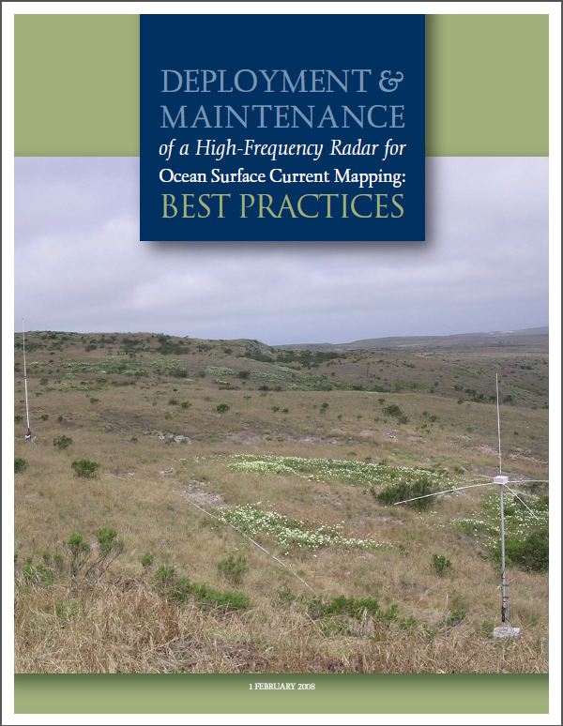
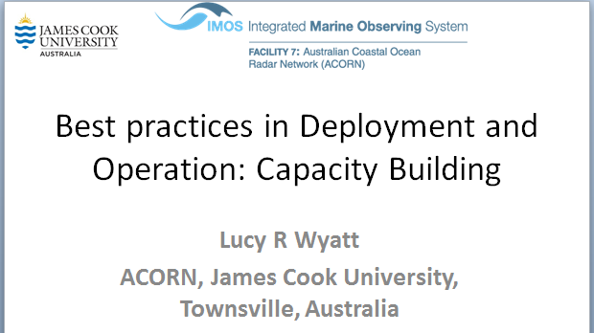
FIRST: WE WILL LOOK AT PREVIOUS EXPERIENCES!
AT LEAST FROM USA and AUS. THEN ADD European specificities
Southern California Coastal Ocean Observing System (www.sccoos.org)
Australian Coastal Ocean Radar network (ACORN)
(http://imos.org.au/acorn.html)
What were the main issues during the installation phase?
  Site Selection and Approvals
  Radar choice
  Environmental Concerns – electromagnetic
  Environmental Concerns – impacts on ground, plants, animals, views
  Power
  Communications
Operations, monitoring and maintenance
  Calibration
  Power outages and communication failures
  Air-conditioning
  Radar system robustness
  Security

Slide 26
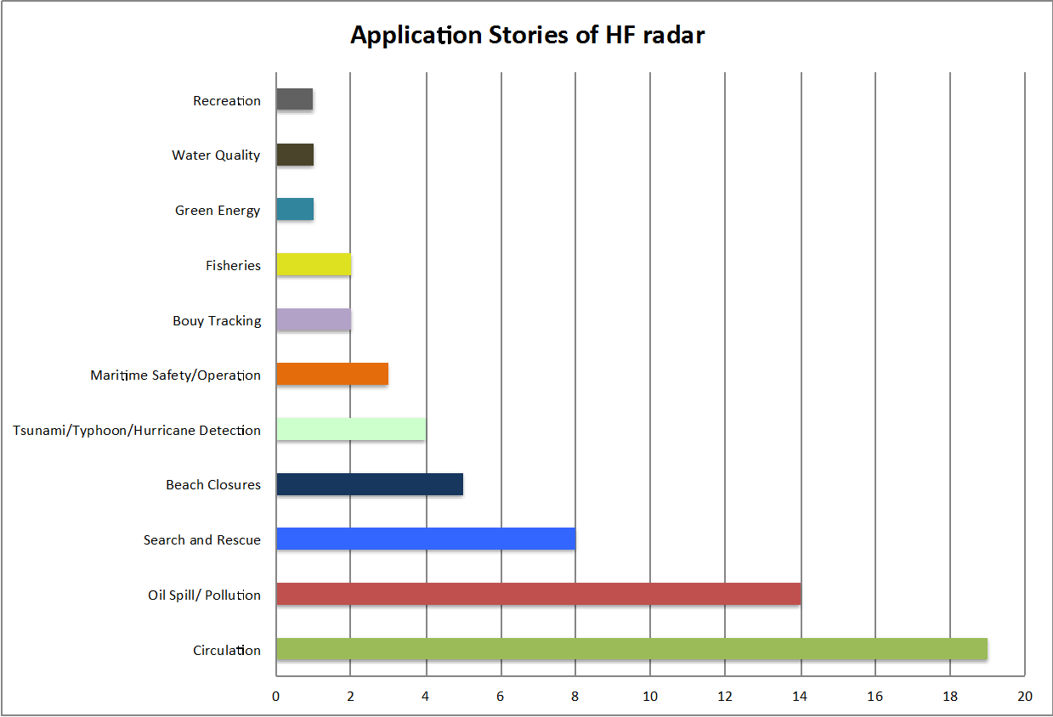
Can we propose access to infrastructure (TNA)? virtual access ?
Operational stations difficult to tune for specific purposes
But Access to HFR Infrastructure for:
working on raw data for technological comparisons
working on Data products
  Quality controlled radial currents plus error (Level 1)
  Gridded total vector velocities (Level 2)
  Objective analysis of gridded surface current maps (Level 3)
working on Application products
working on process oriented study sharing data in a common or similarly driven area
HF RADARS

Slide 27
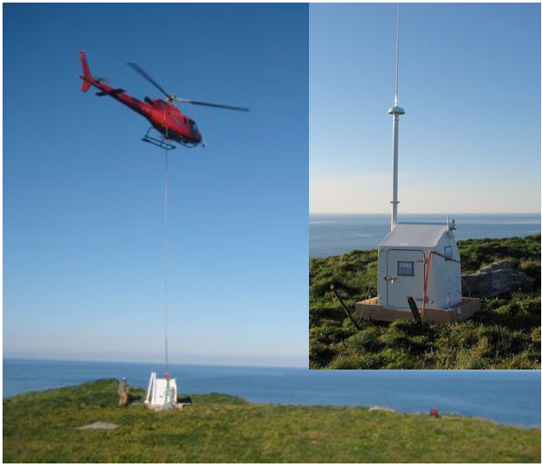
innovative Technological Developments
HF RADARS
Technological developments for new technological solutions
Rapid Deployable HF Radar (NOFO Technology Development Program (CODARNOR, CODAR, the Norwegian Meteorological Institute and QUALITAS)
New products for wave data, wind data, ship detection, etc.
New developments (Pierre Flament, Louis Marié…)
…

Slide 28
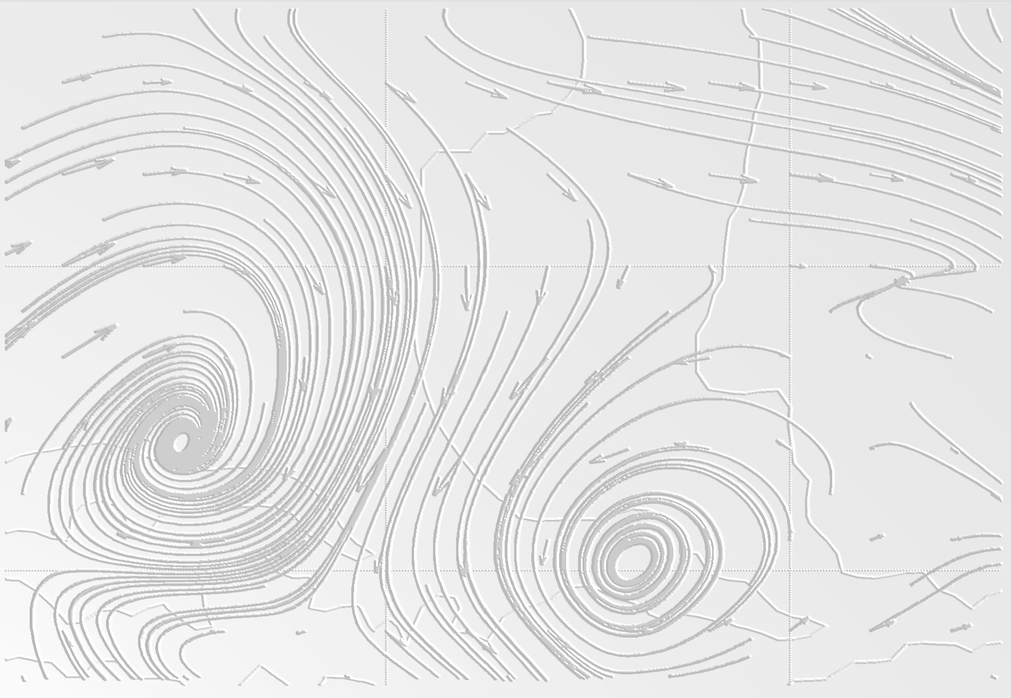


HF Radar, Future strategy IN COASTAL OBSERVATION INFRASTRUCTURE
HF RADARS
THANK YOU FOR YOUR ATTENTION!
Wed May 7th 2014, Oslo

