Slide 1
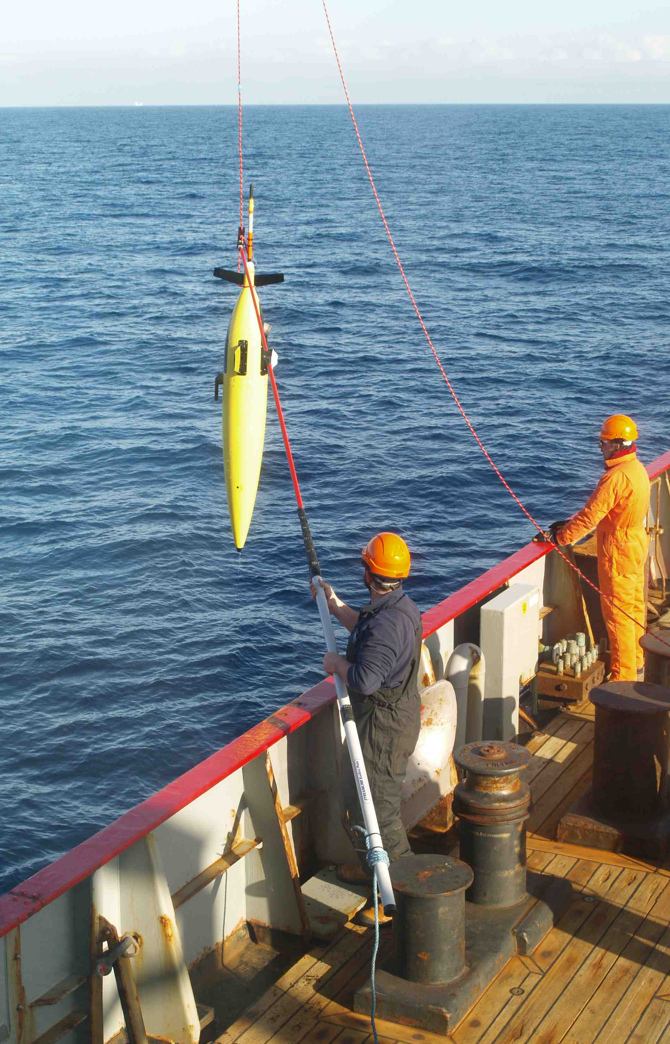
Seagliders as a multidisciplinary ocean observing platform
Rob Hall
School of Environmental Sciences
University of East Anglia
robert.hall@@uea.ac.uk
www.ueaglider.uea.ac.uk
With UEA colleagues Karen Heywood, Jan Kaiser, Gillian Damerell, Bastien Queste, Ben Webber, Adrian Matthews, Gareth Lee and Stephen Woodward
Notes:
Introduction slide

Slide 2
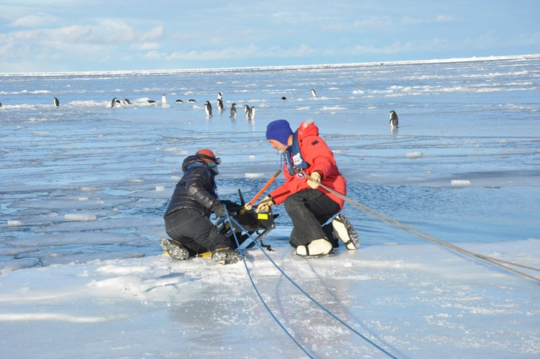
Seagliders : a new component of the ocean observing system
Ocean gliders weigh 50 kg in air, use buoyancy changes to descend/ascend
20-30 cm s⁻¹ horizontal, 10-20 cm s⁻¹ vertical speeds
Maximum profile depth 1000 m, minimum 50 m
At the surface, they transmit data back in real time via satellite & receive new piloting instructions
Surface every 15 minutes for shallow dives or 4-6 hours for 1000 m dives
Ideal for winter or rough weather
Work autonomously with set waypoints or in virtual mooring mode
Missions of up to ~ 6 months’ duration
Designed by UW, formerly licenced to iRobot, now to Kongsberg
Notes:
Introduction slide

Slide 3
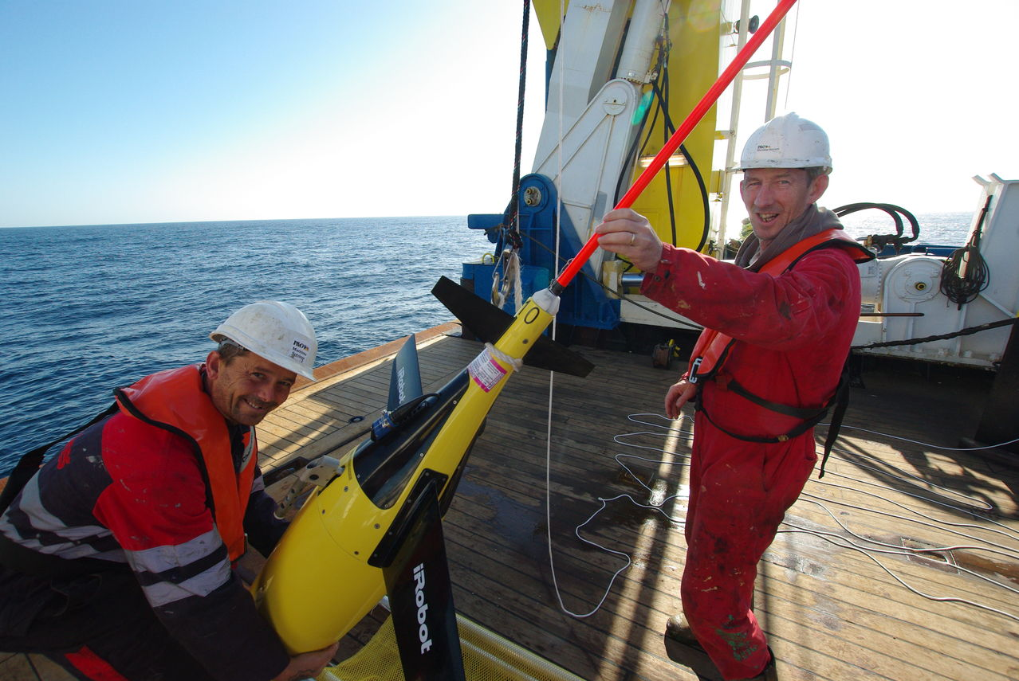
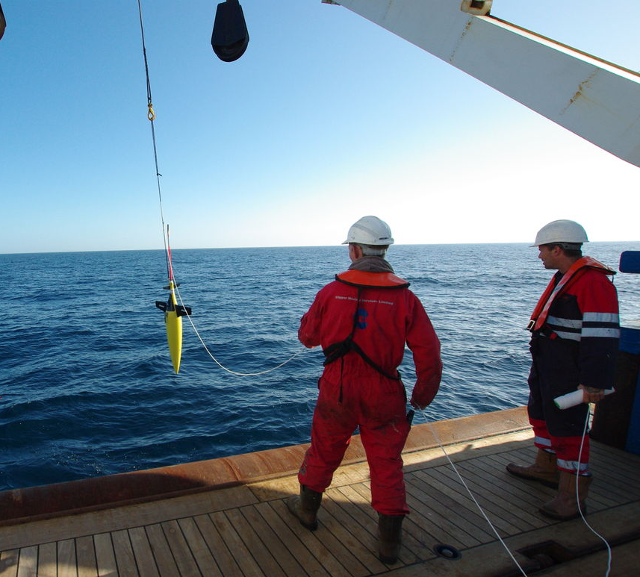
Seaglider sensors
CTD – temperature, salinity and pressure
Dissolved oxygen O2 from Aanderaa optode
Chlorophyll and CDOM fluorescence (Wetlabs triplet puck)
Optical backscatter for particulate carbon (Wetlabs puck)
PAR solar radiation
Bioacoustic echo sounder for zooplankton biomasss
Dive-average current
Surface drift
Independent Argos tag on the glider antenna for emergency location

Slide 4
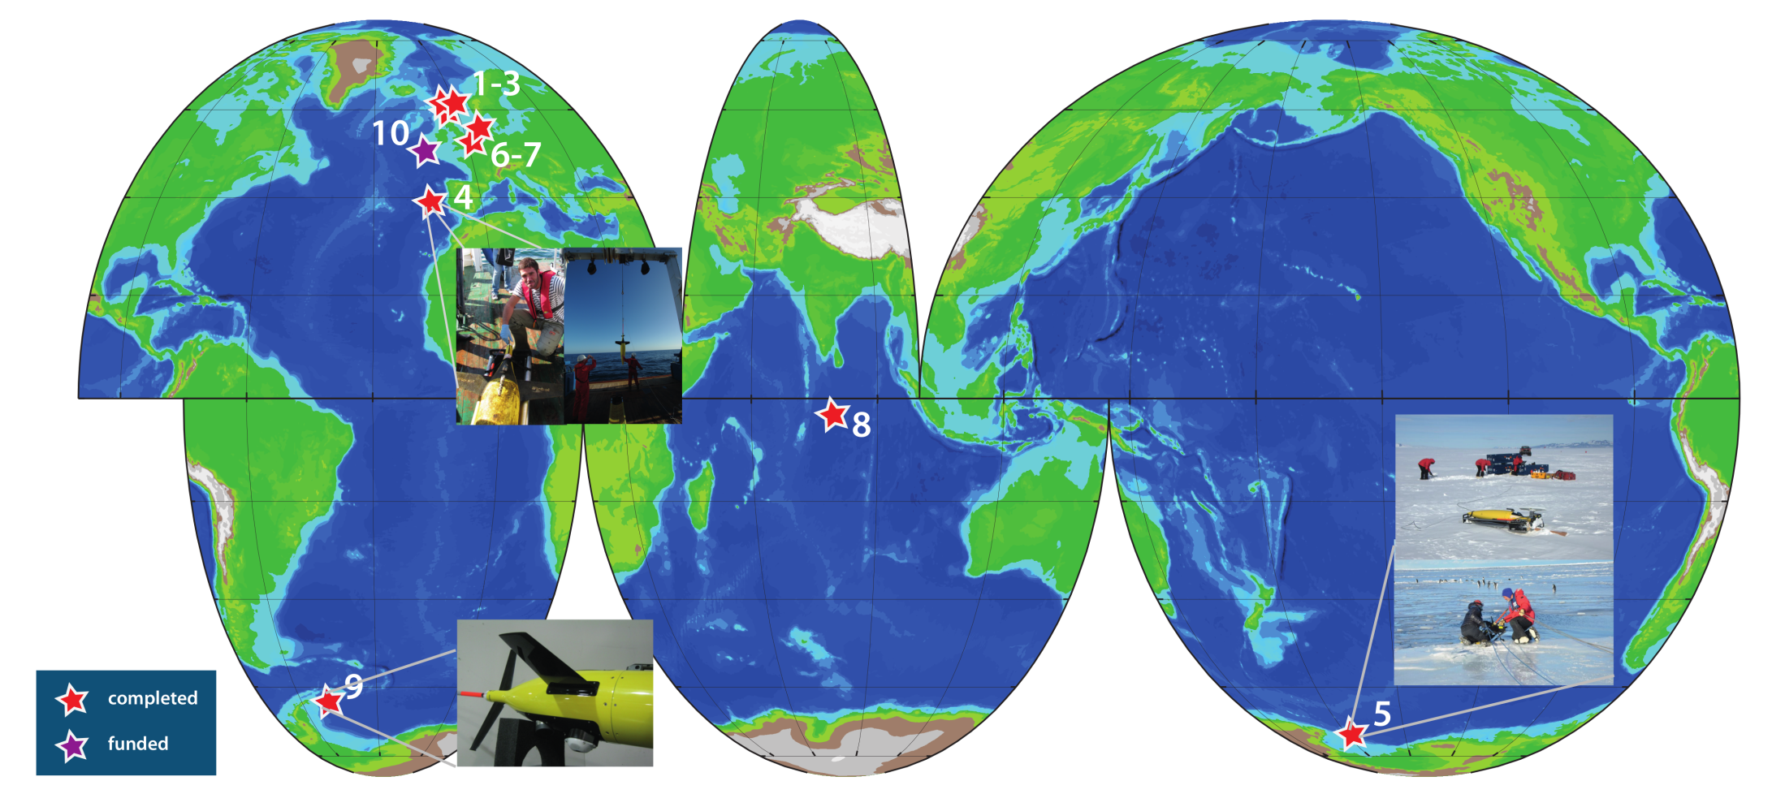
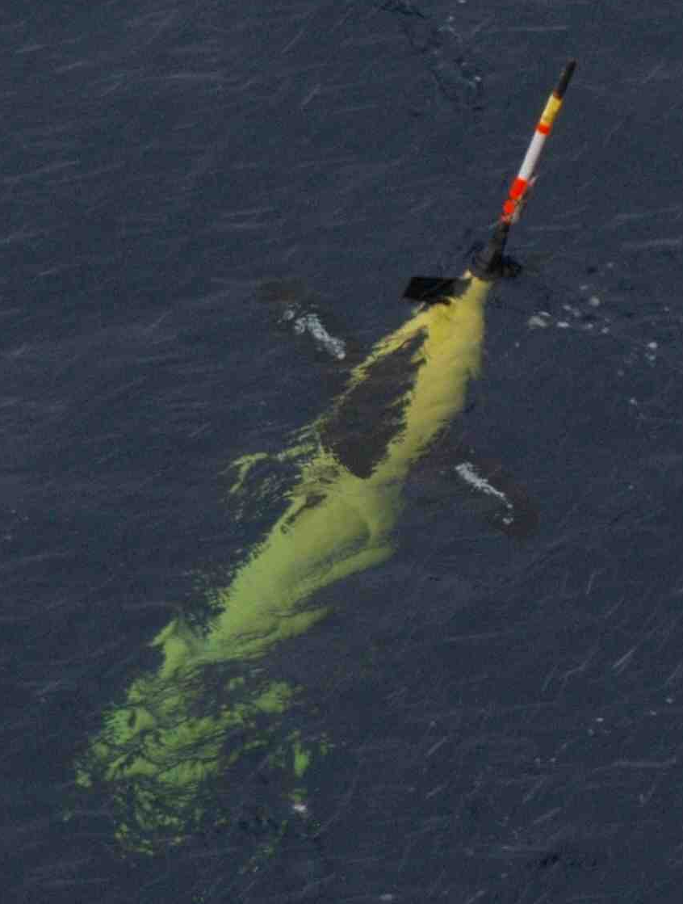
UEA Seaglider Group
Deployments to date:
North Sea, 2013, 1 glider, 2555 dives, 60 glider-days
North Sea, 2010, 1 glider, 181 dives, 5 glider-days
Scotland, 2010, trials of 3 gliders, 90 dives, 5 glider-days
Ross Sea, 2010-2011, 1 UEA glider, 701 dives, 59 glider-days
Vigo, 2010, 1 glider, 1611 dives, 113 glider-days
PAP, 2012-2013, 2 gliders, 4069 dives, 750 glider-days
Indian Ocean, 2011-2012, 1 glider, 738 dives, 131 glider-days
Weddell Sea, 2012, 3 gliders, 795 dives, 104 glider-days
UEA operates a fleet of 4 Seagliders
ueaglider.uea.ac.uk
Notes:
Blue text slide with orange bullet points

Slide 5
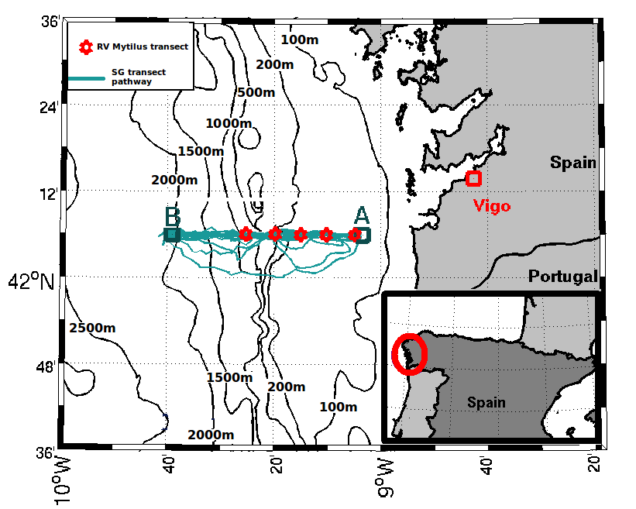
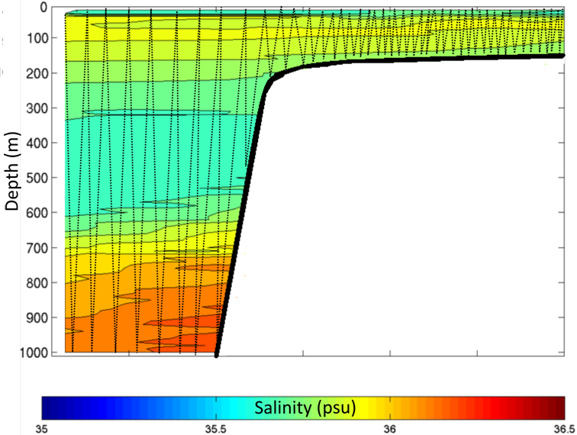
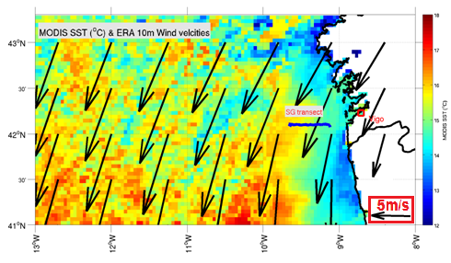
UEA SeaGlider Deployment summer 2010
Iberian continental shelf and slope
50 km section
17 sections June-August
1300 glider dives
CSIC Mytilus Transect
Salinity from Seaglider transect 4
(June 27th- July 3rd).

Slide 6
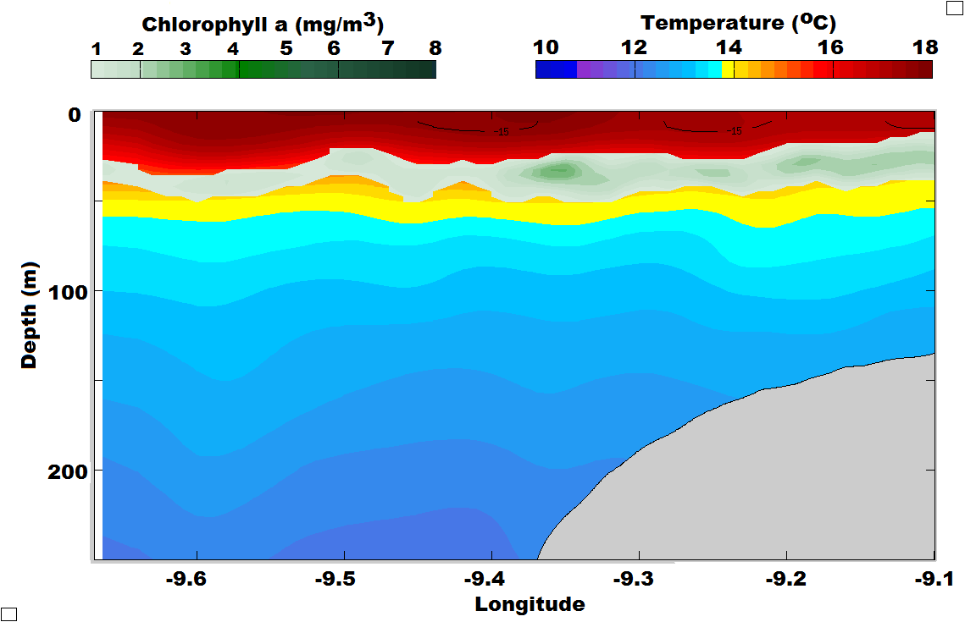
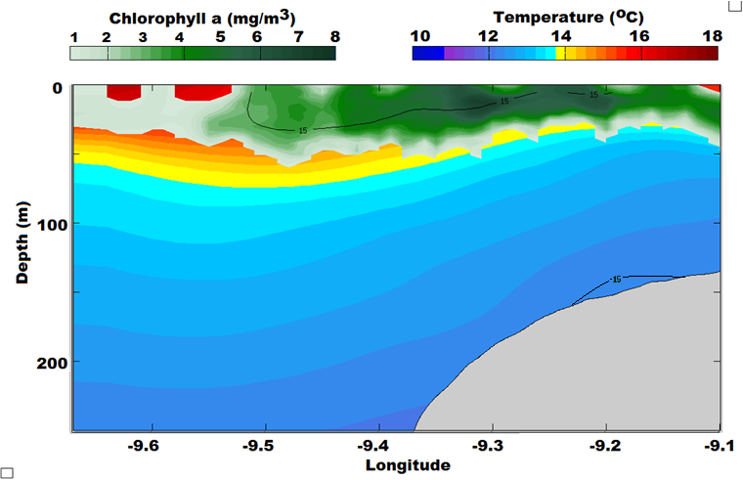
No upwelling, limited productivity
Deep chlorophyll maximum at 30-45m depth
Isotherms are near horizontal
Oxygen depleted near surface
Large bloom event
Isotherms sloping indicating upwelling
Cooler near surface temperatures
Increase in oxygen
Net community production estimated using Seaglider dissolved oxygen measurements

Slide 7
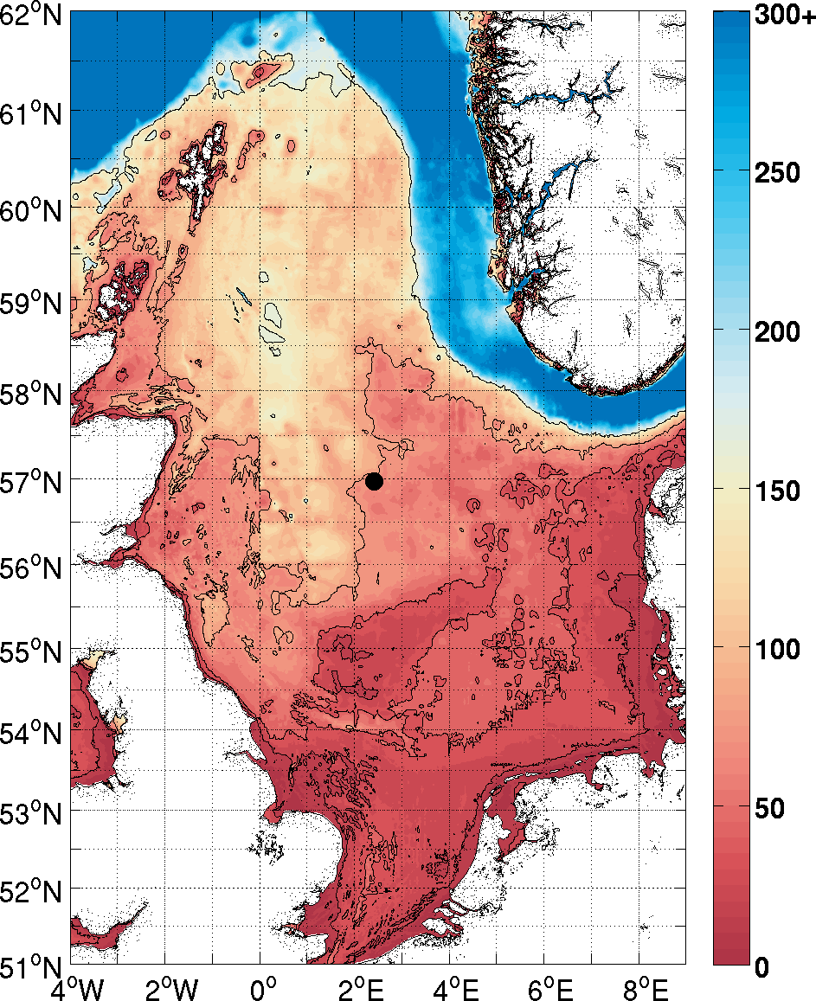
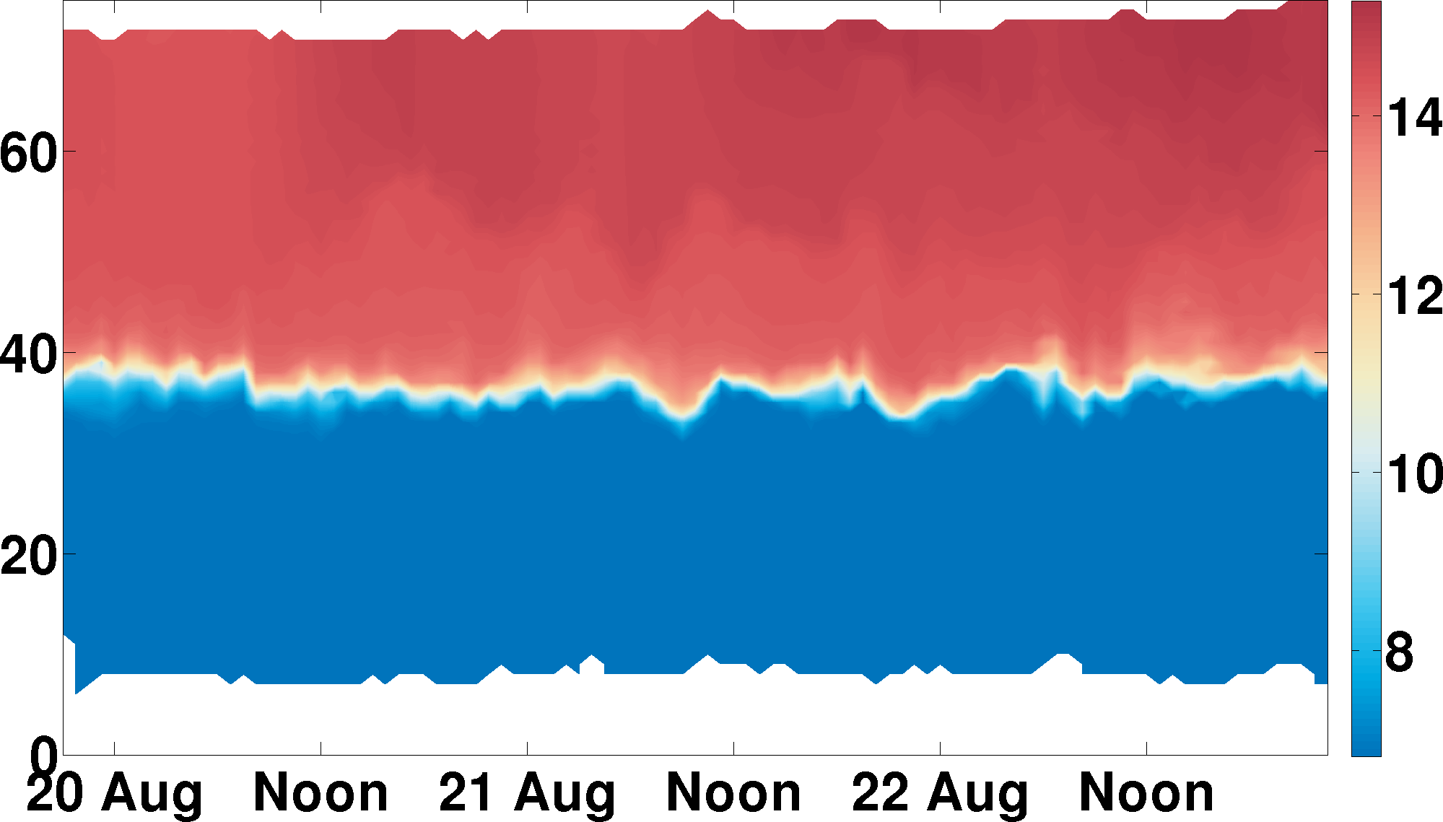
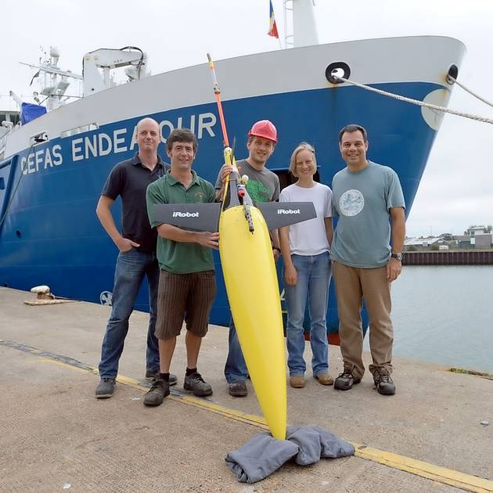
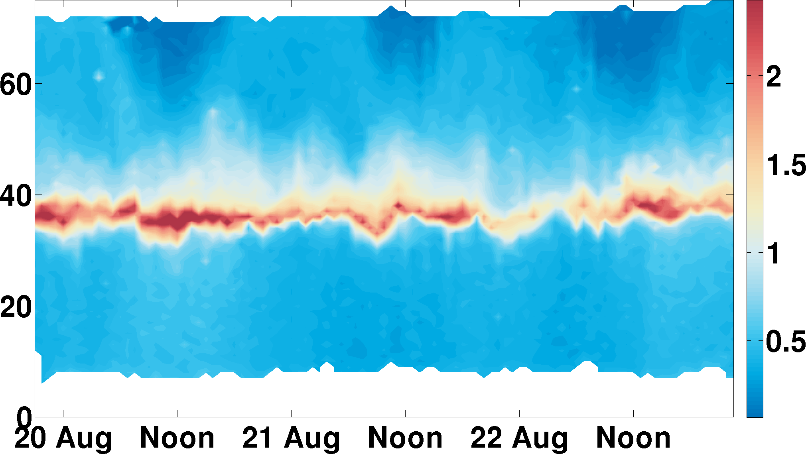
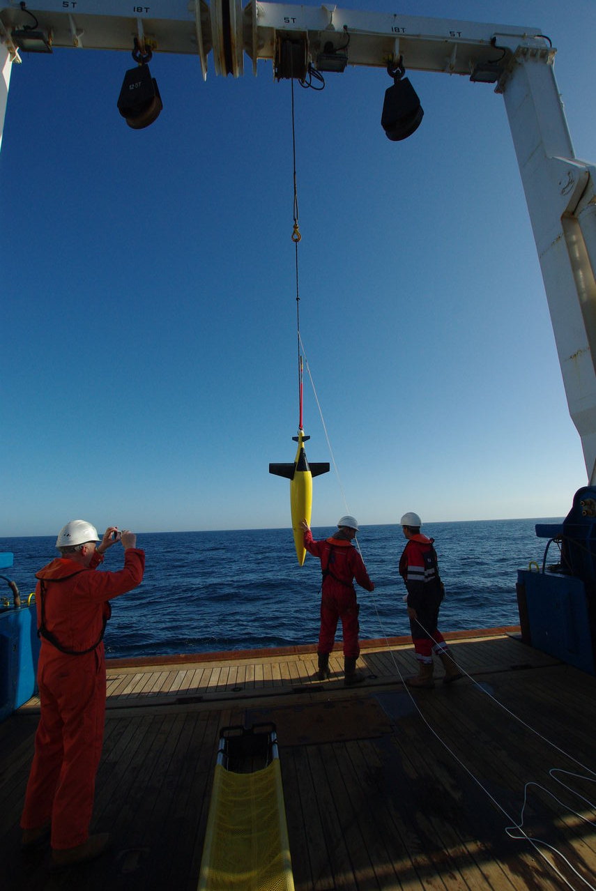
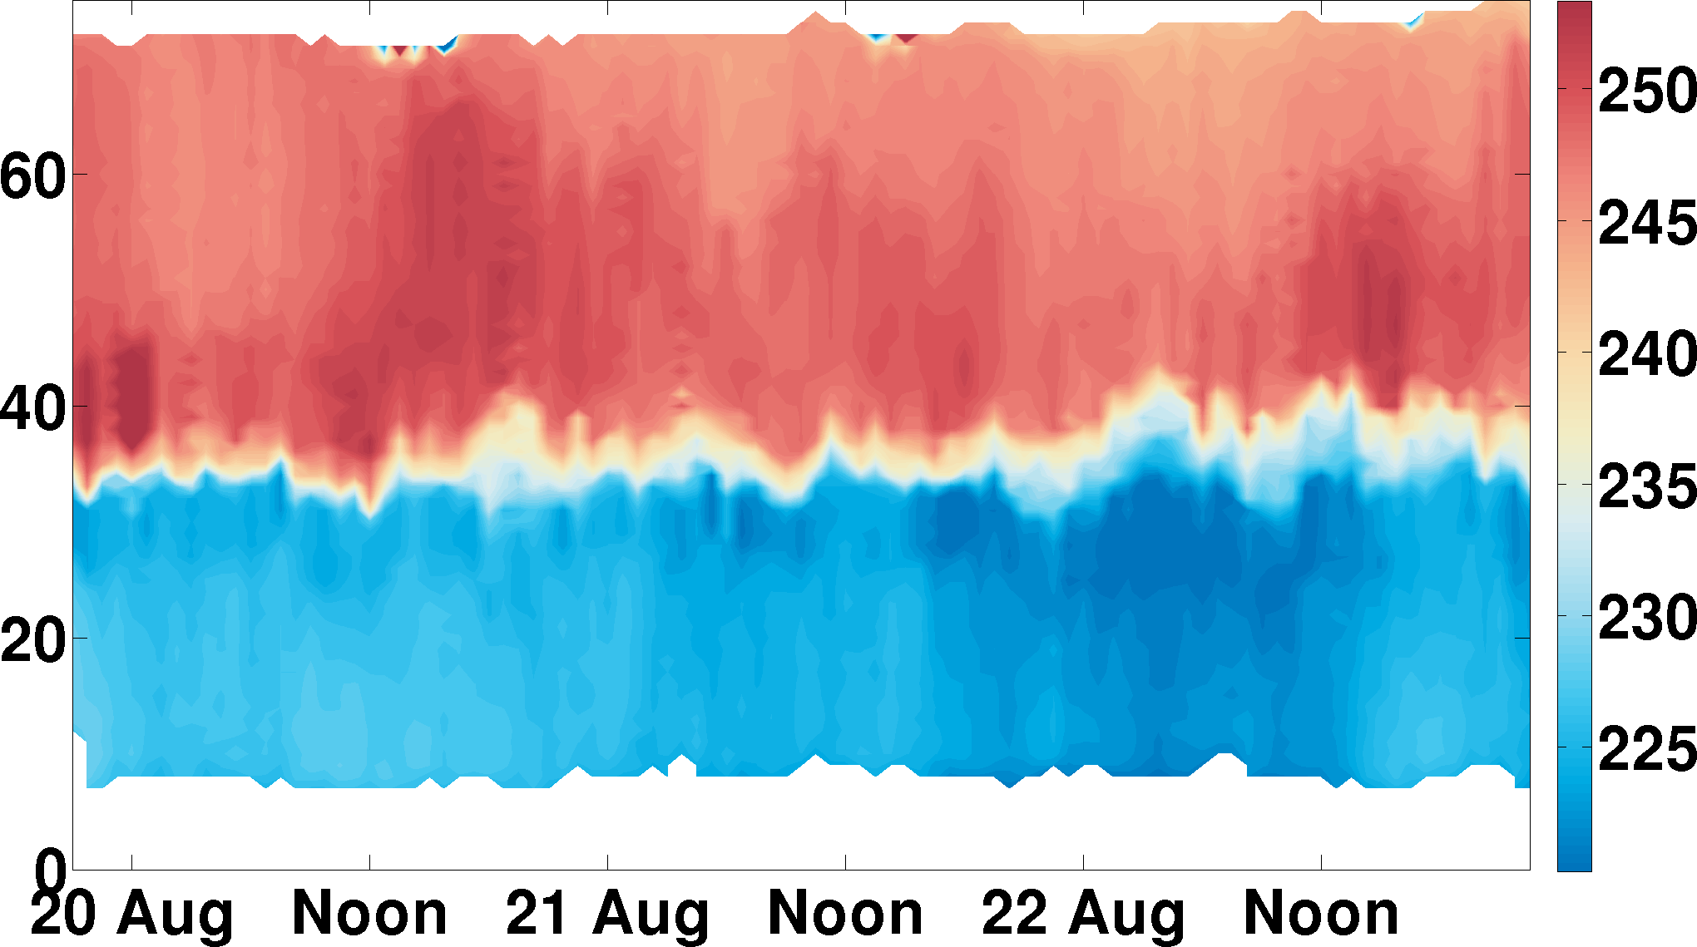
UEA and Cefas Seaglider Deployment
North Sea pilot study summer 2011
Metres above bottom
Temp
Metres above bottom
Chlor
23 + 158 dives
CASE PhD studentship with Cefas
Mechanisms for oxygen depletion
Metres above bottom
Oxy

Slide 8
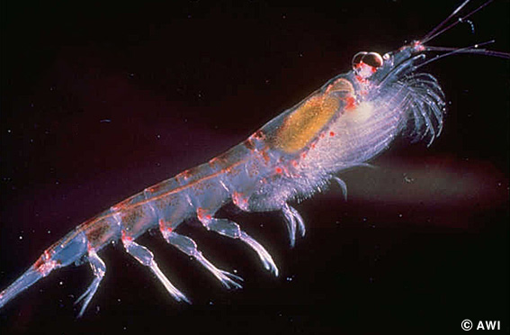
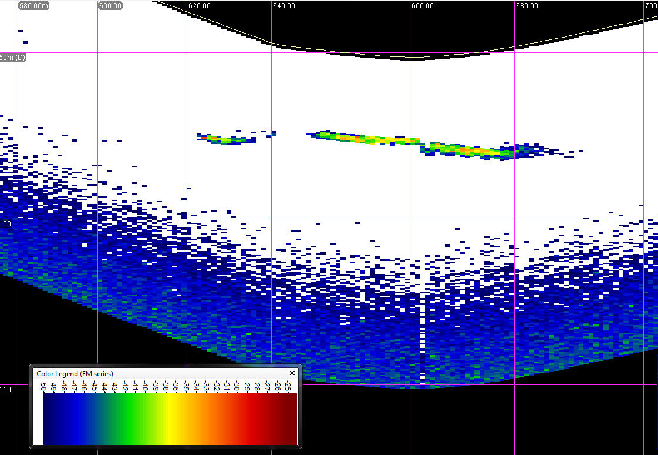
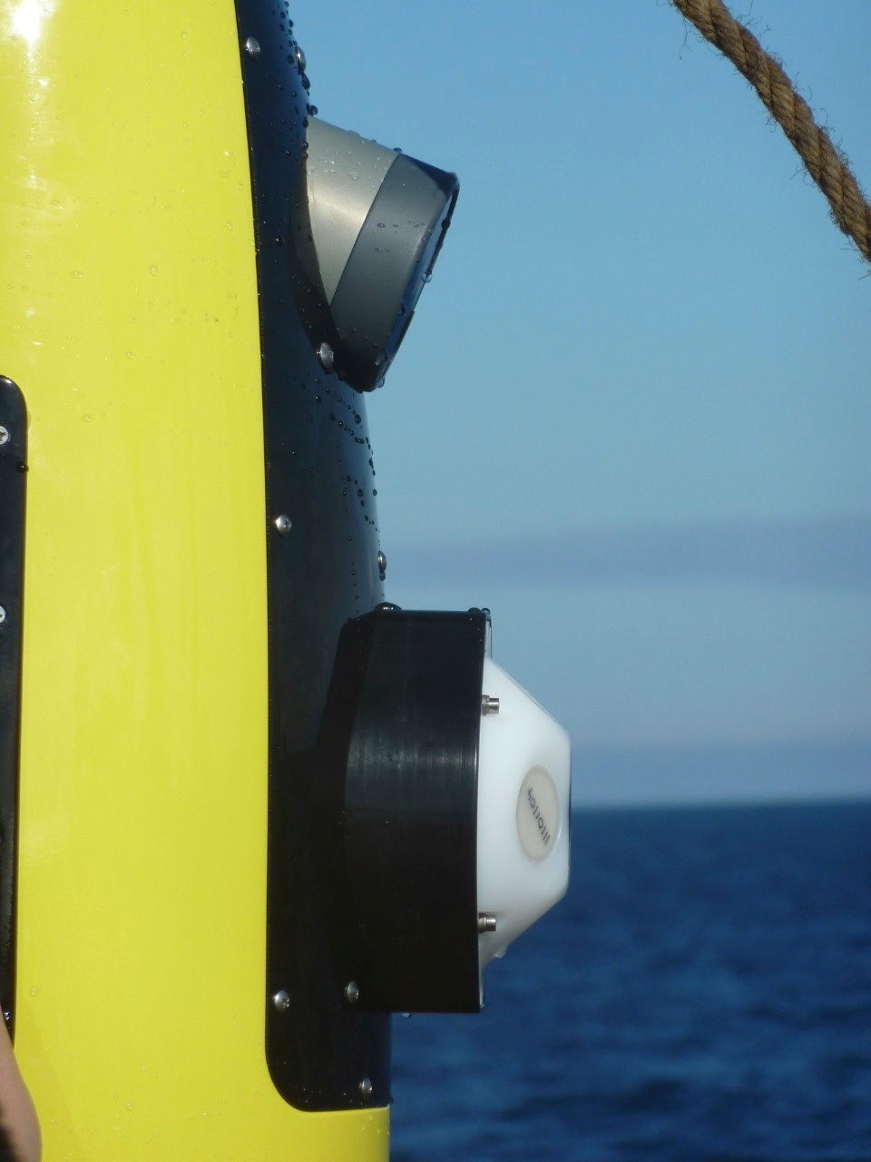
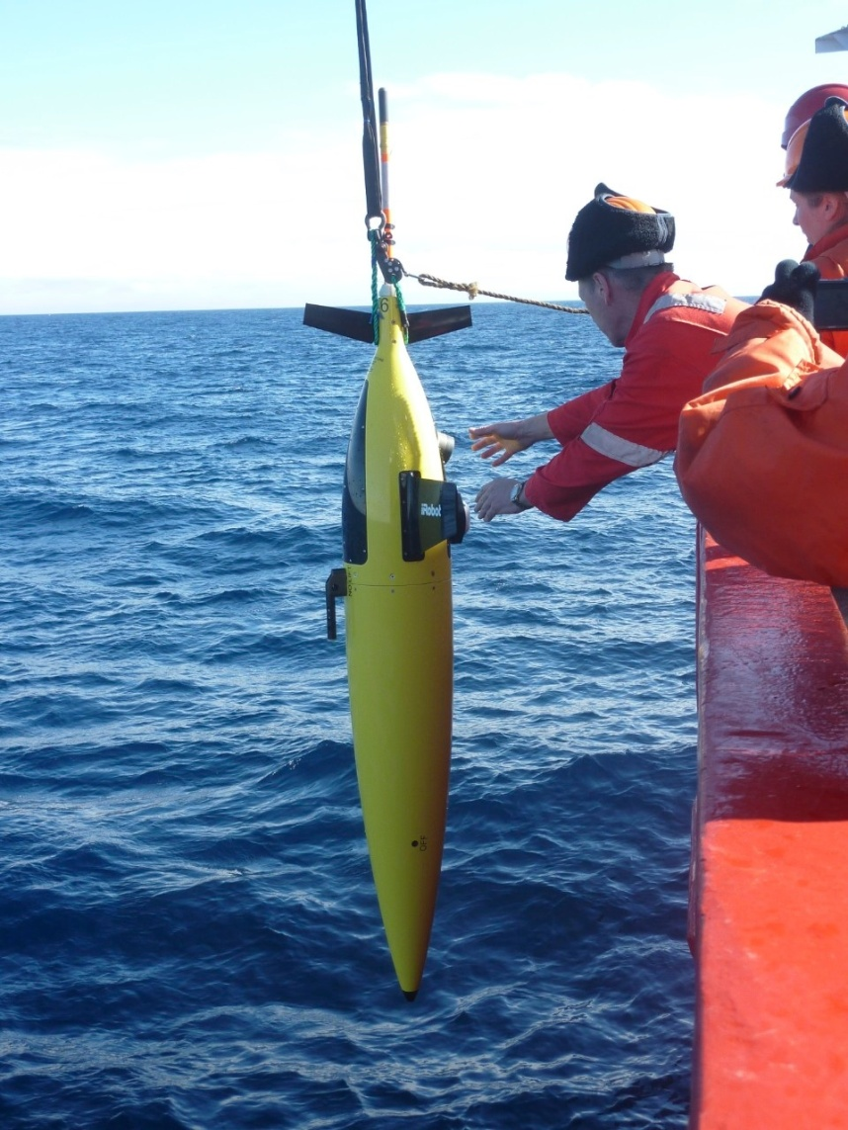
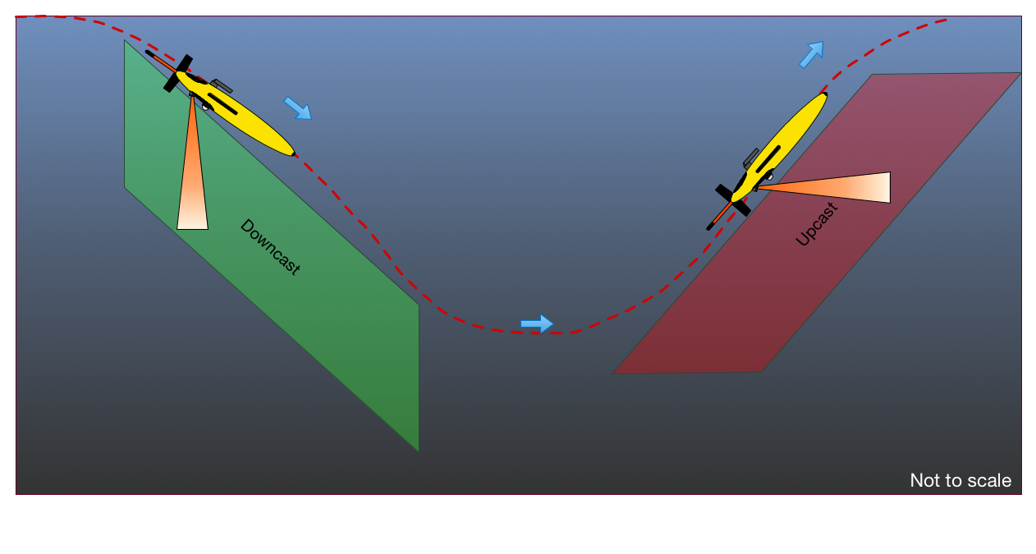
New sensors on a Seaglider for krill dynamics
Imagenex echo sounder – for acoustic backscatter signal strength
120 kHz single beam echo sounder
Known acoustic characteristics
0.5 m bins, with range to 100 m
echo
sounder

Slide 9
Osmosis gliders
617 dives
Oxygen sensor
656 dives
430 (590) dives
655 dives
804 dives
Cond. sensor
519 dives

Slide 10
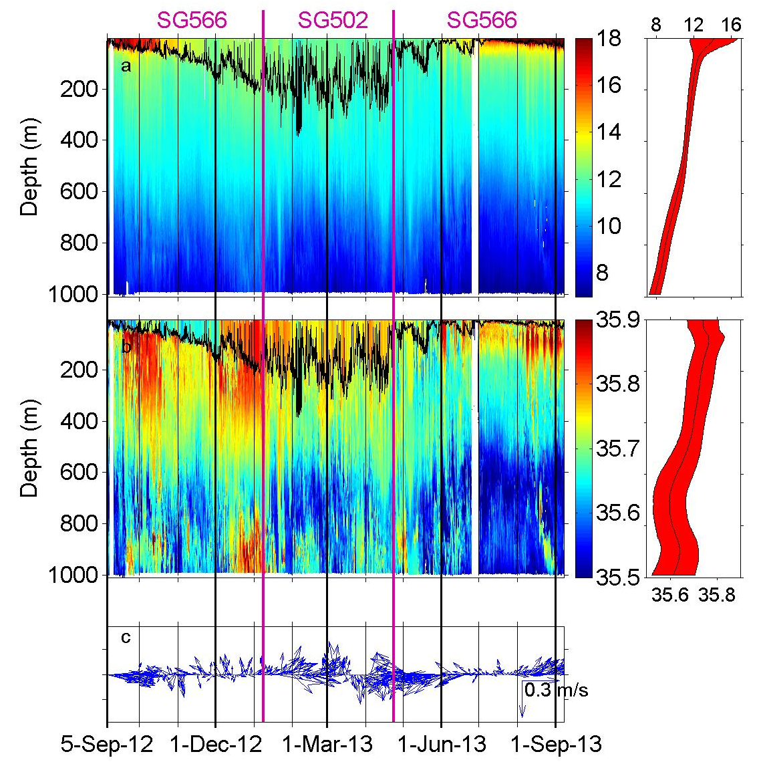
Seaglider study of deepening and shoaling of mixed layer
Two gliders at the Porcupine Abyssal Plain time series site
Seasonal cycle in processes over one year
Multidisciplinary

Slide 11
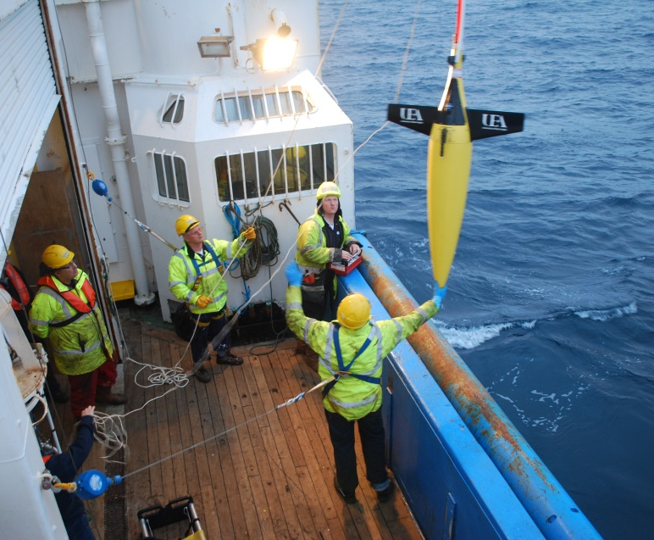
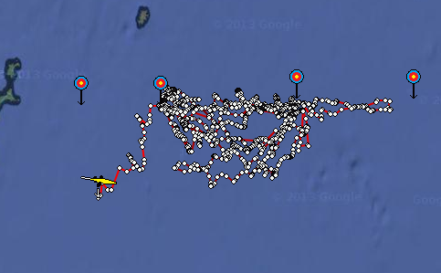
Brahan Project with Marine Scotland Science
October – December 2013
Water depth ~ 100 m
Tidal currents > 50 cm/s
>2500 dives
Deployment
Recovery

Slide 12
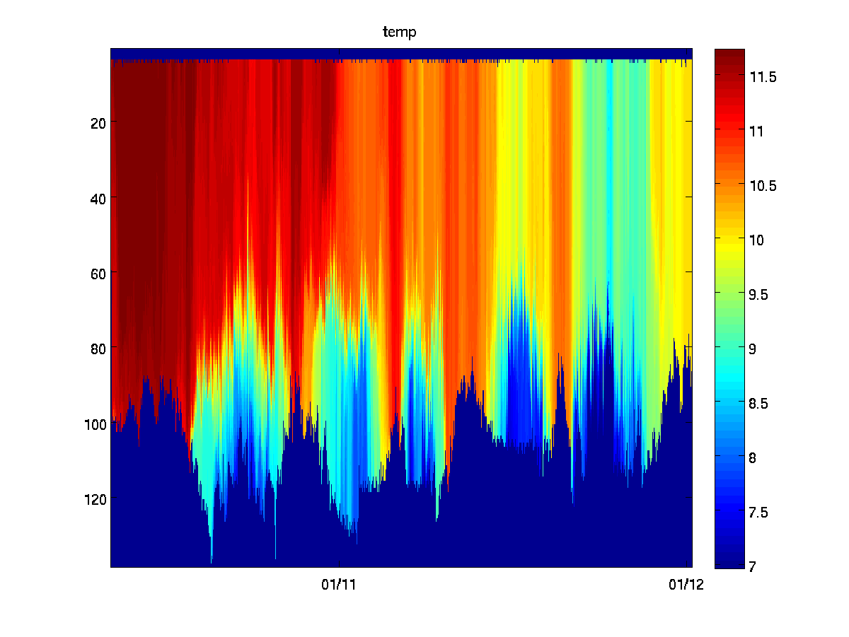
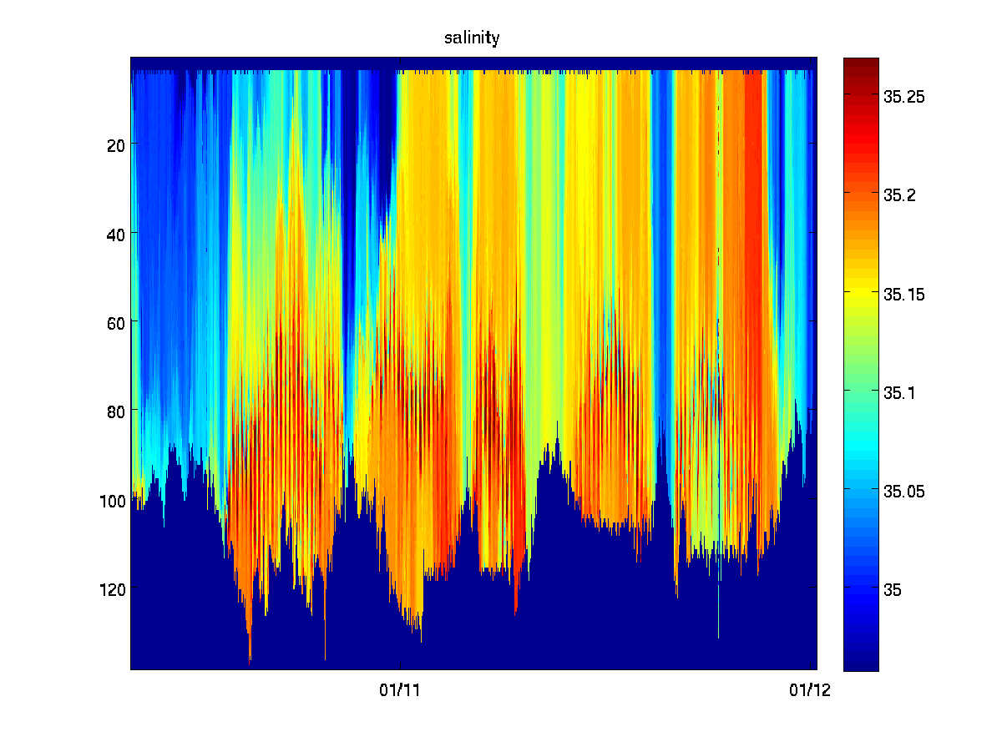
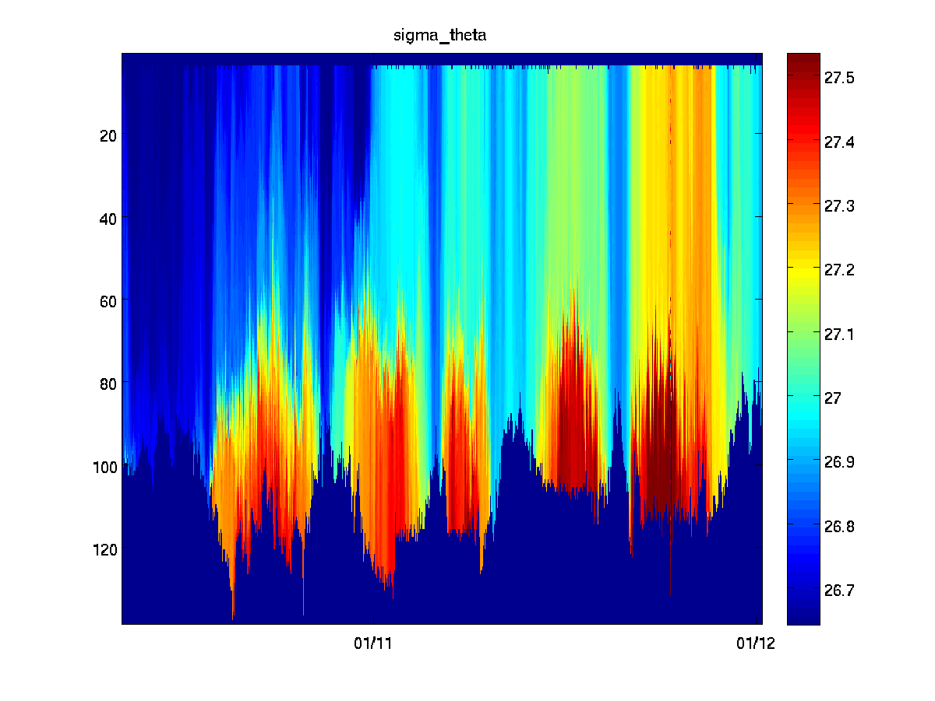
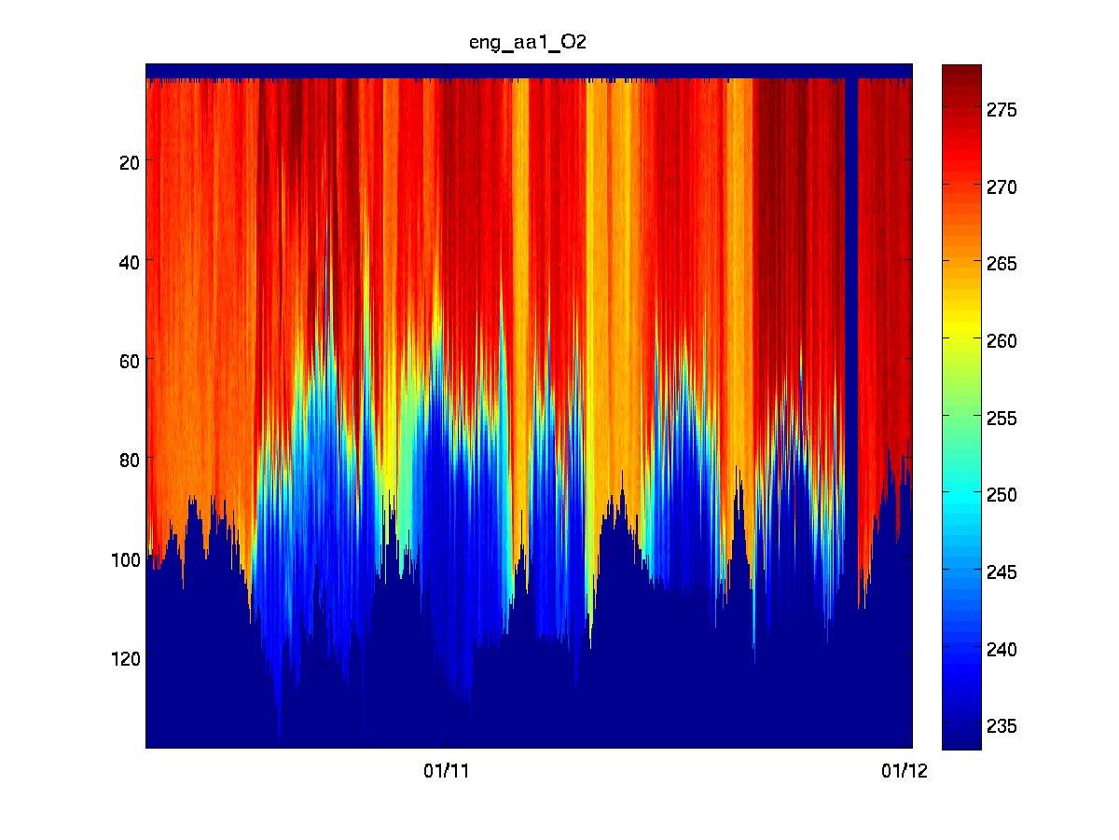
Brahan Project with Marine Scotland Science
Temperature
Salinity
Potential Density
Oxygen Conc.
Deployment
Recovery

Slide 13
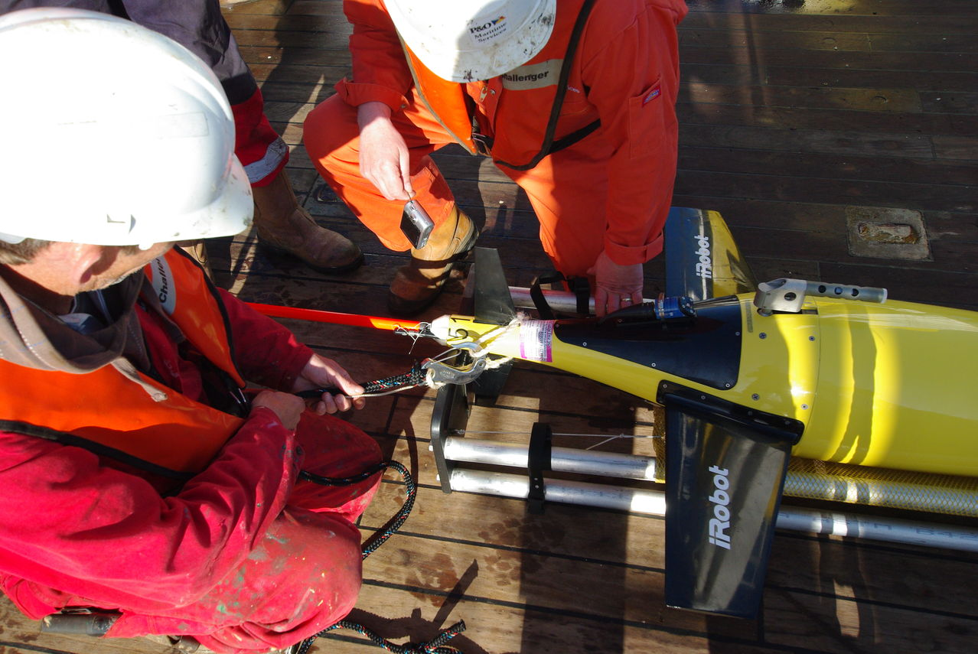
Seaglider infrastructure
UEA now equipped to undertake refurbishments of Seagliders, including
testing of any faults/problems
battery replacement
replacement of all screws and sacrificial anodes
greasing of all gearings
formatting of flashcard
deep clean
compass check and possible calibration
reballasting for required ocean water density
Recalibration of sensors between deployments by manufacturers
Iridium transmissions using RUDIX

Slide 14
Data processing and calibration
Real-time data are available straight away by ftp
Delayed mode data are calibrated and cleaned up
Flight model regressions to optimise data quality and calculate dive-average currents
Flags for good/bad/modified data
Thermal lag corrections for conductivity cell
Lag corrections for dissolved oxygen optode
Compare with CTD data for absolute calibrations
Calibrate dissolved oxygen, chlorophyll against samples
Vertical and horizontal gridding

Slide 15
New Sensors for Gliders
New passive acoustic monitoring (PAM) sensor being integrated into Seaglider by Kongsberg
For marine mammal detection and monitoring of anthropogenic noise (2-50 Hz)
New pH and pCO2 sensors being integrated into Seaglider at UEA
For ocean acidification and marine carbon cycling
We are undertaking trials of both sensors in Mediterranean in June 2014 in conjunction with CMRE on RV Alliance
In future: microstructure sensors for turbulent mixing, ADCPs

Slide 16
The Way Forward?
Ocean gliders can measure physics, chemistry and biology of the ocean simultaneously
Offer the opportunity to measure in remote areas and during rough weather, including near-surface values
Complement existing technologies such as moorings and HF radar
Real time data
Deployment from small boats or ships of opportunity

