Slide 1

Future Possible Use Fixed Platforms

Slide 2
Fixed platform
Buoys, platforms, coastal stn, stand alone
Caged instruments beneath buoy
In line instruments with surface floats and seabed anchor
U-shaped mooring
Tethered line
Spar buoy, Doughnuts, others
‘Virtual’ moorings

Slide 3
ECOSYSTEM BASED MANAGMENT
Pikich et al., 2004 Science
to “sustain healthy marine ecosystems and the fisheries they support “
Avoid degradation of ecosystems as measured by indicators of environmental quality and system status;
Minimize risk of irreversible change to communities and ecosystem processes;
Maintain long-term socioeconomic benefits without compromising the ecosystem;
Generate knowledge of ecosystem processes sufficient to understand the likely consequences of human action.

Slide 4
Core Variables - Biological
 |  | Weather & climate | Marine operations | Natural hazards | National security | Public health | Healthy ecosystems |  |  |  | Sustained resources
 |  |  |  |  |  |  | Clean & safe | Healthy & biologically diverse | Productive | Ocean processes
Biological | Chlorophyll |  |  |  |  |  | ✓ | ✓
 | Pathogens |  |  |  | ✓ | ✓ |  | ✓ |  |  | ✓
 | Phytoplankton species | ✓ | ✓ |  | ✓ | ✓ | ✓ (Indicator spp.) | ✓ |  |  | ✓
 | Zooplankton abundance |  |  |  |  |  |  | ✓ |  |  | ✓
 | Zooplankton species |  |  |  |  | ✓ |  | ✓ |  |  | ✓
 | Shellfish toxins? |  |  |  |  | ✓ | ✓ |  |  |  | ✓
 | Incidence of fish kills |  |  |  |  |  | ✓ (fish kills) | ✓ | ✓ |  | ✓
 | Fish species |  |  |  |  |  |  | ✓ | ✓ |  | ✓

Slide 5
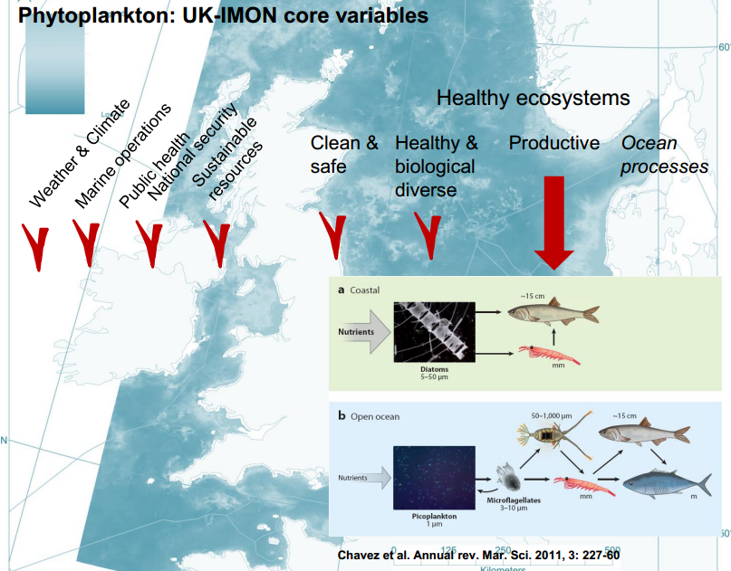
V. Creache

Slide 6
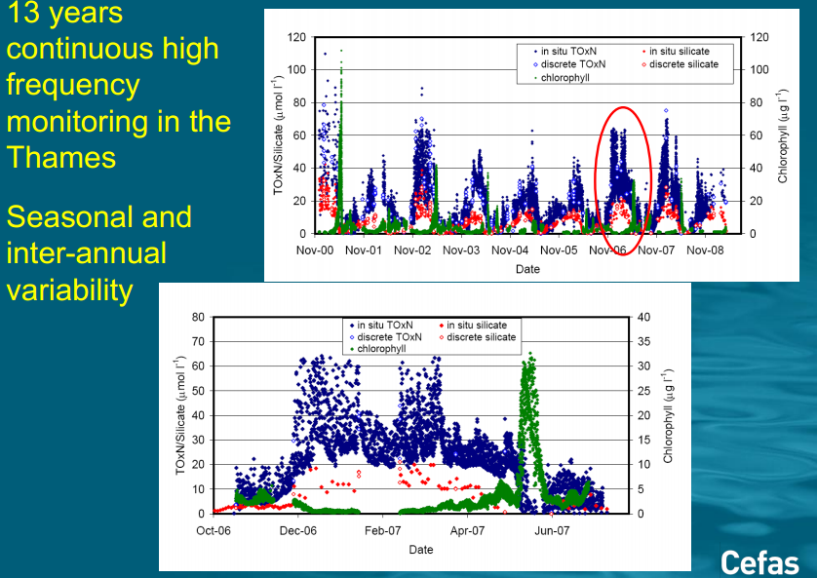
Biogeochemistry

Slide 7
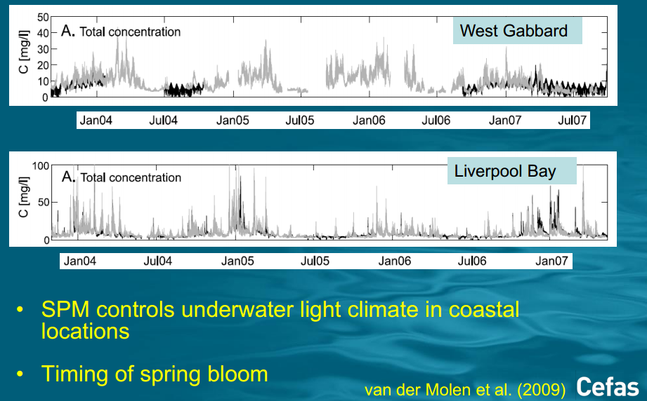
Optical properties

Slide 8
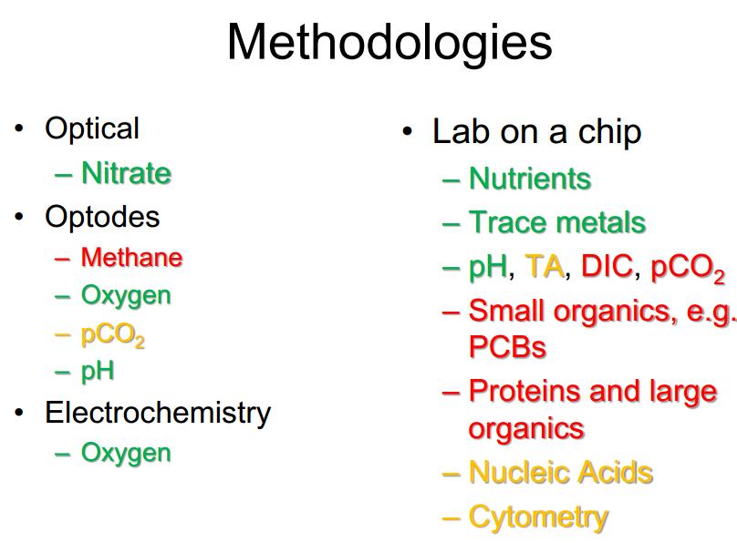
Sensor methodologies
M. Mowlan

Slide 9
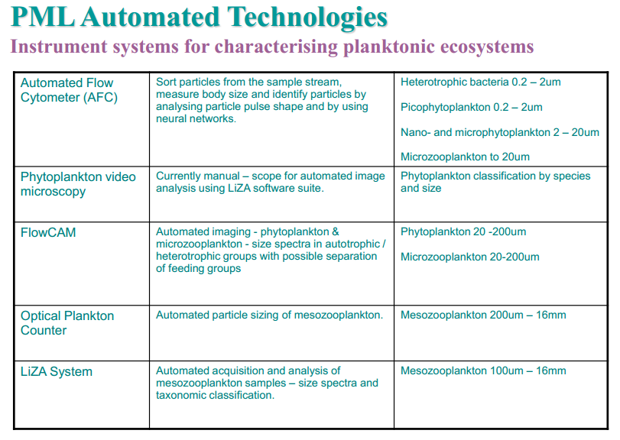

Slide 10
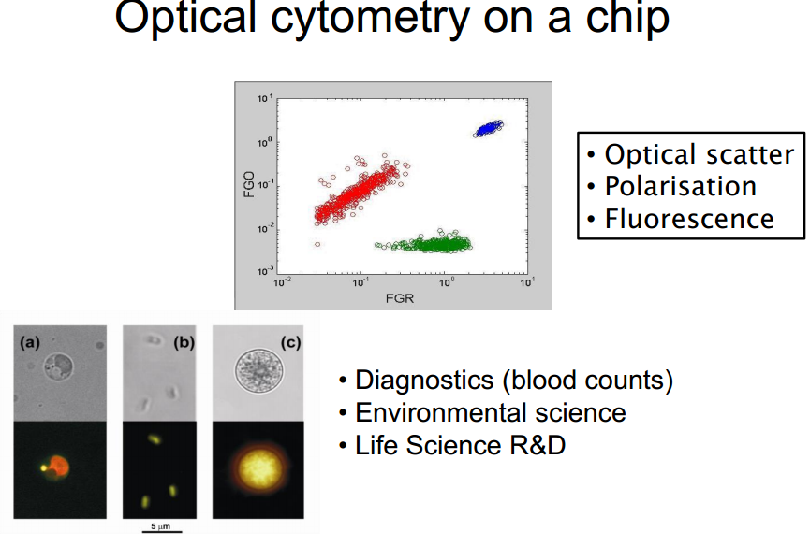
Lab on a Chip (loc)
M. Mowlan

Slide 11
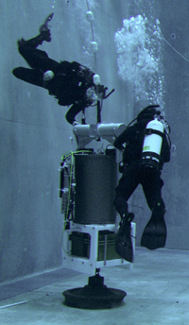
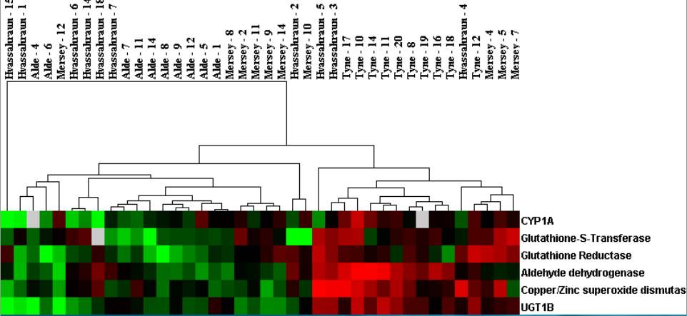
Molecular biological techniques (sequencing and probe based)
Recommendation
Transition molecular biological techniques (sequencing and probe based) from research tools to an operational capability for monitoring microbial diversity, contaminant impact and non indigenous species.
MBARI Environmental Sample Processor
Genes relating to PAH exposure
DNA probe arrays and analysis
Tim Bean Cefas

Slide 12
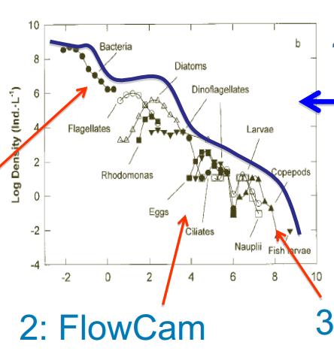
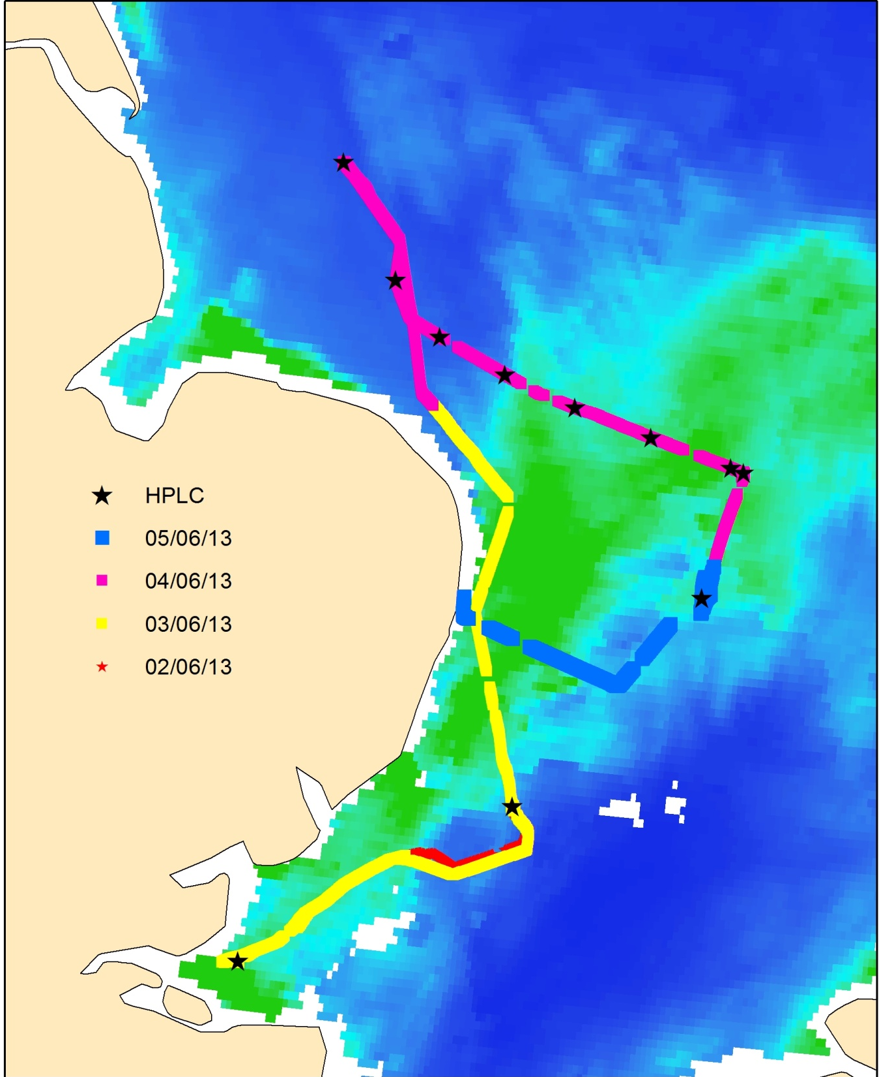
Optical Imaging
Recommendation
Plankton Life Forms
UK East Coast Central North Sea Outer Thames
Multi-optical approach for plankton abundance, distribution and composition from > 1µm - > 1mm
Flowcytometer
Flowcam
Zooscan
RV underway sampling track
L. Stemmann, et al.,OOV CNRS-UPMC (Janvier 2013)

Slide 13
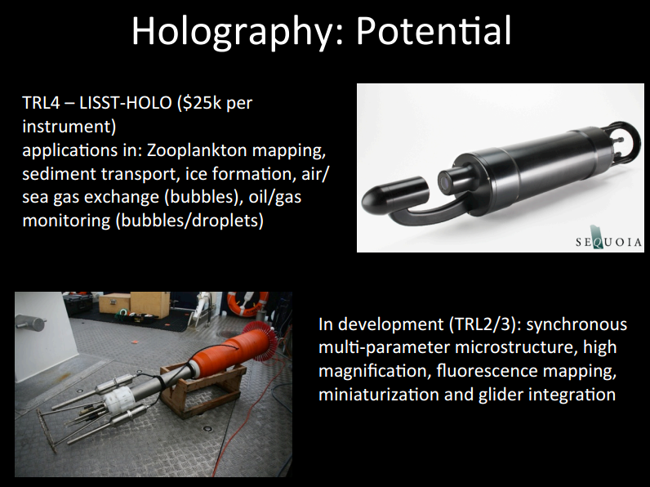
HOLOGRAPHY

Slide 14
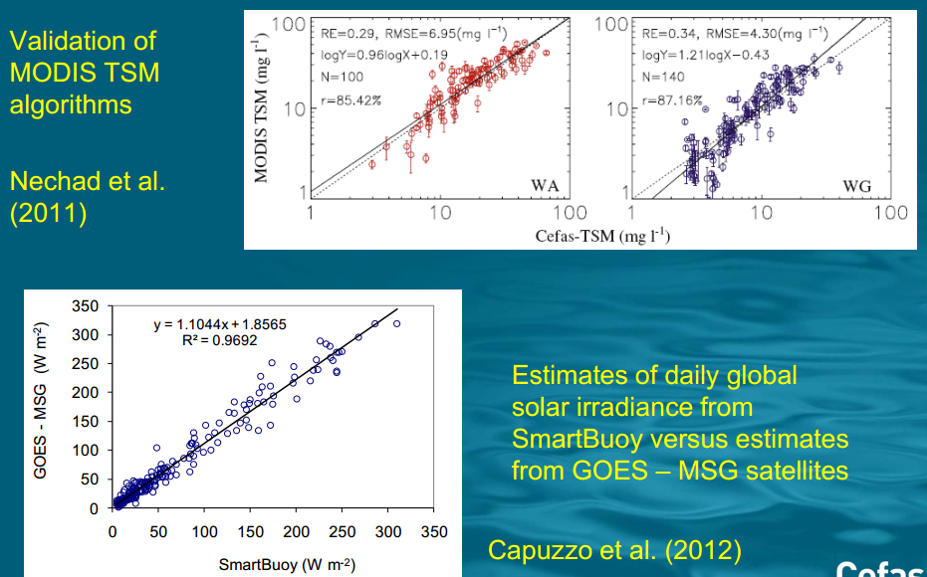
seatruth

Slide 15
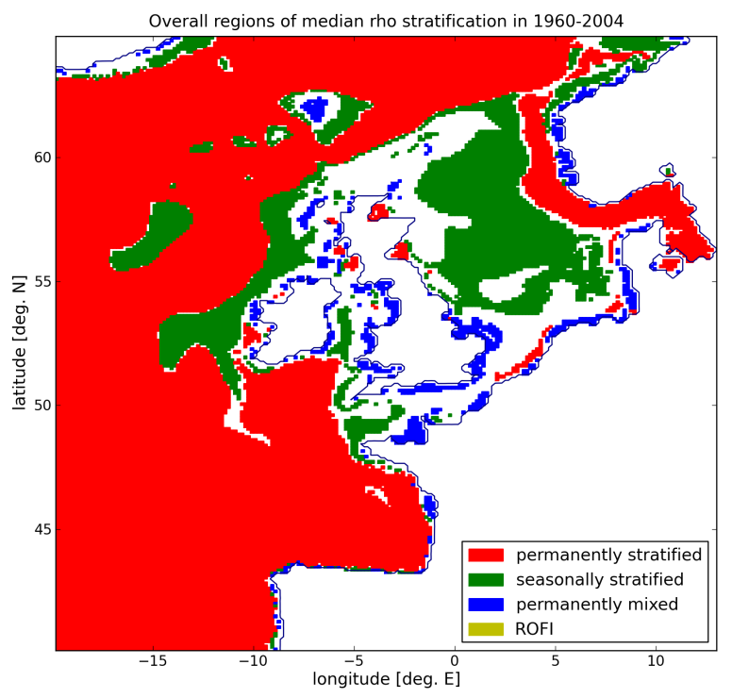
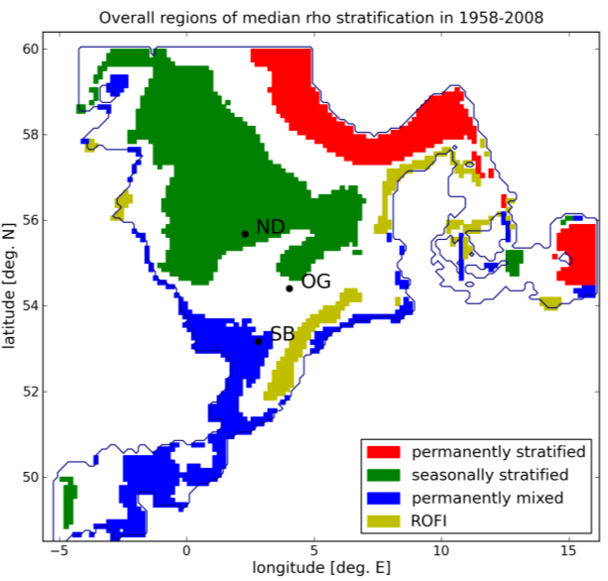
Eco-hydrodynamic regions

Slide 16
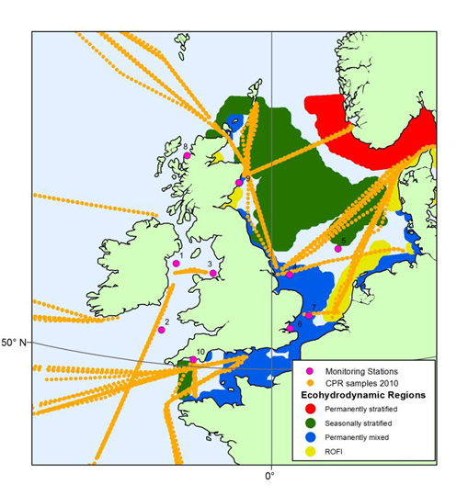
Plankton ‘lifeform’ monitoring

Slide 17
Moorings and other fixed point observations
Disadvantages
Advantages
Biofouling limits deployment
Vulnerable to shipping
Can’t locate anywhere
Can’t do everything
Require vessels with appropriate capability
Profiles, fixed depth inst.
Difficult to distinguish between vertical and horizontal transport
Cost
Resolve episodic events
Operate in severe weather
Can represent wider areas
High-frequency time series
Real-time data return
Contextual information
Cost

Slide 18
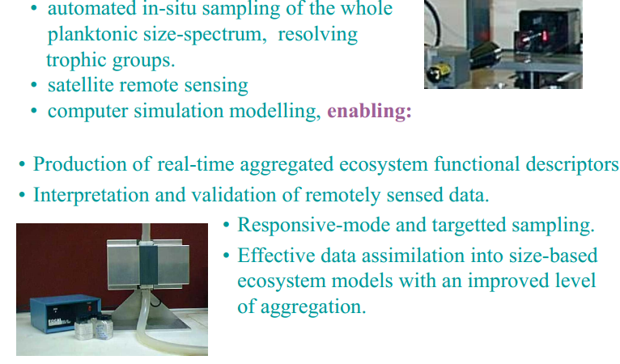
Resolving the biology

Slide 19
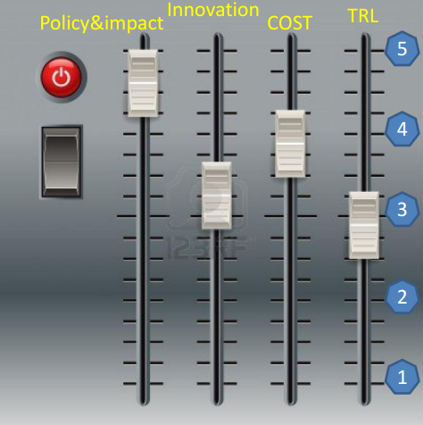
Future perspective & Challenges
(Jean-François Rolin, Ifremer)

Slide 20
Thanks for listening..

