Slide 1
Second MonGOOS meeting
The JERICO Consortium

Slide 2
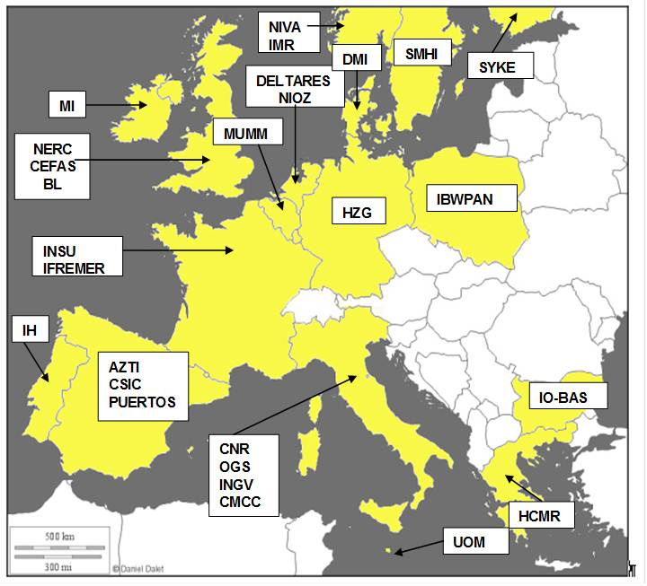
JOINT EUROPEAN RESEARCH INFRASTRUCTURE NETWORK FOR COASTAL OBSERVATORIES
Project acronym: | JERICO
Grant agreement no: | 262584
Funding Scheme: | FP7 CAPACITIES – Reasearch Infrastructures - INFRA-2010-1.1.6
EU financial contribution: | € 6.5 million
Duration: | 48 months
Start date: | 1 May 2011
Completion date: | 30 April 2015
Coordinator: | Patrick Farcy, patrick.farcy@ifremer.fr
Project webpage: | http://www.jerico-fp7.eu
Partners:
www.jerico-fp7.eu

Slide 3
Coastal Observatories - Challenges
Complexity and high variability of coastal areas at Pan-european level
  New requirements arising from WFD and MSFD
  Operational marine services (GMES)
In the last decades marine observing systems have been implemented in coastal and shelf seas around Europe
  They mostly answer local/regional monitoring and oceanographic research demands
Heterogeneity and geographical dispersion
Often driven through short-term research projects. Sustainability is an issue
Need to Increase the consistency and the sustainability of these infrastructures by addressing their future within a shared pan-European framework.
www.jerico-fp7.eu

Slide 4
THE JERICO VISION
To make a significant contribution to the harmonisation of existing European coastal observatories and to prepare for the future European Network of Operational Coastal Observatories (OCO).
www.jerico-fp7.eu

Slide 5
JERICO Objectives
To set up a European Research Infrastructure for coastal observations based on existing systems in European coastal and shelf seas
To support standardization of operations and activities for the benefit of data quality and availability.
  Harmonizing technological aspects: assure compatibility and promote interoperability wherever possible
  Harmonizing operation and maintenance methods: sensor calibration, antifouling measures, quality control, maintenance and costs
  Definition of a JERICO label (brand, standard)
To promote the cost-effective use of the facilities
To stimulate the development of new automated systems for the operational monitoring of the coastal marine environment, with the focus on the biochemical compartment. (JRA + Forum for Coastal Technology)

Slide 6
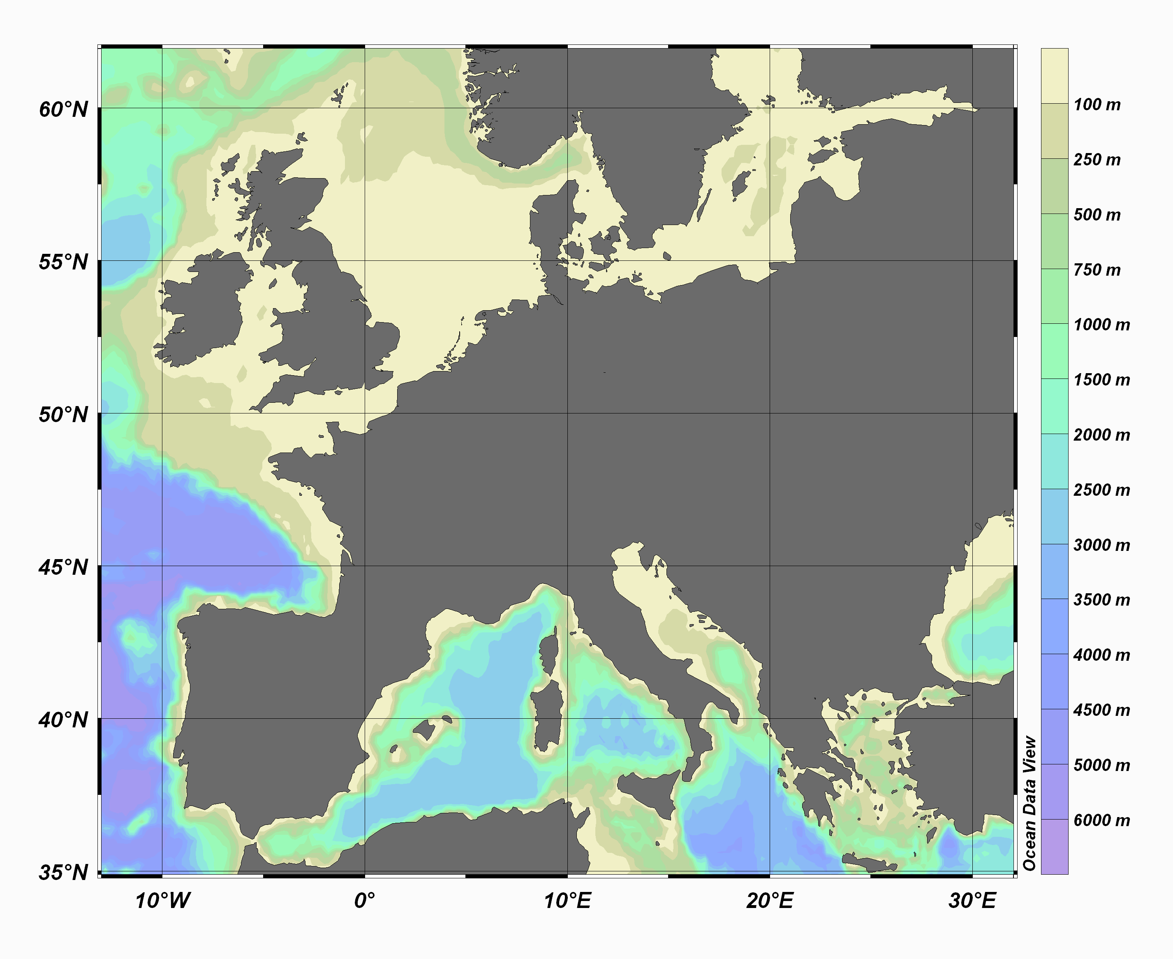
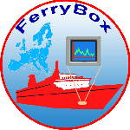
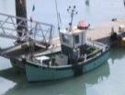

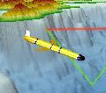

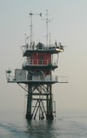

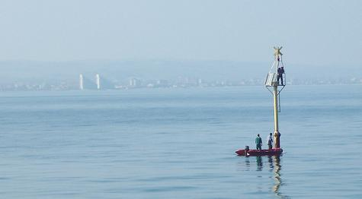
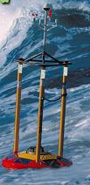
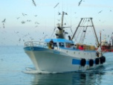
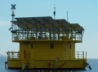
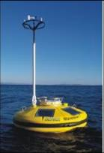

The JERICO infrastructures
Fixed platforms
Ferrybox
Fishing vessels
Gliders

Slide 7
Where does JERICO fits?
Marine Core Services (DG ENT / GMES)
Oceanic modelling
Coastal modelling
Coastal and shelf seas continuous in situ measurements
GMES-MYOCEAN
National/regional activities/projects
JERICO (I3)
Rivers discharges
EURO ARGO (ESFRI)
Fisheries data
EUROFLEETS (I3)
Social/commercial activities
EMSO (ESFRI)
MY OCEAN
GROOM
Marine data thematic centers
SEADATANET (I3) standards and web portal
WISE-Marine (DG ENV)
EMODNET (DG MARE)

Slide 8
How is the project structured?
Scientific Advisory Committee
General Assembly
Forum
for Coastal Technology
Steering Committee
JERICO Coordinator
Project Management Team (WP11)
Networking Activity
Transnational Access Activity
Joint Research Activity
NA (WP1 to WP6)
JERICO
Cost efficient long term coordination of European coastal observatories
TNA (WP7 to WP8)
JRA (WP9 to WP10)
Advanced management of costs, resources, planning , knowledge, communications, quality indicators.

Slide 9
  To stimulate the development of new automated systems for the operational monitoring of the coastal marine environment (focus on the biochemical compartment)
  (RTD = JRA)
FCT (SMEs)
WP10:
New technologies
WP1:
A common
Strategy
EuroGOOS
ROOSs
WP9:
Assess the impact
of Coastal obs.
systems
WP2:
Strengthening
Regional and
trans-regional
activities
Ships of opportunity
N.A.
JERICO
Gaps
  To promote harmonisation and coordination by “Best practices”, including calibration and bio-fouling, share and promote them through workshops, Oceanboard website and summer schools.
  (Coordination Actions = NA)
TNA
SA
WP3:
Harmonizing
Technological
Aspects
WP8: TNA
Fixed Platforms
JRA
Gliders
Best
practices
WP4: Operation
& Maintenance
Harmonization
  To promote the cost-effective use of the facilities, providing access to external users (experiments and testing, access to data and services)
  (Support Actions = TNA and SA)
WP7: Service
& Data Access
WP5: Data
Manag. rules
WP6: Outreach
and web portal
Data
quality
Data
Data distrib.
MyOcean 2
SeaDataNet II
Users communities

Slide 10
Coordination Actions (NA)
WP1 : A common strategy, including definition and implementation aspects
Define the rules for a better coordination at European level
Launching a European strategic view on OCO
Creating a JERICO label
Promote open access to JERICO network (TNA)
Provide cross-regional integration and demonstration (TOP)
Coordinating networking actions for optimal integration of knowledge and for reaching consensus (best practices)
Suggest a Roadmap for a deployment strategy
Organizing a Forum for Coastal Technology

Slide 11
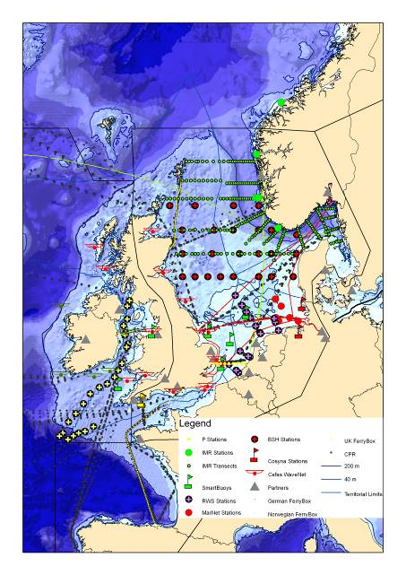

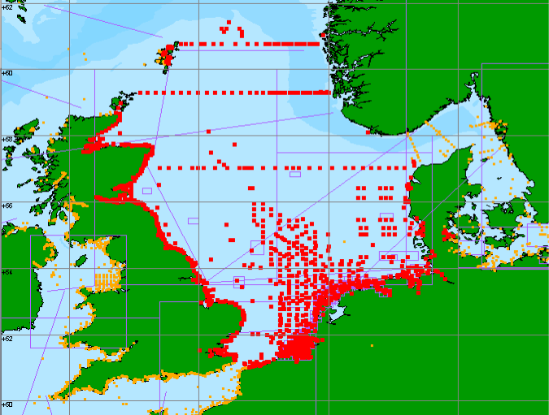
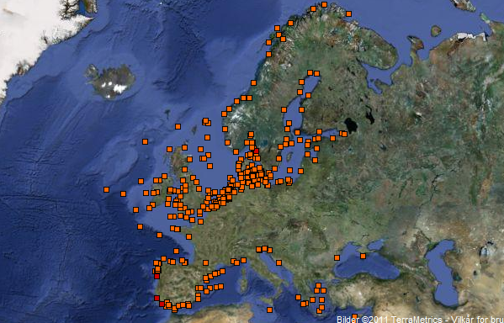
Coordination Actions (NA)
WP2 : Strengthening regional aspects
  EuroGOOS ROOSs aspects and inter regional interfaces
programmes and projects collecting in situ data
(focus on) biochemical parameters
identification of Gaps
data accessibility
administrative and legal barriers
Make an inventory of existing
Coastal observing systems
Seprise
EDIOS

Slide 12
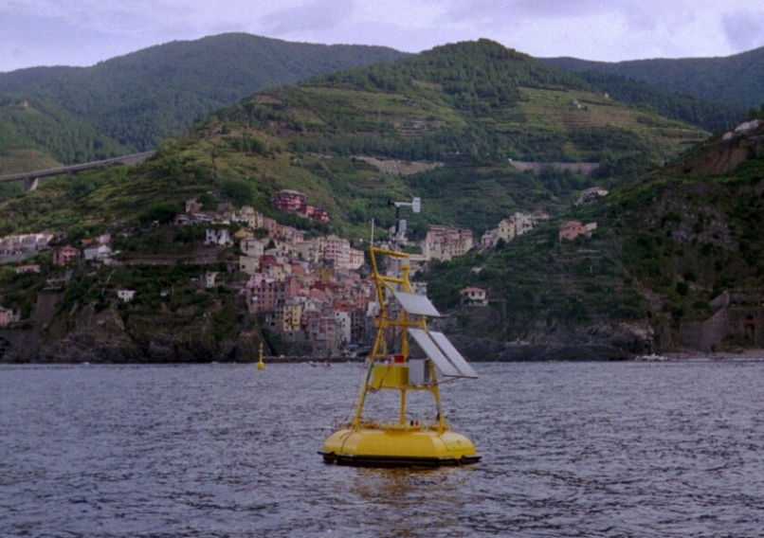
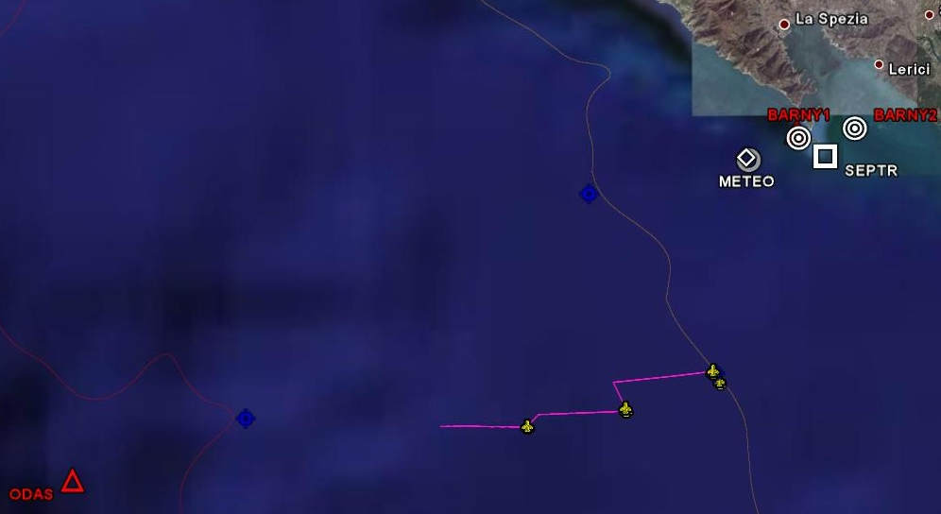
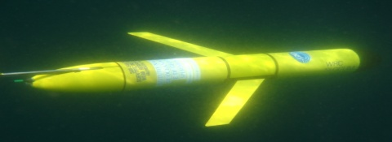
Coordination Actions (NA)
WP3 & WP4: Harmonizing technological aspects and operations (fouling, calibration, quality control, maintenance and costs)
Based on the experience of infrastructure
operators and relevant regional activities
WP3 will:
provide a common base for the operational use of gliders, ferryboxes, fixed platforms,
review the current status of existing operational systems,
define best technical practices and procedures for, harmonizing and merging data, integrating and testing new sensors.
WP4 will:
gather elements of best practice in conducting operations and maintaining coastal observatories,
identify the successes in terms of
systems autonomy and reliability,
propose common procedures to be
followed by all operators
Two COST proposals submitted
7 km
Start
6.3 km
End
7.25 km

Slide 13
Coordination Actions (NA)
WP5 : Data distribution (Seadatanet, MyOcean and EModNet)

Slide 14
Coordination Actions (NA)
WP6 : Public outreach and
education
Website: www.jerico-fp7.eu,
Summer schools
Ocean Board
JERICO data tool
Educational tools

Slide 15
Support Actions (SA)
WP7 : Service Access (SA) to the data
Provision of data coming from most of the JERICO partners
2 years of data access (from Jan 2013 to Dec 2014), compliance with SeaDataNet and MyOcean standards and requirements
+ 1 year of data from 3 Targeted Operation Phases (from Jan 2014 to Dec 2015)
  TOP 1: Processing Value added products
  TOP 2: Integrating data from fishing fleets into regional observing systems portals
  TOP 3: Combined buoys and ferry box data

Slide 16
Support Actions (TNA)
WP8 : Trans National Access (TNA) to Coastal Observatories
OBJECTIVE To enable Transnational and free-of-charge access to original coastal infrastructures among those operated by the JERICO Consortium
ACTIVITIES
    Three call openings (Jan 12, Jan 13, Sept 13)
    Selection of proposals by a Selection Panel composed of international experts in the field
    Implementation of projects by user groups supported by a local team
    Reporting of information and results of the access activity on the TNA Web page http://www.jerico-fp7.eu/content/trans-national-access
MAIN RULES AND PRIORITIES
  The user group leader and the majority of the group must work in a Member State or Associated State other than the country of the facility operator
  Priority should be given to user groups composed of users who:
    have not previously used the infrastructure
    are working in countries where no such research infrastructures exists

Slide 17
RTD Actions (JRA)
WP9 : New Methods to Assess the Impact of Coastal Observing Systems
OBJECTIVE
Evaluate the impact of major existing observational data sets on three-dimensional dynamical state estimates by integrating existing observations in high resolution coastal models (OSEs).
Evaluate the impact of new observing platforms on three-dimensional dynamical state estimates by integrating simulated observations in high resolution coastal models (OSSEs).
Study areas: Baltic, North Sea, Bay of Biscay, Adriatic and Aegean Sea.

Slide 18
RTD Actions (JRA)
WP10 : Improved Existing and Emerging Technologies
10.1
10.2
10.3
10.4
10.5
10.6
Biological compartments
Contaminants
Profiling technology
VOS
Ferrybox QA
In situ video
PAH
Adriatic
SOOP
Workshop
Algorithim development
Sediment profile imagery
Algal pigments
Ligurian
FV
Recopesca
SPM inter
comparison
In situ fixed camera
CO2
Atlantic
RS, Buoy, Lander concurrent measurements
FlowCam
Zooscan
Notes:
Polycyclic aromatic hydrocarbons
Volunteer Observing Ships

Slide 19
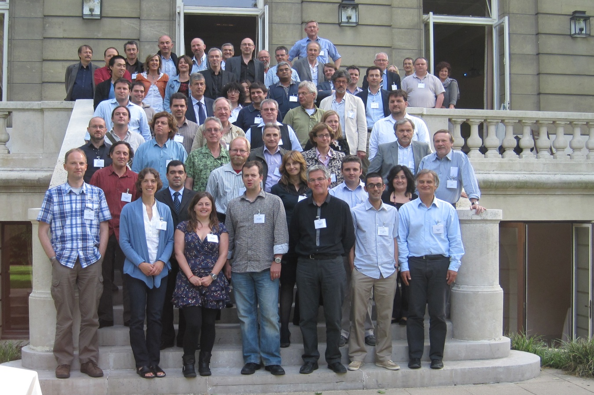
The jerico consortium

